Slide 1
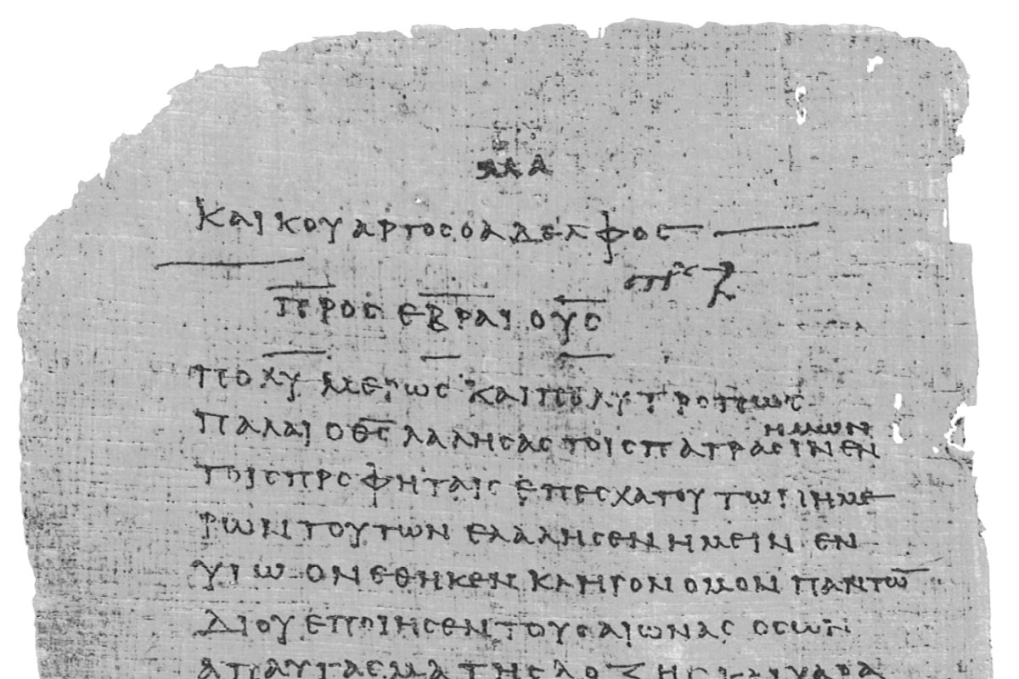
Pharisee Paul’s ἀπολογία to the Hebrews
Ἑβραῖος
Session-3
Hebrews 1:10-14
and 2:1-3a
Paul cites:
Psalms 102, 110
Isaiah 34
Dr. Dave Newton
© 2025
Figure It Out
Calvary Chapel
Santa Barbara

Slide 2
Pharisee Paul’s ἀπολογία to the Hebrews
Ἑβραῖος “hay-brai-os”
Last Week / Session-2
Paul’s case that Jesus is Superior to aggelos [more than a dispatched messenger]
Notes and Video at NewtonFIO.com

Slide 3
Amazing Presentation of Jesus in Hebrew Scriptures
Acts includes 15 teachings by 4 different men on this very same topic
AND these always result in significant responses from listeners
Chap-2 Peter in Jerusalem at Pentecost to Jews
Chap-3 Peter after he healed the lame man to Jews
Chap-4 Peter to the Sanhedrin to Jews
Chap-7 Stephen to the Sanhedrin to Jews
Chap-10 Peter to Cornelius [explains Jewish salvation for Gentiles too]
Chap-11 Peter to Jerusalem church to Jews
Chap-13 Paul at synagogue in Pisidian Antioch to Jews
Chap-15 Peter at Council of Jerusalem to Jews
James at Council of Jerusalem to Jews
Chap-17 Paul on Areopagus in Athens to Greeks re: Jewish God and Jesus
Chap-20 Paul at Miletus to Ephesus elders to Jews and Greeks
Chap-22 Paul gives his testimony in Jerusalem to Jews
Chap-23 Paul to Sanhedrin to Jews
Chap-24 Paul to Felix and his wife Drusilla
Chap-26 Paul to King Agrippa, his wife Bernice, and to Festus

Slide 4
Paul’s Bibliography
2 Samuel 7:12-14 Heb 1:5a
Psalm 2:7 Heb 1:5b
Psalm 104:4 Heb 1:7
Psalm 45:6-7 Heb 1:8-9
Psalm 102:25-27 Heb 1:10-12
Isaiah 34:4-12 Heb 1:12
Psalm 110:1 Heb 1:13
Psalm 8:4-6 Heb 2:5-10
Psalm 22:22 Heb 2:12
Isaiah 8:17 Heb 2:13
Isaiah 8:18 Heb 2:13
Psalm 95:7-11 Heb 3:7-11
Psalm 95:11 Heb. 4:3
Genesis 2:2 Heb 4:4
Psalm 2:7 Heb 5:6
Psalm 110:4 Heb 5:6
Deut. 32:43 Heb 6:1
Gen 22:16-17 Heb 6:14
Psalm 110:4 Heb 7:17
Psalm 110:4 Heb 7:21
Exodus 25:40 Heb 8:5
Jeremiah 31:31-34 Heb 8:7-13, 10:15-18
Exodus 24:8 Heb 9:20
Psalm 40:6-8 Heb 10:5-10
Deut. 32:35 Heb 10:30
Deut. 32:36 Heb 10:30
Habakkuk 2:3-4 Heb 10:37-38
Gen 21:12 Heb 11:18
Prov. 3:11-12 Heb 12:5-6
Deut. 9:19 Heb 12:21
Haggai 2:6 Heb 12:26
Deut. 31:6 Heb 13:5
Psalm 118:6 Heb 13:6

Slide 5
Pharisee Paul’s ἀπολογία to the Hebrews
5 Warning to Believers
2:1-5 tonight Warning-1: Don't Drift Away
3:7 thru 4:13 Warning-2: Open Disobedience/Unbelief
6:4-8 Warning-3: Time to Grow up/Be Mature
10:26-39 Warning-4: Volitional/Deliberate/Willful Sin 12:25-29 Warning-5: Indifference/Casual Ambivalence
and over 20 times, Paul includes himself [“we”] in these warnings!

Slide 6
Pharisee Paul’s ἀπολογία to the Hebrews Ἑβραῖος
Hebrews 1:10-14 thru 2:3a
Citing Psalm 102:25-27
v10-12 “YOU, LORD, IN THE BEGINNING LAID THE FOUNDATION OF THE EARTH
AND THE HEAVENS ARE THE WORKS OF YOUR HANDS
THEY WILL PERISH . . . . BUT YOU REMAIN [You are Eternal]
THEY ALL WILL BECOME OLD LIKE A GARMENT AND LIKE A
MANTLE [SCROLL] YOU WILL ROLL THEM UP
LIKE A GARMENT THEY WILL ALSO BE BECOME THREADBARE,
BUT YOU ARE THE SAME AND YOUR YEARS WILL NOT COME TO AN END”
Of old You were the founder of the Earth and the heavens are the works of Your hands!
They will perish but You endure. All of them will wear out like a garment,
You will change them like one changes clothing, but You Are the same
Your years will not come to an end.

Slide 7
Pharisee Paul’s ἀπολογία to the Hebrews
From 1:10-12 Pharisee Paul stands firm on the Hebrew Scriptures:
that Jesus existed prior to the “foundations” of the Earth ‘mosada’
Psalm 18:7 82:5 104:5 Proverbs 8:29 Isaiah 24:18 40:21 51:13
Jer. 31:37 Micah 6:2 Job 8:4
Go back to Genesis 1: heavens above and the Earth below The first things created!
Earth “became” [transitive verb] formless and void
Isaiah 45:18 God did not create Earth to be formless/empty
Then comes light, and separation of lights in ‘heavens’
Earth created Day-1 before sun and moon!! Sun and stars on Day-4
EARTH has always been foundational central to God’s plan for mankind
Jesus is BEFORE even the mosada for this Earth was created

Slide 8
Pharisee Paul’s ἀπολογία to the Hebrews
AND when you look up in the night sky to ponder the οὐρανός [ouranos]
the second heaven
ALL that you see was created by Jesus!
One day these ouranos will perish [2nd Peter 3:10 elements melt with intense heat]
v12- will wear out [2nd Law Thermodynamics, entropy, winding-down “heat death”]
when old clothes wear out, you put on new clothes!!
Paul cites Isaiah 34:4-12 heavens will wear away - the skies rolled up like a scroll
as the hosts whither away like Rev. 6:14 universe rolled up like a scroll
Replaced with: NEW ouranos and NEW Earth [Revelation 21]
Mankind not intended to dwell in God’s HEAVENLY realm of His majesty
EARTH and NEW Earth created – and specifically designated for Mankind
God will then “Tabernacle” among His own people
Foreshadowed in Jesus - then Millennium - NEW Earth/New Jerusalem

Slide 9
Pharisee Paul’s ἀπολογία to the Hebrews Ἑβραῖος
Paul cites Psalm 110:1 quoted 10 times in Hebrews - 25 times in NT
v13 [Rhetorically] but to which of the angels has He ever said, “SIT AT MY RIGHT HAND UNTIL I MAKE YOUR ENEMIES A FOOTSTOOL FOR YOUR FEET?” [he knows answer . . . NONE]
When does this occur? NOT at Jesus’ First Coming.
At 2nd Coming Jesus will have conquered ALL His enemies
and He will begin to reign forever in His Millennial Kingdom
“Kingdom” like 2 bookends at start and end of Paul’s letter
Hebrews 1:8 His throne is forever and ever
His righteous scepter of His Kingdom
Hebrews 12:28 since WE will inherit a Kingdom that cannot be shaken
then show God acceptable service with
complete reverence and awe

Slide 10
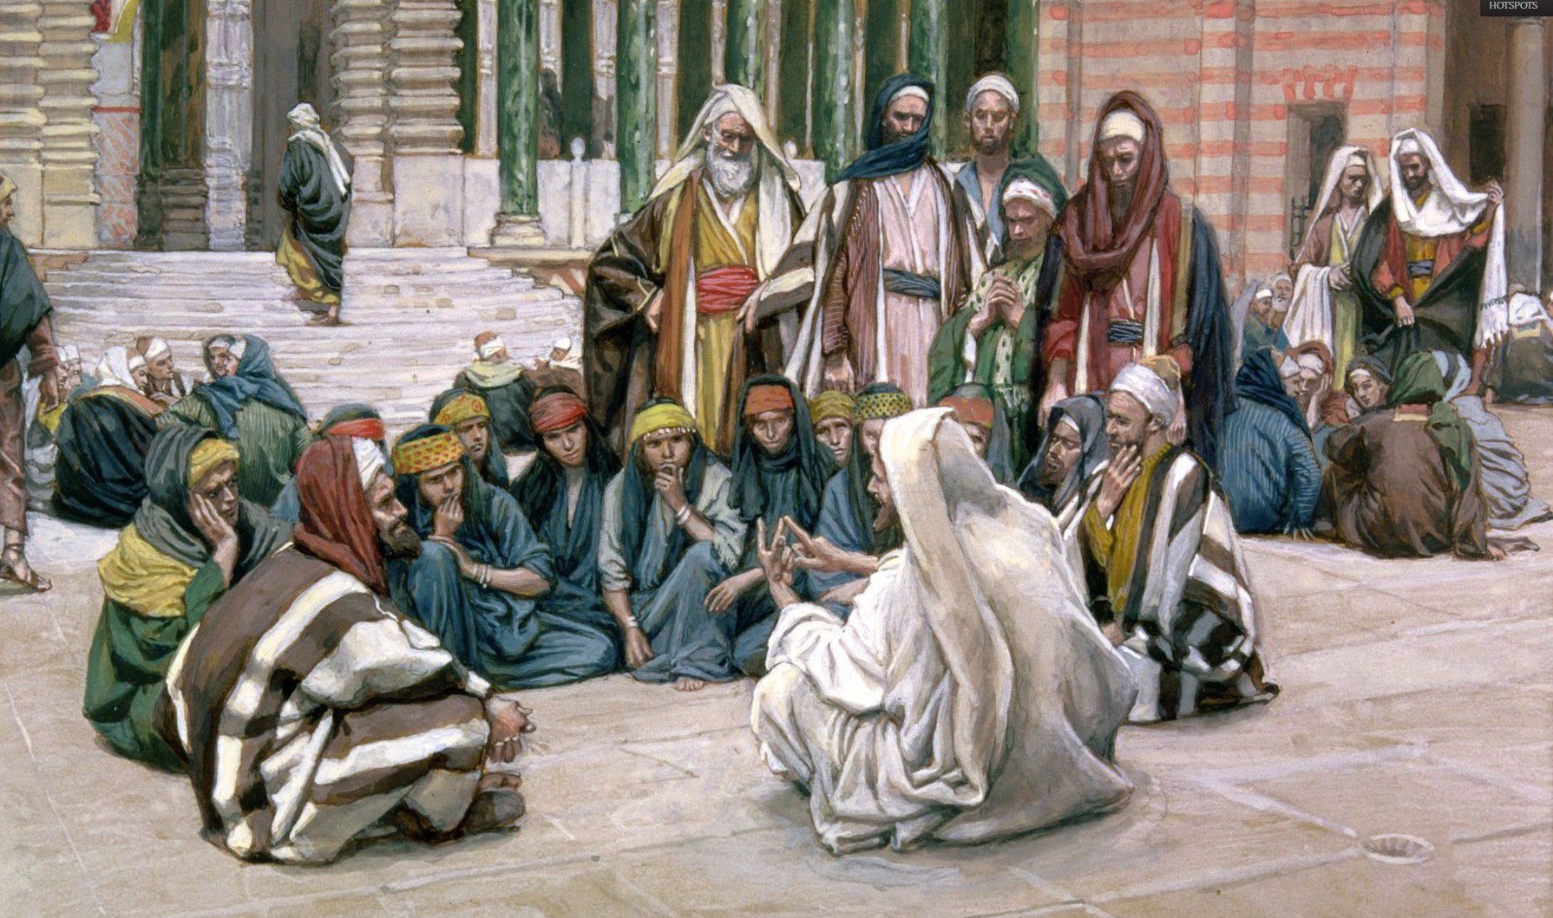
Pharisee Paul’s ἀπολογία to the Hebrews Ἑβραῖος
Matt. 22:41-46 Jesus asked Pharisees a Q? What do you think about the Christ?
Whose son is He?” They said, “The son of David” [they know their Scriptures]
He replied, “Then how does David in the Spirit call Him ‘Lord,’ saying, ‘the Lord said
to my Lord, “Sit at my right hand until I put your enemies beneath your feet?“
If David then calls Him ‘my Lord,’ how is He David’s son?
Results: 1] NONE could answer
even one word on this
2] NONE from that day
on dared to ask Jesus
any more questions

Slide 11
Pharisee Paul’s ἀπολογία to the Hebrews Ἑβραῖος
Matt. 22:41-46 Lord said to my Lord YHWH said to David’s ‘my adoni’ [not Adonai]
Some theologians see conversation between 2 distinct Persons of the Eternal God
however, it is not Adonai which is a title for God - in the original language it is
adoni = same consonants, unique marker-pointing yot makes it ‘possessive’ master
That yot means “my master”
Reads: [R to L] אָדוֹן נְאֻם יְהֹוָה adoni neum Y-hova
Genesis 24:12 Abraham’s servant calls him adoni = my master, my lord
Psalm 110 the second “Lord” is also adoni = my master, my lord
So it reads: YHWH says to my adoni [remember it’s David speaking]
1] Eternal God Almighty of the universe . . . . says to
2] David’s master / Lord
In Matt. 22:44 Jesus clearly states He is David’s adoni
but also He is David’s son

Slide 12
Pharisee Paul’s ἀπολογία to the Hebrews Ἑβραῖος
Seems logical David writes/calls Mashiach my Lord / my Master
That’s why Jesus uses this Psalm to show that Mashiach is lord over David
Consider Matt. 5:17-18 I come not to abolish the Law but to fulfill it all
until heavens and Earth pass away not one yot or tittle [apostrophe]
will pass away until ALL is fulfilled!
That one tiny yot is difference between adoni rather than Adonai
Jesus is the adoni over David, while also the ‘son of David’ in Davidic Covenant
it’s like saying, “You Pharisees use ‘son of David’ for Mashiach
but wait, David calls Him adoni [my master/my Lord]
so Mashiach HAS to be far more than simply ancestry
lineage to David because He was alive in David’s time
AND He is greater than David”

Slide 13
Pharisee Paul’s ἀπολογία to the Hebrews Ἑβραῖος
Pharisee Saul from Tarsus, PhD would have fit right in on that particular
roundtable “crossfire” philosophical discussion
Matthew 22:41-46
- Top legal minds of the day state Messiah is David’s son
- but David does not call Messiah “son”
David calls Messiah “my master” adoni
- HOW then can Messiah be David’s son?
Jesus is BOTH born of Mary in the physical lineage of King David
and
Pre-existent Creator of the world
Jesus precedes David while also physically from David’s lineage!

Slide 14
Pharisee Paul’s ἀπολογία to the Hebrews Ἑβραῖος
Paul clarifies angels:
v14 Are they not all ministering spirits sent out [dispatched messengers]
to render service for the sake of those [mankind] who will inherit salvation?
This language structure is “who will inherit salvation” [in the future]
but they are at that time in 1st Century AD believers who are already saved
John 3:16, 18, 5:24 Eph. 2:8 by grace you have been saved
Salvation-Justification is NOT a conditional inheritance. It has happened!!
However . . .
- angels don’t inherit salvation, only mankind saved by the man Jesus
- angels minister to believers WHO WILL inherit salvation
- angels don’t sit on thrones, angels don’t rule, in fact . . .
1st Corinth. 6:3 believers will judge angels!

Slide 15
Pharisee Paul’s ἀπολογία to the Hebrews Ἑβραῖος
v14 is referring to something still future, who WILL inherit [still to come]
ALL will be glorified in new body, BUT some will receive more glory/rewards
Romans 14:10-12 believers stand before the βῆμα bema = reckoning seat
2nd Corin. 5:10 we must all stand before the βῆμα give account
Luke 19:11-26 Jesus will ask what we have done with what was entrusted to us
Romans 8:1 there is NO condemnation for those who are in Christ
John 5:24 the is no judgment for those who are saved by Jesus

Slide 16
Pharisee Paul’s ἀπολογία to the Hebrews
5 unique “Crowns” to be granted at the Lord’s decision/discretion
Referred with the Greek stephanos = circular wrapped-wreath of leaves awarded to
winners of events [diadem = worn by King as Royal Ruler]. These stephanos include:
Crown of Righteousness
2nd Tim. 4:8 those who love/long/look for return of Jesus
Crown of Life
James 1:12 those who persevere under trial [Rev. 2:10]
Crown of Glory
1st Peter 5:4 those who shepherd the flock with love
Crown of Exultation
1st Thess. 2:19 those who rejoice in the Lord [Philippians 4:1]
Incorruptible Crown
1st Corinth. 9:25 all who compete in Greek games receive perishable
stephanos BUT we will get an imperishable crown

Slide 17
Pharisee Paul’s ἀπολογία to the Hebrews
Warning #1 [continues same thought from 1:14 with transition term “therefore”]
v14 angels minister to believers who will inherit salvation . . . .
2:1-3a therefore [because of that] WE must pay much closer attention to what
WE have heard so that WE do not drift away from it - for because the word
[logos] spoken thru angels proved unalterable, and every transgression and
disobedience received a just penalty how will WE escape if WE neglect
Such Great Salvation? [direct reference to inheritance just covered]
AND Paul includes himself in this warning #1
Greek: περισσοτέρως is peris-soteros = greater degree/more earnestly
παραρρέω is pararreo = glide slowly away [boat at dock on at shoreline]
for if the Word [logos] spoken through angels proved unalterable - and every
transgression and disobedience received a just penalty [Romans 6:23 “wages”]
How then will we escape if we neglect so great a salvation?
ἀμελέω is ameleo = careless, simply don’t care at all

Slide 18
Pharisee Paul’s ἀπολογία to the Hebrews
Examples: Leviticus 10 Nadab & Abihu [sons of Aaron] did not follow God’s clear
instructions to them then they were killed
Numbers 16 Korah Abiram Dathan rebel against Aaron’s priesthood
then they were killed
Joshua 7 Achin disobeyed God’s clear word to all then he was killed
Numbers 20 Moses struck rock twice then not allowed into Canaan
1st Kings 13 man of God disobeys and joins false prophet then killed by lion
2nd Chron. 7 Solomon turns to idols then God gives his lands to enemies
2nd Samuel 6 never touch Ark of Covenant then Uzzah killed
1st Kings 11 Solomon later turns to idols then his kingdom taken from him
1st Samuel 13 Saul kept livestock then his kingdom was taken from him
Numbers 14 Hebrew nation grumbled “should have stayed in Egypt”
then God only allowed Joshua and Caleb into Canaan

Slide 19
Pharisee Paul’s ἀπολογία to the Hebrews
‘IF you Drift’ from God’s Word you WILL lose your still future inheritance!
Deut. 28:15 Isaiah 59:2 Jeremiah 7:23-24 IF you cease to follow me . . .
Deut. 11:26-28 it’s your choice, blessing or curse - entirely up to you
v3a “neglect” ἀμελέω ameleo = cease all regular care, no longer maintained
pay zero attention to something
“Such Great Salvation” τηλικοῦτος σωτηρία teli-koutos sotayria =
Incredibly massive deliverance from an enemy
We are to not “pay zero attention to” this GREAT inheritance
Matt. 22:1-14 guests invited to wedding feast ἀμελέω = treated it like “oh well”
1st Peter 1:18 you are not redeemed with silver and gold, but precious blood

Slide 20
Pharisee Paul’s ἀπολογία to the Hebrews
DON’T let your future inheritance “drift away” [gradually slip aside]
IF: 1] Word [logos] to men thru angels was disobeyed and resulted in
punishment, HOW MUCH MORE will the punishment be for disobeying
2] what came directly thru Jesus the Son, who is far above the angels!
WE have even GREATER accountability to God’s Word
and His clear instructions to us
because it comes directly from Jesus!

Slide 21
Pharisee Paul’s ἀπολογία to the Hebrews
God’s Warning #1 is Intentional
Proverbs 3:11-12 don’t reject Lord’s discipline, loathe His reproof of you
it means God loves you, like a Father correcting his son
Prov. 1:32 complacency of fools will destroy them
1st Corin. 10:12 be careful you don’t fall when you think you’re standing
2nd Corin. test yourself, examine yourself
Consider James 1:12 blessed is a man who perseveres under trial [discipline]
for once he has been approved, he will receive
the crown of life which the Lord has promised to those who love Him

Slide 22
SUMMARY
Paul notes: A] God punished disobedience to His Word from angels, so how
much more are we to obey now that we have Jesus’ Word?
B] Don’t treat lightly this GREAT salvation, bought by Jesus’ blood
Paul uses 3 citations from Hebrew Scriptures to show:
- Jesus is GOD He is of David’s physical lineage but also David’s Master/Lord
- Jesus is King and His Kingdom is forever and ever - after heavens are rolled up
Get ready for Paul to pre-handle 2 major concerns re: Jesus
1. Jesus is ABOVE the aggelos, but He was a 100% human man
which makes Him lower than the aggelos How Can That Be?
2. Jesus died a human-physical death – and angels,
whom He is greater than, don’t die How Can That Be?
How can Jesus be higher than the angels?

Slide 23
Pharisee Paul’s ἀπολογία to the Ἑβραῖος
NEXT WEEK
Hebrews 2:3b-10
Paul cites:
Psalm 8:4-6

