Slide 1
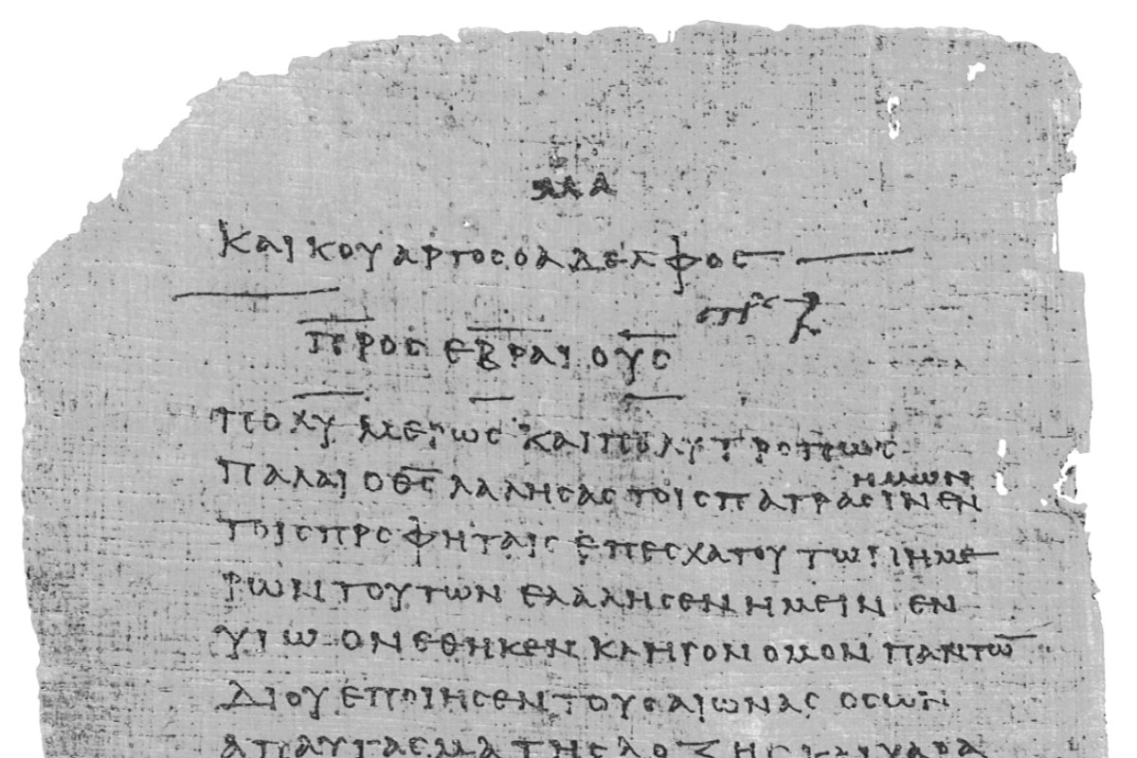
Pharisee Paul’s ἀπολογία to the Hebrews
Ἑβραῖος
Session-5
Hebrews 2:10 thru 3:3
Paul cites:
Psalms 8, 22
and Isaiah 8
Dr. Dave Newton
© 2025
Figure It Out
Calvary Chapel
Santa Barbara

Slide 2
Pharisee Paul’s ἀπολογία to the Hebrews
Ἑβραῖος “hay-brai-os”
Last Week / Session-4
Paul’s timeline: Prophets to Jesus to Apostles
confirmed by God with signs-wonders-power-distribution
Paul’s life-analogy of running the race to receive the prize!
Notes and Video at NewtonFIO.com

Slide 3
Pharisee Paul’s ἀπολογία to the Hebrews Ἑβραῖος
Cessation vs. Continuation 1st Corinthians 12:1-31 Paul clearly states
concerning spiritual gifts I don’t want you to be unaware
FREE books this evening for everyone!
Chapter 3 - details on Fruit of the Holy Spirit
EVERYONE exhibits God’s character
Chapter 4 - details on Gifts of the Holy Spirit
As HE wills for HIS purposes

Slide 4
Pharisee Paul’s ἀπολογία to the Hebrews Ἑβραῖος
Jesus in His full glory
Ephesians 3:18 in our future glorification we will be able to
fully comprehend the four dimensions of Jesus
πλάτος platos = full extent of Time
μῆκος maykos = Length measure
ὕψος hypsos = Height measure
βάθος bathos = Depth measure [like the sea]
Modern physics: 3 spatial + 1 temporal dimension = “spacetime”

Slide 5
Pharisee Paul’s ἀπολογία to the Hebrews Ἑβραῖος
Remember last week Psalm 8 I mentioned the “Psalms Alive” worship chorus
Oh Lord our Lord how excellent Your Name is how excellent Your Name in all the
Earth Your glory fills the heavens beyond the farthest star
When I think about the heavens the moon and all the stars, I wonder
what You ever saw in me, but You took me and You loved me and You’ve given me
a crown and now I’ll praise Your name eternally

Slide 6
Remember last week Paul’s analogy of the runner finishing well to receive the prize
consider again 1st Corinth. 9:24-25 run on Earth to receive corruptible stephanos
but WE run to receive incorruptible stephanos
v26-27 I, Paul, run not with uncertainty
I discipline my body so that AFTER I have
preached to others I will not be disqualified
I will not be cast aside
Disqualified/Cast aside from what?
NOT his salvation! WHAT is Paul so concerned about? INHERITANCE
2nd Timothy 1:12 for I know whom I have believed and am persuaded that He is able
to keep that which I’ve committed unto Him until that day
John 10:27-28 My sheep know My voice and will never perish
Eph. 1:13-14 the Holy Spirit is the down-payment on our redemption
Romans 8:38-39 nothing can separate us from the love of God in Jesus Christ

Slide 7
Quick Review/Details on Heb. 2:2 "the Law communicated thru ANGELS aggelos to Moses"
Galatians 3:19 Why the Law? It was added because of transgressions
having been ordained through angels
Greek = arranged, prescribed, appointed, delivered
Acts 7:53 Stephen speaking to Jewish religious leaders:
you who received the law as ordained by angels, and yet did not keep it
Greek = arranged, deposed [written deposition]
Exodus 19 no mention of angels functioning on Sinai between God and Moses with the Law
but Acts 7:38 Stephen: Moses is the one who was in the congregation in the wilderness
together with the angel who was speaking to him on Mount Sinai
Deuteronomy 33:2 records that 10,000 holy ones [angels] accompanied the Lord
when He came to Sinai to meet Moses
Flavius Josephus [Antiquities Book 15, Ch. 5:3] early 1st Century rabbis quote King Herod,
“We have learned from God the most excellent of our doctrines
and the most holy part of our Law by angels”

Slide 8
Quick Review/Details on Heb. 2:2 "the Law communicated thru angels aggelos to Moses"
Psalm 68:17 Could also very well be in support of Deuteronomy 3:2 how the Almighty was
accompanied by a host of angels at Sinai as He gave the Law to Moses
chariots of God are myriads [thousands upon thousands] as
the Lord is among them as at Sinai, in holiness.
God often dispatched His "messenger-angels" to deliver God’s direct Word to man:
Genesis 19 direct word to Lot
Exodus 3:2 angel of the Lord got Moses' attention to draw him to the bush not
consumed by fire, then the Lord spoke directly to Moses
Daniel 9:20-27 word to Daniel
Matt. 1:20-25 word to Joseph
Luke 1:11-20 word to Zacharias
Luke 1:26-38 word to Mary
Acts 27:23-24 word to Paul
Rev. 1:1 revelation of Jesus, sent to and communicated by His angel to John
Rev. 19:10 John so overwhelmed he tried to worship this angel, who reminded
John “I’m fellow servant like you . . . . Worship God”

Slide 9
Paul’s Bibliography reminder: Romans 15:4 Hebrew Scriptures for OUR benefit!!
2 Samuel 7:12-14 Heb 1:5a
Psalm 2:7 Heb 1:5b
Psalm 104:4 Heb 1:7
Psalm 45:6-7 Heb 1:8-9
Psalm 102:25-27 Heb 1:10-12
Isaiah 34:4-12 Heb 1:12
Psalm 110:1 Heb 1:13
Psalm 8:4-6 Heb 2:5-10
Psalm 22:22 Heb 2:12
Isaiah 8:17 Heb 2:13
Isaiah 8:18 Heb 2:13
Psalm 95:7-11 Heb 3:7-11
Psalm 95:11 Heb. 4:3
Genesis 2:2 Heb 4:4
Psalm 2:7 Heb 5:6
Psalm 110:4 Heb 5:6
Deut. 32:43 Heb 6:1
Gen 22:16-17 Heb 6:14
Psalm 110:4 Heb 7:17
Psalm 110:4 Heb 7:21
Exodus 25:40 Heb 8:5
Jeremiah 31:31-34 Heb 8:7-13, 10:15-18
Exodus 24:8 Heb 9:20
Psalm 40:6-8 Heb 10:5-10
Deut. 32:35 Heb 10:30
Deut. 32:36 Heb 10:30
Habakkuk 2:3-4 Heb 10:37-38
Gen 21:12 Heb 11:18
Prov. 3:11-12 Heb 12:5-6
Deut. 9:19 Heb 12:21
Haggai 2:6 Heb 12:26
Deut. 31:6 Heb 13:5
Psalm 118:6 Heb 13:6

Slide 10
Last week: Jesus for a short time made lower than angels for the suffering of death
to experience death for all mankind . . .
Hebrews 2:10-13 for it was fitting for Him, for whom are ALL things and thru whom
are ALL things, in bringing many sons to glory, to complete the Captain of their
[archegos = captain] salvation [Jesus] thru sufferings for BOTH:
1] He who sanctifies [Jesus] and
2] those who are sanctified [believers]
are all from one Father, for which reason He [#1] is not ashamed to call them [#2] His own adeplphos - Jesus became a man just like all mankind, so the one who
ἀδελφός sanctifies can now refer to us as His very own brothers!
ἀδελφός adelphos
John 17:19 I sanctify Myself that they [brethren] also may be sanctified in truth
sanctify/sanctified - “set aside” “separated out”
This is that ‘present tense’ of our salvation

Slide 11
Pharisee Paul’s ἀπολογία to the Hebrews Ἑβραῖος
saying [about them]: “I will proclaim Your Name [Father] to My brethren, in the midst
ἀδελφός adelphos
of the congregation I will sing Your praise” [exactly as Psalm 22]
ἐκκλησία ekklesia = assembly-congregation-church
Jesus demonstrated HOW to walk by Faith in submission to the Father
He is our model for our daily life by the same Holy Spirit in Him, in us
Paul will next cite Isaiah 8 as prophetic of THIS very principle!!
WHO are Jesus’ ἀδελφός ? They are His Hebrew nation!

Slide 12
Pharisee Paul’s ἀπολογία to the Hebrews Ἑβραῖος
Hebrews 2:10-13
and again Jesus says: “I will put my trust in Him” [Father as Isaiah 8:18 about his sons]
and “behold I [the One who sanctifies] [first it’s about Jesus]
the children [those who are sanctified] whom God has given me” [to Jesus]
Paul: This is WHY Jesus became a man, our Kinsman, and walked like us
Jesus as a man put His trust in the Father, as an example to us
Confirms: Psalm 40:7 in the scroll of the book it is written of Me
Heb. 10:7 in the scroll of the book it is written of Me [we cover this later]
Jesus said to the Pharisees: John 5:39 You search the Scriptures
because you think that in them you have eternal life
it is these [Hebrew Scriptures] that testify about Me

Slide 13
Hebrews 2:14-16
Therefore, since the children [mankind] share in flesh and blood [that’s me and you]
He Himself likewise also partook of the same [flesh and blood, 100% man]
that thru DEATH [as a man] He might render powerless him who had the
power of death, that is, the “slanderer-accuser” [devil, Satan]
and then Free those [me and you] who thru fear death were subject to slavery [to sin]
all their lives - for assuredly He [Jesus] Does Not give help to angels!!
Colossians 2:18 do not worship angels
but He DOES give help to the descendant of Abraham [you Hebrew believers]
σπέρμα sperma = ‘seed of Abraham’
Abraham to Isaac, Jakob [Israel], Judah to Boaz, Obed, Jesse, to David
as such He HAD to be made like His brethren in ALL things
Jesus did not become an angel. He did not die on the cross for angels.
Jesus DID become a man. He died on the cross for mankind.
This ENTIRE process is summarized by Paul in 1st letter to Corinth . . .

Slide 14
Jesus did not become an angel. Jesus did not die for angels.
Paul further clarifies Hebrews 2:14-18 it points to the Millennial Kingdom
1st Corinth. 15:20-28 But now Christ has been raised from the dead
the first fruits of those who have already passed away - for since
by a man [Adam] came death, by a man [Jesus] also came the resurrection of the dead
for as in Adam all die, so also in Christ all will be made alive - Each in his own order:
1] Christ the first-fruits, after that 2] those who are Christ’s at His coming!!
Then comes the end when He hands over the Kingdom to the God and Father
when He has abolished all rule, all authority, and power - for He must reign
until He has put ALL His enemies under His feet - the last enemy that will be
abolished is death - for He [Father] has put all things in subjection under His feet [Jesus]
but when He says, “ALL things are put in subjection,” it is evident that He [Jesus]
is excepted who put all things in subjection to Him - so when all things are subjected
to Him, then the Son Himself [Jesus] also will be subjected to the One [Father]
who subjected all things to Him, so that God may be all in all

Slide 15
Pharisee Paul’s ἀπολογία to the Hebrews Ἑβραῖος
Hebrews 2:17-18 from v16: He HAD to be made like His brethren in ALL things . . .
. . . so He might become a merciful and faithful High Priest in things pertaining to God
to make propitiation for the sins of the people [details in Chaps. 5-8]
because since He Himself was tempted in that which He has suffered
He is able to come to the aid of those who are tempted [mankind]
βοηθέω bon-theo “run to assist” [Father runs to the prodigal]
Jesus was tempted as a man like we are, but He could not sin!!
”opportunity to sin and interest to act” is our sin nature
Jesus DID not have the interest to follow thru on opportunity
Matthew 4:1-11 Satan tempts His physical need for food
Satan tempts His physical protection by God’s angels
Satan tempts His position regarding the world

Slide 16
[NO chapter break]
He is able to come to the aid of those who are tempted . . .
Hebrews 3:1 . . . therefore, holy brethren who are partakers of a Heavenly calling
consider Jesus the: 1] Apostle AND 2] High Priest of our confession
ἀπόστολος Apostolos = Ambassador-Emisary
First: “holy brethren” is hagios adelphos this PROVES Paul’s readers are believers!!
ἅγιος ἀδελφός They are his brothers in Christ
Second: “partakers” is metochos μέτοχος = sharing in something of someone else
8 times in NT 7 by Paul 4 in Hebrews letter 3:1 3:14 6:4 12:8
Third: Paul calls Jesus THE Apostle of our confession [Gospel]
Paul understands he is the Apostle to the Gentiles, so this is where he attributes
Jesus as the true “Abassador” to the Hebrew nation
Paul wants all his readers to KNOW that Jesus is their Apostle [not Paul]
Perhaps another reason Paul does not sign his name to Hebrews

Slide 17
Pharisee Paul’s ἀπολογία to the Hebrews Ἑβραῖος
Hebrews 3:2-3
He was faithful to Him [God the Father] who appointed Him
as Moses also was faithful in all His house - for He [Jesus] has been counted
worthy of more glory than Moses - by just so much as the Builder of the
house [Jesus] has more honor than the house [Moses, the Law, Hebrew nation]
Jesus is the very substance of the Law! John 5:46 again
This “house” οἶκος oikos = inhabited/lived-in dwelling place
Paul no doubt means the “house of Israel”
Remember: Joseph and his brothers and father Jakob [Israel] and entire family go
into Egypt from Abraham’s lands at oaks in Mamre as a family-clan
Abram the pagan Chaldean from Ur “from you I will build great nation”
They Exodus Goshen as that “nation of Israel” 500K-to-1M people
JESUS is worthy of more than Moses . . . “we have Moses and the Law”
Jesus is far superior to Moses and is the fulfillment of that Law

Slide 18
Pharisee Paul’s ἀπολογία to the Hebrews Ἑβραῖος
Preview What’s Coming Feb. 24th
Jesus is Far Above/Superior to MOSES
Moses Jesus
- led Israel from bondage - leads from bondage of sin
- led Israel from wilderness - leads to eternal glory
- builds temporary tabernacle - “the” Tabernacle among men
- sin nature from Adam + Abraham - entirely without sin
- man of God - is God
- king in Jeshurun [Deut. 33:5] - King of all kings
- THE prophet spoke God’s Word - fulfillment of that Word
- a priest to God [Ex. 24:6] - our Great High Priest

Slide 19
Pharisee Paul’s ἀπολογία to the Ἑβραῖος
NEXT WEEK
No Study Feb. 17th
President’s Holiday
BACK
Monday
February 24th

