Slide 1
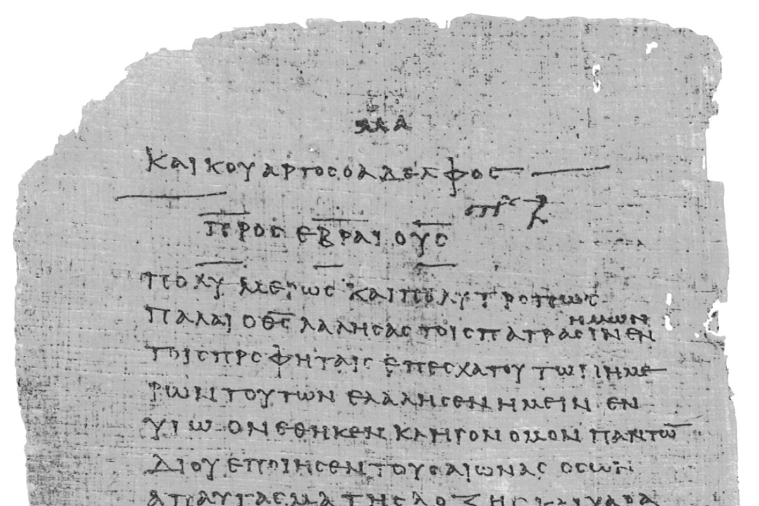
Pharisee Paul’s ἀπολογία to the Hebrews
Ἑβραῖος
Session-4
Hebrews 2:3b-9
Paul cites:
Psalms 8, 22
and Isaiah 8
Dr. Dave Newton
© 2025
Figure It Out
Calvary Chapel
Santa Barbara

Slide 2
Pharisee Paul’s ἀπολογία to the Hebrews
Ἑβραῖος “hay-brai-os”
Last Week / Session-3
Paul’s continued proofs of Jesus being Mashiach and his first
Warning to not drift away due to so GREAT a Salvation!
Notes and Video at NewtonFIO.com

Slide 3
Paul’s Bibliography reminder: Romans 15:4 Hebrew Scriptures for OUR benefit!!
2 Samuel 7:12-14 Heb 1:5a
Psalm 2:7 Heb 1:5b
Psalm 104:4 Heb 1:7
Psalm 45:6-7 Heb 1:8-9
Psalm 102:25-27 Heb 1:10-12
Isaiah 34:4-12 Heb 1:12
Psalm 110:1 Heb 1:13
Psalm 8:4-6 Heb 2:5-10
Psalm 22:22 Heb 2:12
Isaiah 8:17 Heb 2:13
Isaiah 8:18 Heb 2:13
Psalm 95:7-11 Heb 3:7-11
Psalm 95:11 Heb. 4:3
Genesis 2:2 Heb 4:4
Psalm 2:7 Heb 5:6
Psalm 110:4 Heb 5:6
Deut. 32:43 Heb 6:1
Gen 22:16-17 Heb 6:14
Psalm 110:4 Heb 7:17
Psalm 110:4 Heb 7:21
Exodus 25:40 Heb 8:5
Jeremiah 31:31-34 Heb 8:7-13, 10:15-18
Exodus 24:8 Heb 9:20
Psalm 40:6-8 Heb 10:5-10
Deut. 32:35 Heb 10:30
Deut. 32:36 Heb 10:30
Habakkuk 2:3-4 Heb 10:37-38
Gen 21:12 Heb 11:18
Prov. 3:11-12 Heb 12:5-6
Deut. 9:19 Heb 12:21
Haggai 2:6 Heb 12:26
Deut. 31:6 Heb 13:5
Psalm 118:6 Heb 13:6

Slide 4
Pharisee Paul’s ἀπολογία to the Hebrews
5 Warning to Believers
2:1-5 Warning-1: Don't Drift Away last week
3:7 thru 4:13 Warning-2: Open Disobedience/Unbelief
6:4-8 Warning-3: Time to Grow up/Be Mature
10:26-39 Warning-4: Volitional/Deliberate/Willful Sin 12:25-29 Warning-5: Indifference/Casual Ambivalence
Paul includes himself [“we” “us”] in these warnings!
WHY warn? Basic intention of this letter: “Okay, you believe and you’re saved [justified]
but don’t lose your inheritance/reward still to come [at bema] See how God
judged His own when they disobeyed [OT examples] - word given by angels?
How much more for us with word direct from the Lord? Think you’ll escape
if take lightly so great a salvation? If at the bema and get nothing, will you
wish for 2nd chance? Had done more with your opportunities?
[Consider Dickens’ message thru Scrooge]
[Consider “tears” Rev. 7:17, 21:4]

Slide 5
Pharisee Paul’s ἀπολογία to the Hebrews
If at bema get nothing, wish for 2nd chance to do more with your opportunities?
Paul is not talking about your, my, his, our salvation [justification].
He wrote Romans 8:29-30 Even as Jesus confirmed in John 10:28-29
Paul wants to be sure his beloved nation fully understands what’s at stake far
beyond the time we first believe in Jesus. Beyond justification ,Paul is focused on
sanctification-process. He compares our Earthly life to a race:
Philippians 3:13-14 have not yet laid hold of the prize that lies ahead
1st Corinth. 9:24 run toward a final prize [after being saved]
2nd Tim. 4:7-8 finish the course to obtain Crown of Righteousness
God will award it to me On That Day! [bema]
not just me but all who loved His appearing [harpazo]
Heb. 12:1 stands are packed, all are watching, run race with endurance

Slide 6
Pharisee Paul’s ἀπολογία to the Hebrews
ALL Paul: Philippi have not yet laid hold of the prize that lies ahead
Corinth run toward a final prize [after being saved]
Timotheus finish the course to obtain Crown of Righteousness
God will award it to me On That Day! [bema]
not just me but all who loved His appearing [harpazo]
Heb. 12:1 stands are packed, all are watching, run race with endurance
NONE of these are about losing one’s salvation . . .
He reminds Timothy about Demas 2nd Tim. 4:10 deserted Paul because of his
love for this present world!
1st John 2:17-19 this world is passing away, yet many have gone after it
they went out from us but were never really/truly of us,
if they had been of us they would have remained, but they
made the volitional decision to go out from us
so that it would be shown they were never really of us

Slide 7
Pharisee Paul’s ἀπολογία to the Hebrews Ἑβραῖος
Tonight Hebrews 2:3b-10 note this 3-sequence delivery-confirmation
v3b - 6a clear segue from: How will we escape if we neglect so great a salvation?
right into: after IT was at FIRST spoken thru the Lord, IT was [second] confirmed to us
by those who heard [eyewitnesses] then [third] God also testifying with them by:
1] signs and
2] wonders and
3] various miracles and
4] gifts of the Holy Spirit according to His own will [the Spirit’s]
for He did NOT subject to angels the world to come [Millennium] concerning
which we are speaking [Kingdom] - but one has testified somewhere, saying . . .
Paul then cites Psalm 8:4-8 directly from his beloved
Hebrew Scriptures [coming up in 5 slides . . . but quick detour]

Slide 8
Pharisee Paul’s ἀπολογία to the Hebrews Ἑβραῖος
Face to
face in
Eden
Jesus
in
person
Apostle
eye-
witnesses
Through
His written
Word
Through the Prophets
4000 BC 1600BC . . . . . . . . . . . 397 BC 29-32 AD 32-98 AD 2nd Century to today

Slide 9
FIRST spoken thru the Lord - then confirmed to us by those who heard [eyewitnesses]
Gal. 2:9 Peter, James, John meet Paul and confirm his Apostleship-teaching
[Paul meets Jesus AFTER His Earthly ministry]
then God testifying with them thru four means: [‘authentication sequence’]
1] signs and
2] wonders and
3] various miracles and
4] gifts of the Holy Spirit according to His own will [the Spirit’s]
Romans 15:19 in the power of signs and wonders, in the power of the Spirit
I have fully preached the gospel of Christ [across all those locations]
Does not say “I preached the full Gospel” [not an adjective to Gospel]
It says “I full preached the Gospel” [it is an adverb to preached]
The “full Gospel” is defined by Paul in 1st Corinth. 15:1-4
Does the Bible teach the sequence: prophets who prophesied then the word
directly thru Jesus then confirmed by eyewitnesses to us then God
backing their testimony with 4 evidences and these were uniquely
given by the Holy Spirit for that time?

Slide 10
Pharisee Paul’s ἀπολογία to the Hebrews Ἑβραῖος
What does the Bible teach about these four?
1] signs 2] wonders 3] power [miracles] 4] gifts of the Spirit
Could this simply be Paul referencing Pentecost in 32 AD from Acts 2?
signs σημεῖον semeion = sign, mark, token to distinguish something known
This vouches for the individual being Authentic-Legitimate!
wonders τέρας teras = marvel “who did that?” “how did that happen?”
Gets people’s attention to take notice of the individual speaking.
power δύναμις dunamis = supernatural happenings ‘miracles’
This is clearly God’s ‘power’ not the individual’s.
gifts μερισμός merismos = distribution/division NOT χάρισμα charisma
1st Corinth. 12, 13, 14
Enabled-equipped by God, not the individual.

Slide 11
Pharisee Paul’s ἀπολογία to the Hebrews Ἑβραῖος
Paul is clearly teaching: The veracity of the Gospel was authenticated first by the direct
word from Jesus, second from those Apostles [the eyewitnesses]
and this was confirmed by of signs, wonders, power, gifts.
MAJOR theological debate: Were these 4 authentication/confirmations passed on
to the next generation after the Apostles? OR Were these specifically given just to
their generation for fulfilling the Commission given by Jesus?
Question? Were early 1st Century AD believers all doing signs, wonders, power, gifts?
The Bible seems to not show this apart from the 12 Apostles
Is this simply referring to Pentecost in May of 32 AD?
Cessation vs. Continuation . . . yet Paul explains gifts, apostles, prophets, teachers,
power, healings 20-30 years after that Pentecost in
31 verses of 1st Corinthians 12

Slide 12
Pharisee Paul’s ἀπολογία to the Hebrews Ἑβραῖος
Cessation vs. Continuation 1st Corinthians 12:1-31 Paul clearly states
All are not apostles are they? All do not prophesy? All do not teach do they?
Not all do power? All do not have gifts of healing do they?
Not all speak in tongues or interpret, do they?
v1 now concerning spiritual gifts I don’t want you to be unaware
FREE books this evening for everyone!
Chapter 3 - Fruit of the Holy Spirit
Chapter 4 - Gifts of the Holy Spirit

Slide 13
Pharisee Paul’s ἀπολογία to the Hebrews Ἑβραῖος
for God did NOT subject to angels the world to come [Millennium] concerning
which we are speaking [Kingdom] Angels have no inheritance. Not joint heirs.
οἰκουμένη oikoumene = inhabited Earth
13 times in NT it is always Earth - which was not created for aggelos
Colossians 3:23-24 do your work unto God to receive reward of inheritance!!
but one has testified somewhere, saying
Psalm 8:4-8 directly from his beloved Hebrew Scriptures
v 6b-8 “What is man that You are mindful/aware of him, or the Son of Man [Jesus] that
You are concerned about Him? You have made him for a little while lower than the
angels - You have crowned him with glory and honor and have appointed him over the
works of Your hands - You have put all things in subjection under his feet, for in
subjecting all things to him He left nothing that is not subject to Him, but now [this time]
we do not yet see all things subjected to Him

Slide 14
Pharisee Paul’s ἀπολογία to the Hebrews Ἑβραῖος
Rhetorically: “What is mankind that God even cares? David reflects on himself
or the Son of Man [Jesus] that God is concerned? David segues to Prophecy
full context of Psalm 8:4-6 begins with verses 1-3 [wonderful Maranatha worship song]
Human lives last for just a short time in the physical world, yet God knows all
Best translation: Jesus, for a little time, was made lower than His angels
מְעַט meh-at = refers to short time
Paul uses βραχύς brachus = short time period
Yet God crowns Jesus with glory, honor - puts him over the creation
Gen. 1:26-28 first Adam had dominion and lost it.
Romans 5:12-21 1st Corin. 15:21-22 Second Adam gains it all back
WHY? to clearly demonstrate God pointing to still-future time when Jesus Will Rule
and reign on Earth oikoumene [Paul: we do not yet see all things subjected to Him]
Once again Paul refers to the future Millennial Kingdom

Slide 15
Pharisee Paul’s ἀπολογία to the Hebrews Ἑβραῖος
Remember from prior 2 weeks: Law given thru aggelos to Moses
Galatians 3:19 Acts 7:53 Hebrews 2:2
so the 3 most revered by Jews are:
1] angels [top of God’s created beings] who delivered the Law to
2] Moses [THE prophet] “we have Moses and the Law”
3] priests-Temple-sacrifices-rituals [that Law in practice]
Paul is saying [pleading with them]: these 3 that you revere as Hebrews, Jesus is
above ALL of them, so if Law given by angels was disobeyed with
judgment, how much more accountable are we NOW to what has
been given directly by the Son, let’s not neglect so great a salvation!
but the world to come [Millennium and New Earth] NOT entrusted to aggelos
Jesus FAR above the angels! Jesus will redeem Earth and rule over it.

Slide 16
Pharisee Paul’s ἀπολογία to the Hebrews Ἑβραῖος
v8 concludes with: we do not yet see all things subjected to Him 1st Cent. AD]
v9 picks up there: but we DO see Him who was made for a little while
lower than the angels namely, Jesus
because of the suffering of death [Calvary changes everything]
Crowned with glory and honor [again, the Millennium Kingdom]
so that by the grace of God He might ”experience” death for everyone
χάρις charis = gift, grace
Jesus’ death on Calvary and His resurrection that gives us eternal life
is the χάρισμα charisma = free gift of God in Jesus

Slide 17
Pharisee Paul’s ἀπολογία to the Hebrews Ἑβραῖος
Jesus in His full Crowned with Glory and Honor [from verse 9]
1st John 3:2 we are now children of God, but not yet as we Will Be [future]
when we will be like Him because we will see Him as He truly is . . .
Ephesians 3:18 in our future glorification we will be able to finally see
and comprehend Jesus in His fullness
πλάτος platos = full extent of Time
μῆκος maykos = Length measure
ὕψος hypsos = Height measure
βάθος bathos = Depth measure [like the sea]
Physicist Lambert Dolphin notes these are exactly as modern physics defines our
4-dimensional physical universe

Slide 18
Paul has pre-handled 2 major concerns re: Jesus
1. Jesus is ABOVE the aggelos, but He was a 100% human man
which makes Him lower than the aggelos How Can That Be?
2. Jesus died a human-physical death – and angels, whom He is greater than,
don’t die How Can That Be? How can Jesus be higher than the angels?
Because Jesus’ choice to humble Himself, laying aside His glory to become a man born
physically of a woman [Mary] - demonstrates His great agape love for us so that He
is entirely human and understands completely everything we go thru, yet always
without sin. THIS being fully human while also being fully God is what makes
Jesus far above the angels, even while a man [concern #1 above]
AND even as He experienced physical-literal death - something angels do not
experience [concern #2], His death takes the full penalty-consequence for man’s
sin as a propitiation, so we are truly saved from the wages due [Romans 6:23]
Jesus is superior to angels even as a #1 human man #2 who died
because Jesus did this willingly from agape to pay the penalty for man’s sin!
NO angel has done anything even remotely close to that

Slide 19
Pharisee Paul’s ἀπολογία to the Ἑβραῖος
NEXT WEEK
Hebrews 2:10 thru 3:3
Paul cites:
Psalms 8, 22
and Isaiah 8

