Slide 1
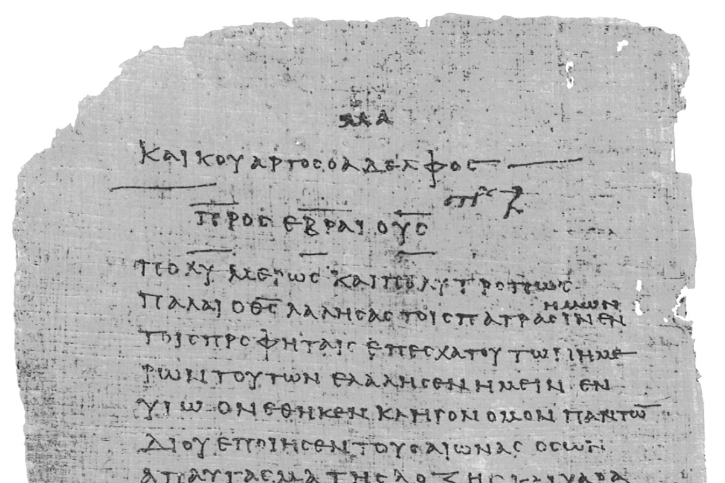
Pharisee Paul’s ἀπολογία to the Hebrews
Ἑβραῖος
Session-10
Hebrews 4:14 thru 5:6
Cites Psalms 2:7, 110:4
Infers Psalm 139:7-12
Dr. Dave Newton
© 2025
Figure It Out
Calvary Chapel
Santa Barbara

Slide 2
Pharisee Paul’s ἀπολογία to the Hebrews Ἑβραῖος
Reminder from last week’s “Crowns”
During Stephanos Doxa [crown of glory]
I mentioned my NJ-Presbyterian experience with the
Doxa-ology but then quoted the “Gloria Patri
Doxology: “Praise God from whom all blessing flow”
[close out Wed AM men’s prayer breakfast]
Gloria Patri: “glory be to the Father and to the Son and
to the Holy Ghost”

Slide 3
Paul’s Bibliography reminder: Romans 15:4 Hebrew Scriptures for OUR benefit!!
2 Samuel 7:12-14 Heb 1:5a
Psalm 2:7 Heb 1:5b
Psalm 104:4 Heb 1:7
Psalm 45:6-7 Heb 1:8-9
Psalm 102:25-27 Heb 1:10-12
Isaiah 34:4-12 Heb 1:12
Psalm 110:1 Heb 1:13
Psalm 8:4-6 Heb 2:5-10
Psalm 22:22 Heb 2:12
Isaiah 8:17 Heb 2:13
Isaiah 8:18 Heb 2:13
Psalm 95:7-11 Heb 3:7-11
Psalm 95:11 Heb. 4:3
Genesis 2:2 Heb 4:4
Psalm 2:7 Heb 5:6
Psalm 110:4 Heb 5:6
Deut. 32:43 Heb 6:1
Gen 22:16-17 Heb 6:14
Psalm 110:4 Heb 7:17
Psalm 110:1-4 Heb 7:21
Exodus 25:40 Heb 8:5
Jeremiah 31:31-34 Heb 8:7-13, 10:15-18
Exodus 24:8 Heb 9:20
Psalm 40:6-8 Heb 10:5-10
Deut. 32:35 Heb 10:30
Deut. 32:36 Heb 10:30
Habakkuk 2:3-4 Heb 10:37-38
Gen 21:12 Heb 11:18
Prov. 3:11-12 Heb 12:5-6
Deut. 9:19 Heb 12:21
Haggai 2:6 Heb 12:26
Deut. 31:6 Heb 13:5
Psalm 118:6 Heb 13:6

Slide 4
Pharisee Paul’s ἀπολογία to the Hebrews Ἑβραῖος
Tonight: Hebrews 4:14 thru 5:3
Therefore, since we have a Great High Priest who has passed through the
the heavens, Jesus the Son of God, let us hold fast our confession
for we do not have a high priest who cannot sympathize with our weaknesses
but One who has been tempted in all things as we are, yet without sin
Therefore let us draw near with confidence to the throne of grace, so that we
may receive Mercy and find Grace to help in time of need
Paul begins new comments: Jesus being superior to Levitical priests
For every high priest taken from among men is appointed on behalf of men
in things pertaining to God in order to offer both gifts and sacrifices for sins he
can deal gently with the ignorant and misguided, since he himself also is beset
with weakness and because of it he is obligated to offer sacrifices for sins as
for the people, and also for himself Isaiah 53:3 despised, forsaken, man of sorrows
acquainted with grief

Slide 5
Pharisee Paul’s ἀπολογία to the Hebrews Ἑβραῖος
Tonight: Hebrews 5:4-6 and no one takes the honor [to be a priest] to himself, but
receives it when he is called by God even as Aaron was - so also Christ did not
glorify Himself so as to become a high priest, but He who said to Him,
“You are My Son, today I have begotten You” [Paul quotes Psalm 2:7]
begotten is NOT created at that time
γεννάω gennhaoh = Father established His Son
John 3:16 μονογενής monogenays = only one of that kind
just as He says also in another passage,
“You [Jesus] are a Priest forever according to the order of Melchizedek”
[Paul quotes Psalm 110:4]
Consider Psalm 110:1 25 times in the NT “enemies your footstool”
Psalm 110:4 “priest forever”

Slide 6
Pharisee Paul’s ἀπολογία to the Hebrews Ἑβραῖος
Hebrews 4:14 thru 5:6
Therefore, since we have a Great High Priest who has passed through the
the heavens, Jesus the Son of God, let us hold fast our confession
[run the race, endure, finish well, stay the course]
for we do not have a High Priest who cannot sympathize with our weaknesses
but One who has been tempted in all things as we are, yet without sin
Matthew 4:1-11 “the accuser” made three direct temptations to Jesus:
1. you’re hungry - use dunamis to transform stones into bread loaves
2. God’s aggelos protect You, let them catch You in gravity freefall
3. bow and worship me and I will give you all kingdoms of Earth
Matt. 26:39-39 IF this suffering can be avoided, please remove it from Me, but
I want Your will not My own [as a man, tempted but without sin]

Slide 7
Pharisee Paul’s ἀπολογία to the Hebrews Ἑβραῖος
Review: let us draw near with confidence to the Throne of Grace
θρόνος χάρις thronos charis
so that we may receive Mercy and find Grace to help in our time of need
for every high priest taken from among men [Jesus the man is our Priest]
Jesus can understand/empathize/sympathize with us as “intermediary”
is appointed on behalf of men in things pertaining to God to offer both: 1] gifts
and 2] sacrifices for sins he can deal gently with ignorant and misguided since he is
also beset with weakness and because of it he is obligated to offer sacrifices
for sins as for the people and also for himself Phil. 2:8 Jesus as a man humbled
Himself becoming obedient even to physical death on a cross
Paul is clearly explaining to 1st Century AD Hebrew believers that after being
saved-justified they now have Jesus as their Hebrew High Priest
All within Leviticus that they were so dedicated to
now pivots away from Torah, Law, Aaron, Levites TO JESUS!

Slide 8
Pharisee Paul’s ἀπολογία to the Hebrews Ἑβραῖος
COMPARE: “order of Aaron” vs. “order of Melchizedek”
Aaron and brother Moses from tribe of Levi [of Amram & Jochebed]
First of Priests from Levi . . . always separate from the Kings from Judah
Exodus 16:33 selected by God
Numbers 17:8 formal confirmation into this ‘office’ of service
Exodus 28:1 called by God to this ministry
Numbers 16:1-15 Korah rejected Aaron’s priesthood over Hebrews
1st Sam. 13:5-14 King Saul tries priestly sacrifice in Nathan’s absence
God then removes Saul from throne
2nd Chron. 26:16-23 King Uzziah tries priestly burning incense
God gives him leprosy

Slide 9
Pharisee Paul’s ἀπολογία to the Hebrews Ἑβραῖος
Hebrews 4:14 thru 5:6
no one takes the honor to himself, but receives it when he is called by God
even as Aaron was - so also Christ did not glorify Himself so as to become a high
priest, but He who said to Him, “You are My Son, today I have begotten You”
just as He says also in another passage,
“You [Jesus] are a Priest forever according to the order of Melchizedek”
Paul quotes Psalm 110:4 forever is in contrast to limited-temporal order of Aaron
Paul is distinguishing Jesus thru Melchi-Sedek, unique from Aaron and Levites
Consider Psalm 110:1-4 27 times in NT - 4 cites in Hebrews + 6 inferences to it
sit at My right hand until I make Your enemies Your footstool
Matt. 22 Mark 12 Luke 20 Jesus quotes this to confound religious leaders
Remember: David calls Him ‘Lord’

Slide 10
Pharisee Paul’s ἀπολογία to the Hebrews Ἑβραῖος
Consider Psalm 110:1-4 context [David writing by inspiration of Holy Spirit]
sit at My right hand until I make Your enemies Your footstool
Matt. 22 Mark 12 Luke 20 Jesus quotes Psalm to confound Sadducees
Acts 2:34 Peter’s Pentecost sermon also quotes it
Jesus asks difficult question: How is Mashiach [Anointed One] David’s son
if David calls him ‘My Lord’ ?
Remember their response to Jesus?
Matt. 22:26 no one was able to answer Jesus and from that day on
no one dared to ask Him another question
Paul cites this very same Psalm 110 to compare Jesus to the “order of Melchizedek”
Separating Jesus from Aaron’s Levitical temporal priesthood
We reviewed “order of Aaron” . . . Let’s examine Melchi-Sedek

Slide 11
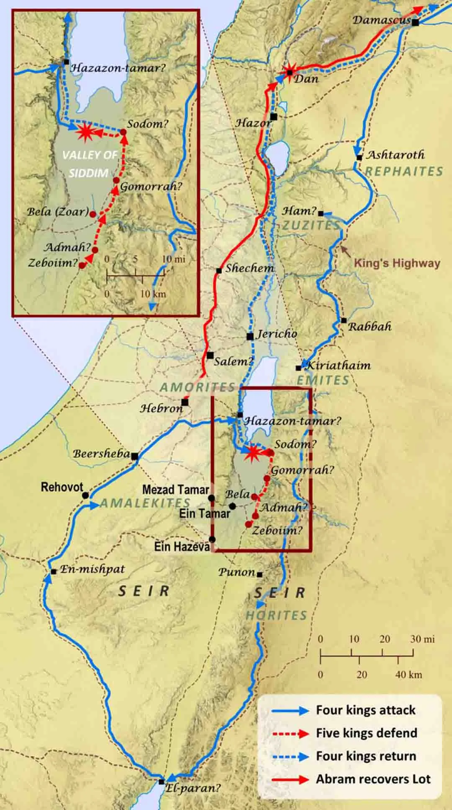
“Order of Melchi-Sedek”
Genesis 14:5-16 famous battle of 9 kings:
Chedorlaomer of Elam defeats:
Rephaim in Ashtaroth [Nephilim]
Zuzim in Ham [Nephilim]
Emim in Shaveh [King’s Valley]
Horites in Mt. Seir
Amalekites and Amorites
Sodom [5 total] [4 total]
Gomorrah Chedorlaomer
Admah vs. Tidal of Goiim
Zeboiim Amraphel of Shinar
Bela [Zoar] Arioch of Ellasar
Battle is in Siddim Valley tarpits
[might factor into Sodom & Gomorrah]
Abram’s nephew Lot captured from Sodom

Slide 12
“order of Melchizedek” מַלְכִּי־צֶדֶק Melchi = my king Sedek = the righteousness
Genesis 14:13-14 Abram’s 318 armed private security force-militia goes after
Lot all the way north to Hobah above Damascus and brought
back Lot, all the women, and all the possessions
14:17 after his [Abram] return from the defeat of Chedorlaomer and the kings
who were with him the king of Sodom went out to meet him [Abram] at the
valley of Shaveh [the King’s Valley]
14:18 Melchi-Sedek King of Salem [shalom = peace] brought out bread + wine
now he was a priest of the Most High God [500 years before Aaron]
Melchizedek blessed Abram, “Blessed be Abram of the God Most High,
Possessor of heaven and earth, and blessed be God Most High,
Who delivered your enemies into your hand”
and Abram paid to Melchi-Sedek one-tenth of all that was captured

Slide 13
Melchizedek” מַלְכִּי־צֶדֶק Melchi = my king Sedek = the righteousness
Literal historical person vs. some form of pre-Hebrew ‘archetype’?
In 2010 Israeli archaeologist Eli Shukron unearthed fascinating structure that
has matsevah [stele] consistent with religious temple. It dates to circa 2000 BC
the exact time period of Abram & Melchizedek Genesis 14
“Temple Zero” has 4 chambers carved into bedrock include a raised dais [altar for
sacrifices], drainage channel for blood, olive press for oil, and place to tie animals
NOTE: This is 500+ years before Passover-Exodus-Law
“Standing stone” sits on 12 foundation support stones [pre-scribes 12 Tribes?]
Stele preps for Gen. 28:18-22 Jacob erects stone stele of commemoration
at Bethel and pours oil over it and declares:
This stone, which I have set up as a pillar, will be God’s house,
and of all that You give me I will surely give a tenth to You”

Slide 14
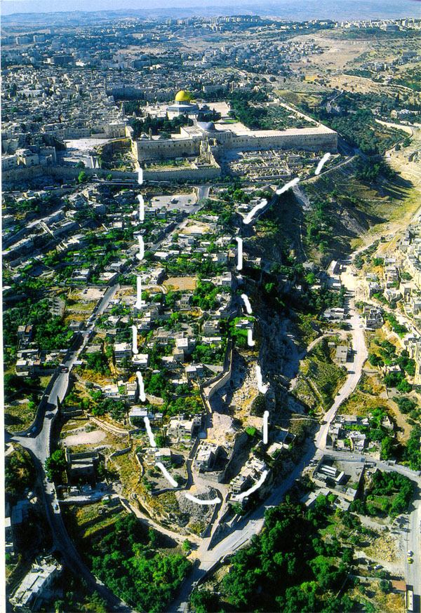
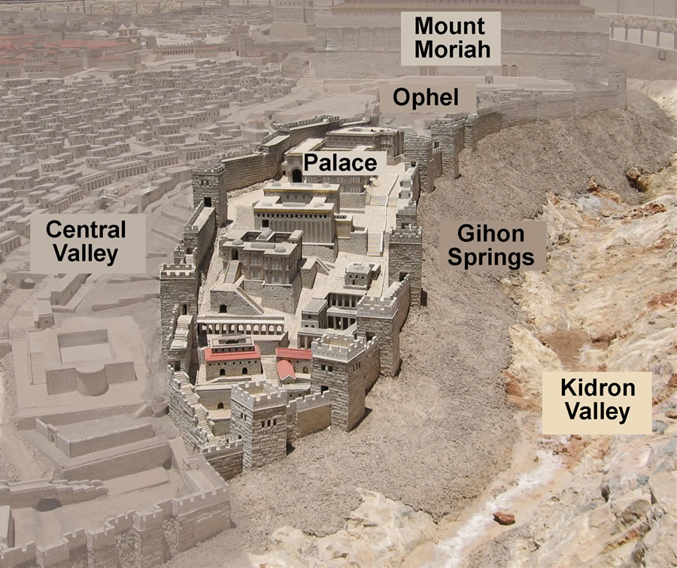
Melchizedek” מַלְכִּי־צֶדֶק Melchi = my king Sedek = the righteousness
City of David [2022]

Slide 15
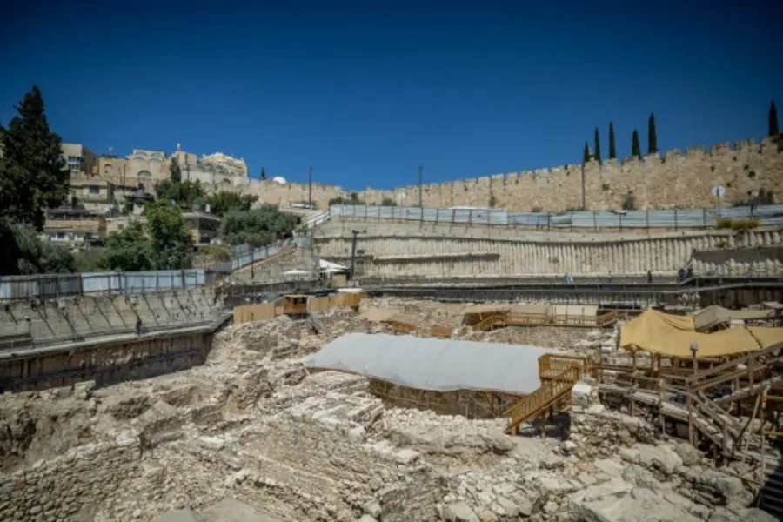
Melchizedek” מַלְכִּי־צֶדֶק Melchi = my king Sedek = the righteousness
City of David [2022]

Slide 16
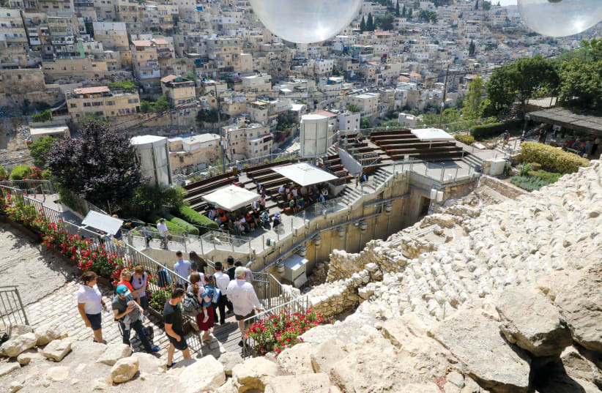
Melchi-Sedek Literal historical person vs. Some form of pre-Hebrew ‘archetype’?
2010 Jewish archaeologist Eli Shukron discovers what could be Melchizedek temple in
City of David, SE corner of Jerusalem above Spring of Gihon [Hezekiah’s tunnel]
City of David [2022]

Slide 17
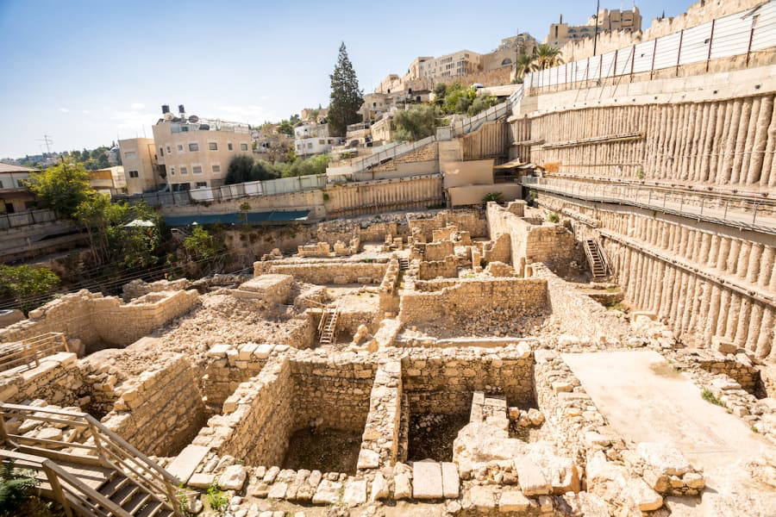
City of David [2022]

Slide 18
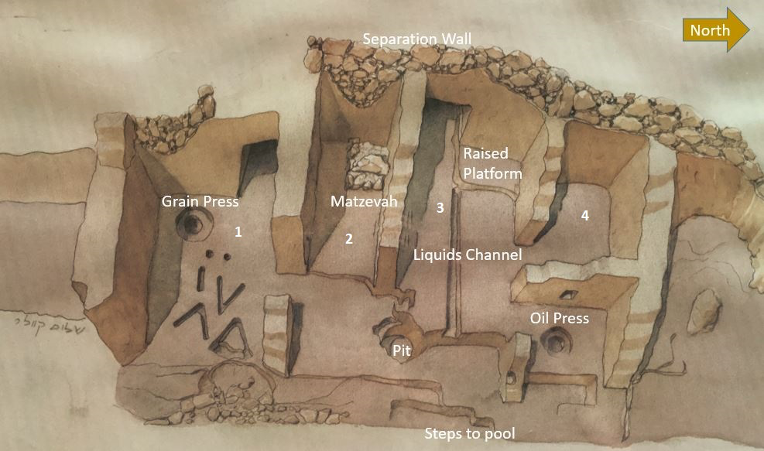
Eli Shukron [2010]
Stele stone
“V” shaped carvings
in rock floor [tripod?]

Slide 19
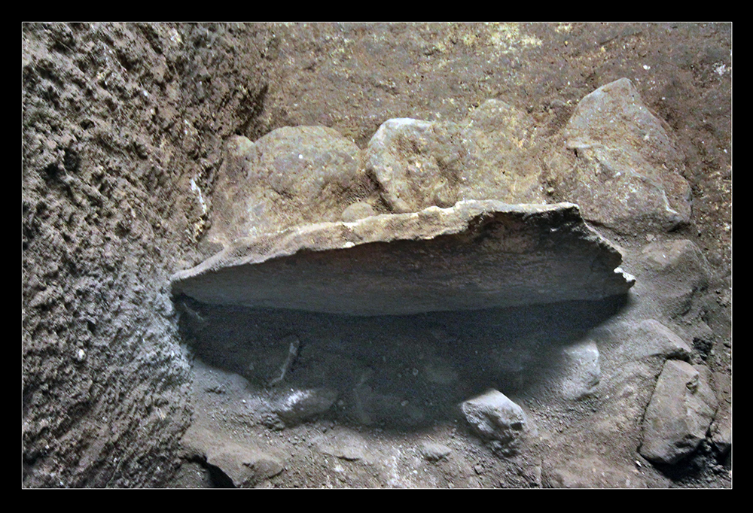
Melchizedek” מַלְכִּי־צֶדֶק Melchi = my king Sedek = the righteousness
Matzevah
on “12” stones

Slide 20
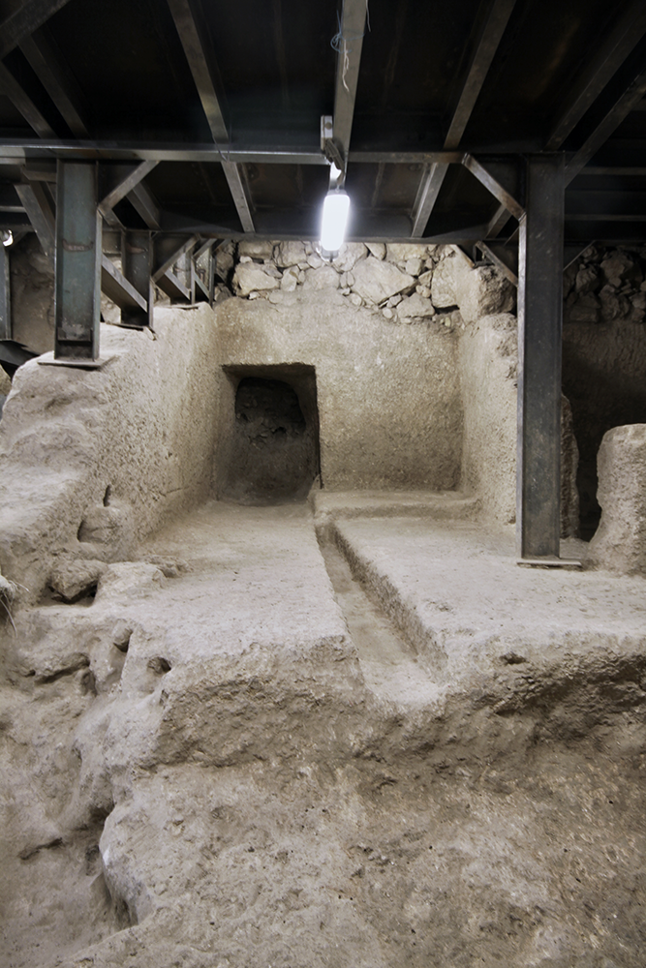
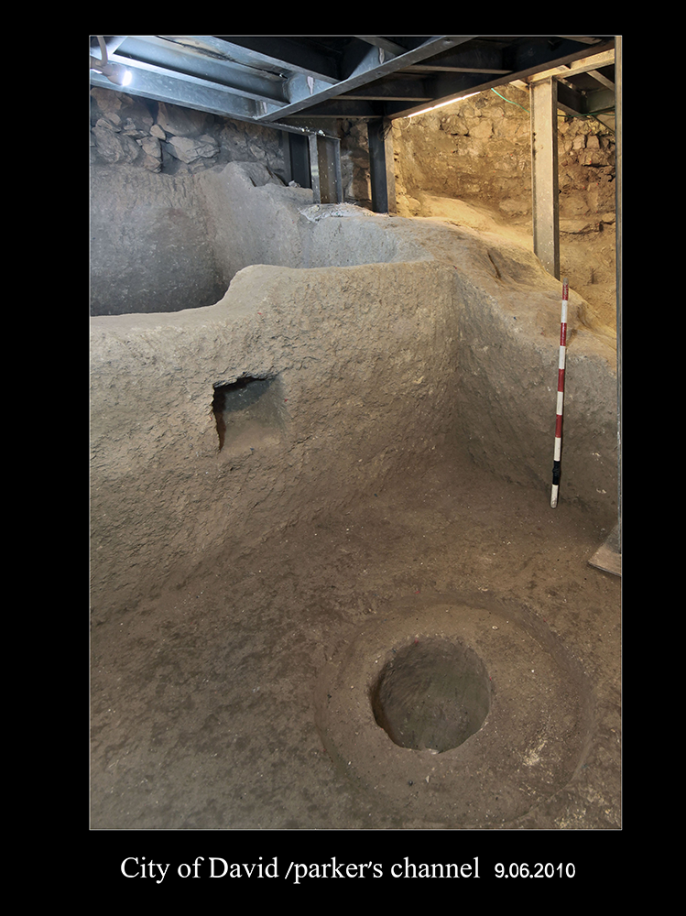
Melchizedek” מַלְכִּי־צֶדֶק Melchi = my king Sedek = the righteousness
floor has blood
drainage channel
floor has an olive press

Slide 21
Pharisee Paul’s ἀπολογία to the Hebrews Ἑβραῖος
Melchizedek” מַלְכִּי־צֶדֶק Melchi = my king Sedek = the righteousness
Consider these 5:
Melchi-Sedek king of righteousness
King of Salem [shalom] Yeru-Shalom = “you will see Peace”
Priest of the Most High God “perpetually” [Hebrews 7:3]
brings bread + wine
bless Abram “Blessed be Abram of God Most High”
Abram pays tithes [one-tenth] to Melchi-Zedek
NOTE: OT kingdom of Israel – OT Levitical priesthood – OT blood sacrifices
OT tabernacle camp – OT Temple [1st and 2nd ] – tithes in Law
These are ALL ‘types” “foreshadows” of Jesus and ultimately His
Millennial Kingdom and then New Earth and New Jerusalem
So too: Melchi-Sedek provides a “type” “foreshadow” of Jesus

Slide 22
Melchizedek” מַלְכִּי־צֶדֶק Melchi = my king Sedek = the righteousness
king of righteousness. King of Salem [shalom]
Priest of the Most High God An actual historical person in 2000 BC
King and Priest are 100% separate-distinct positions in Hebrew Scriptures
Remember: Levitical priests still 500 years in the future at Exodus + Sinai
Bible: Abram born 2056 BC [1,948 yrs after creation]
Abram 75 as he left Haran after Ur-Chaldeas [1970s BC]
Exodus 1446 BC
Jesus in OT Christophany? NO! Jesus is Priest “according to order of Melchizedek”
Heb. 7:3 ”made like Son of Man” ἀφομοιόω aphomoioo = model, image, likeness
He cannot be model-image-likeness of Himself!
Jesus NOT after Aaron’s Torah-priesthood
Jesus TYPE of Melchi-Sedek pre-Torah/pre-Law priesthood

Slide 23
Pharisee Paul’s ἀπολογία to the Hebrews Ἑβραῖος
Melchizedek” מַלְכִּי־צֶדֶק Melchi = my king Sedek = the righteousness
Consider these 5:
brings bread + wine
Alludes to: 1] the Lord’s supper 1st Corinthians 11
2] and to Joseph [a ‘type’ of Jesus] in Egypt
his deliverance linked to: baker [bread] and
wine-steward
Is this an OT Christophany?
Hebrews 7:16 Jesus ascends to Priest not based on physical bloodline requirement
[tribe of Levites, Aaron] but according to the power
of an indestructible life [resurrection overcame death]

Slide 24
Pharisee Paul’s ἀπολογία to the Hebrews Ἑβραῖος
Melchizedek” מַלְכִּי־צֶדֶק Melchi = my king Sedek = the righteousness
Consider these 5:
blesses Abram “Blessed be Abram of God Most High”
Hebrews 7:7 without any dispute, GREATER always blesses the lesser
Melchizdedek Abram
He is clearly greater than Abram – but, is this OT Christophany?
Unlike others in OT, no mention “I have seen/been with/visited by God”
Pharisee Paul continues to make the case that JESUS is superior to
angels, Moses, and now Abram/Abraham AND Aaron’s priesthood . . . . .

Slide 25
Pharisee Paul’s ἀπολογία to the Hebrews Ἑβραῖος
Melchizedek” מַלְכִּי־צֶדֶק Melchi = my king Sedek = the righteousness
Consider these 5:
Abram pays tithe [one-tenth] to Melchi-Sedek
Tithing 500 years before the Law established/detailed tithing
In weeks to come Hebrews 7 Paul states Melchi-Sedek with 5 descriptors:
“without father or mother” what?
“without genealogy” what?
“no beginning of days or end of life” what?
“made like the Son of Man” what?
“he remains a Priest perpetually” wait, perpetually?
OT Christophany?
or is Pharisee Paul delineating Jesus’ priesthood not based on
human Aaron but on this “King of Righteousness / Prince of Peace”?

Slide 26
Melchizedek” מַלְכִּי־צֶדֶק Melchi = my king Sedek = the righteousness
Hebrews 7 Paul states Melchi-Sedek with 5 descriptors:
“without father or mother” what?
“without genealogy” what?
“no beginning of days or end of life” what?
“made like the Son of Man” what?
“he remains a Priest perpetually” wait, perpetually?
Pharisee Paul is delineating the historical Melchi-Sedek [pre-Exodus ‘Hebrews’]
from Aaron [post-Exodus, officially post-Exodus ‘Hebrews’]
Read these as:
- no recorded Hebrew father or mother, like Moses and Aaron
- no written Hebrew genealogy that starts with Abraham, Isaac, Jakob
- no official “beginning” lineage associated with Hebrews
he pre-dates them!
- he is intentionally commissioned by God to be “type” of Jesus
- his “type” for Jesus is non-Hebrew perpetual [while Aaron’s ceased]

Slide 27
Melchizedek” מַלְכִּי־צֶדֶק Melchi = my king Sedek = the righteousness
God’s plan has a pre-Hebrew, pre-Abraham actual man ruling as a KING in the early
city of Shalom [Salem] intentionally OUTSIDE of the Abraham-Isaac-Jakob-Judah
line to Moses and Passover-Exodus-Law that included Aaron + Levite priests
‘Mel’ also serves as PRIEST-intermediary between God and men living in that area
He is “foreshadowing” Jesus in multiple ways:
- bread and wine thankfulness-commemoration at victory
- blesses the ‘father of the Hebrew nation’ and receives tithe
- functions in a ‘temple’ on site for City of David, alongside what will
become Yeru-Shalom Jerusalem
- sets commemorative stele on “12” foundation stones
- pressing olive oil to anoint/worship [type of Holy Spirit]
- blood sacrifices of rams-goats-sheep-oxen?
- deliberately outside ‘Hebrew’ lineage = ‘type’ of pre-existent, eternal Jesus
MUCH MORE STILL TO COME FROM Pharisee Paul

Slide 28
Pharisee Paul’s ἀπολογία to the Ἑβραῖος
NEXT WEEK
Session-11
Hebrews 5:7 thru 6:8
Difficult and Provocative
Passage to
Understand
Correctly

