Slide 1
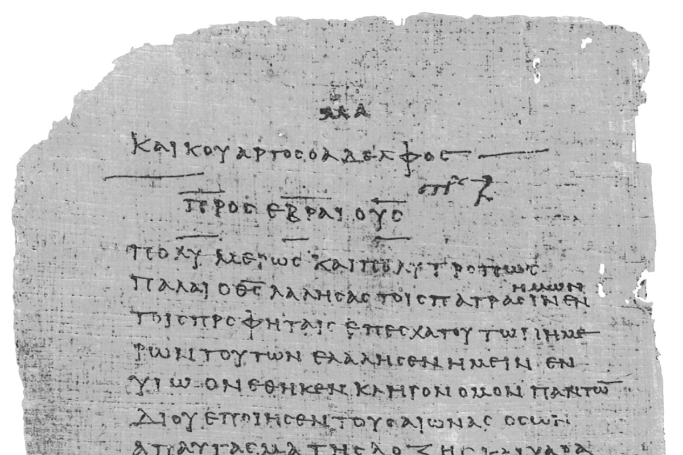
Pharisee Paul’s ἀπολογία to the Hebrews
Ἑβραῖος
Session-7
Hebrews 4:4-11
Paul cites:
Genesis 2
Dr. Dave Newton
© 2025
Figure It Out
Calvary Chapel
Santa Barbara

Slide 2
Pharisee Paul’s ἀπολογία to the Hebrews
Ἑβραῖος “hay-brai-os”
Last Week / Session-6
Paul clearly explains the inheritance waiting at the end of finishing well during
sanctification as he uses a thoroughly Jewish “type” his readers all know and can
relate to: the Passover and Exodus being the Justification “being saved” from sin
followed by the slipping away or outright unbelief that removed the privilege for the Hebrews of entering into God’s “Rest”.
Notes and Video at NewtonFIO.com

Slide 3
Paul’s Bibliography reminder: Romans 15:4 Hebrew Scriptures for OUR benefit!!
2 Samuel 7:12-14 Heb 1:5a
Psalm 2:7 Heb 1:5b
Psalm 104:4 Heb 1:7
Psalm 45:6-7 Heb 1:8-9
Psalm 102:25-27 Heb 1:10-12
Isaiah 34:4-12 Heb 1:12
Psalm 110:1 Heb 1:13
Psalm 8:4-6 Heb 2:5-10
Psalm 22:22 Heb 2:12
Isaiah 8:17 Heb 2:13
Isaiah 8:18 Heb 2:13
Psalm 95:8-11 Heb 3:7-11
Psalm 95:11 Heb. 4:3
Genesis 2:2 Heb 4:4
Psalm 2:7 Heb 5:6
Psalm 110:4 Heb 5:6
Deut. 32:43 Heb 6:1
Gen 22:16-17 Heb 6:14
Psalm 110:4 Heb 7:17
Psalm 110:4 Heb 7:21
Exodus 25:40 Heb 8:5
Jeremiah 31:31-34 Heb 8:7-13, 10:15-18
Exodus 24:8 Heb 9:20
Psalm 40:6-8 Heb 10:5-10
Deut. 32:35 Heb 10:30
Deut. 32:36 Heb 10:30
Habakkuk 2:3-4 Heb 10:37-38
Gen 21:12 Heb 11:18
Prov. 3:11-12 Heb 12:5-6
Deut. 9:19 Heb 12:21
Haggai 2:6 Heb 12:26
Deut. 31:6 Heb 13:5
Psalm 118:6 Heb 13:6

Slide 4
Pharisee Paul’s ἀπολογία to the Hebrews Ἑβραῖος
Reminder from Last Session
Jesus is Far Above/Superior to MOSES
Moses Jesus
- led Israel from bondage - leads from bondage of sin
- led Israel to Canaan - leads to eternal glory
- builds temporary tabernacle - is “the” Tabernacle among men
- sin nature from Adam + Abraham - is entirely without sin
- man of God - is God
- king in Jeshurun [Deut. 33:5] - is King of all kings
- THE prophet spoke God’s Word - is the fulfillment of that Word
- a priest to God [Ex. 24:6] - is our Great High Priest

Slide 5
Last week Q+A? What about ‘backsliding’ . . . still saved?
Old Testament once Jeremiah 49:4 backsliding daughter
New Testament? Mark 14:27 you will all fall away
Galatians 6:1 restore the one caught in sin
James 5:19 if one wanders and you bring him back . . .
Luke 8:13 seed in rocky soil never fully takes root
Heb. 6:4-6 impossible to restore the one who has tasted
of the heavenly gift and shared in the Spirit
but then falls away
Heb. 10:26-31 those who put on a good front then show
who they truly are – is worse for them then
Romans 6:1 sin even more so that grace may abound?
1st John 2:19 they went out from us to demonstrate
they were never really of us
John 10:28-29 whom the Father has given Me
NO ONE can snatch them from My hand

Slide 6
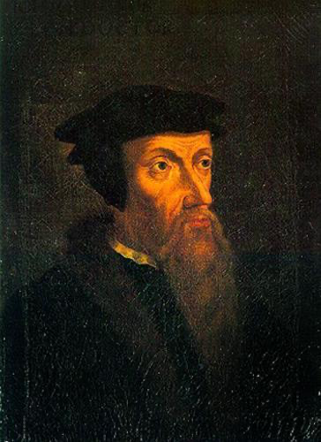
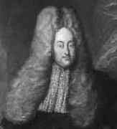
Pharisee Paul’s ἀπολογία to the Hebrews Ἑβραῖος
Can you LOSE your salvation?
French Jean Calvin 1550 “Limited Atonement” “Perseverance” but NO free will
Dutch Jakob Hermann [Latin ‘Arminius] 1715 “Jesus died for ALL”
but some might not Persevere IN free will
1] God’s extra-temporal foreknowledge means He already knows who chooses
2] the ‘Overcomers’ = νικάω nikao
- James 1:12 IF steadfast, stand the test, THEN crown of life
- 1st John 4:4 5:5 who overcomes? The one who BELIEVES in action
- Rev. 3:21 the one who overcomes will sit on my throne
- Rev. 3:5 the one who overcomes clothed in white garments
- John 16:33 Jesus has overcome the world [our model]
- Romans 8:31-39 we are more than overcomers

Slide 7
Last week finished: Hebrews 4:1-3 therefore, let us fear IF while a promise remains
of entering His rest any one of you may seem to have come short of it - for indeed we
have had good news [Gospel] preached to us, just as they did also but the word they
heard did not profit them because it [justified-salvation] not united by faith in those
who heard for we who have believed enter that rest, just as He has said,
“As I swore in My wrath they shall not enter My rest” then this very provocative:
Although His works were finished from the foundation of the world
God's work for our justification salvation was tetelestai ”finished” – an eternal plan for sin
once-for-all as our 'type’ [model] - no need to "work thru your salvation" Philippians 2:12
when after the harpazo we stand at the bema to enter into His Rest = word for inheritance
God's Spirit speaking thru David and thru Paul says emphatically He has set
‘TODAY' to hear His voice - Not looking back at Hebrew history for that eternal rest because
Joshua taking them into the land was still a 'type’ or 'foreshadow’ and not the Rest God
because He's speaking of ANOTHER day after that still future still to come
[coming up in v8-11]

Slide 8
Pharisee Paul’s ἀπολογία to the Hebrews Ἑβραῖος
NOW v 4-7 for He has said in what place concerning the 7th day: ”God rested on the 7th
day from all His works – and again in this passage, “They shall not enter My Rest”
Therefore, since it remains for some [not all] to enter it [God’s Rest] and those who
formerly had good news [Gospel] preached to them failed to enter
because of disobedience [the “IF” contractual conditional]
IF stay strong to the end, finish well, endure . . . REST!
IF because of disobedience . . . then fail to enter
He again fixes a certain day, “TODAY” saying through David after so long a time
just as has been said before, “TODAY IF you hear His voice do not harden your hearts”

Slide 9
v8-11 for if Joshua had given them Rest, He would not have spoken of another day
still future
after that [the enter-Canaan-rest of 1400BC is a “type” of the eternal Rest]
so there remains a Sabbath Rest for the people of God
for the one who has entered His Rest has himself also rested from his works
[Genesis 2 citation: sanctification process will also be finished]
just as God did REST from His work - therefore let us be diligent to enter that Rest
so that no one will fall due to following that same [prior] example of disobedience
Paul linking God’s shabbat rest from Creation directly to
those who could fall/miss out on future Rest due to same disobedience
v10 God’s Invitation to “enter My rest” is a present-tense offer still available ‘TODAY’
those who enter God’s rest have also rested from their work/stay the course in this life
in the very same way that God ceased from His works
v11 so then let us be diligent to enter that rest
Remember Heb. 3:13 para-kleo advocate for one another day after day while it
is still called ‘TODAY’ don’t let your heart be hardened

Slide 10
Pharisee Paul’s ἀπολογία to the Hebrews Ἑβραῖος
BE SURE TO GET THIS:
Had Joshua given them ”the” Rest
then he would not have spoken of another day after that [still future]
Paul lets us know going into Canaan was NOT actual “Rest”
There Remains a Sabbath Rest for the people of God [Paul’s present audience]
Joshua 21:44 the Lord gave them rest on every side according to what
He had sworn to their fathers
Joshua 22:4 and now the Lord has given rest to your brothers as He spoke
Joshua 23:1 after many days when the Lord had given them rest on each side
Paul is very clearly explaining that they all know the Hebrews did
receive ‘rest’ in Canaan, but that is not the Final Rest at all – it is
simply a “type” or “foreshadow” of future: another DAY after that
That “Rest” is still open/available for God’s people [present tense]

Slide 11
Pharisee Paul’s ἀπολογία to the Hebrews Ἑβραῖος
v8-11 therefore let us be diligent to enter that Rest
What is this “Rest”?
Greek word is κατάπαυσις kata-pausis used 8x in Hebrews 3 and 4
ceasing one’s activity/actions, no longer needed
LXX Greek word κληρονομία klero-nomia take possession of inheritance
“Rest” and “Inheritance” are equal!
Pharisee Paul skillfully for believers taking possession of inheritance
Hebrews 10:22-23 believers washed in baptism to hold fast the confession with wavering
Hebrews 10:32-34 remember your former Judaism, then you got saved, and then you
had to endure great suffering, being made a public spectacle and with
open reproaches spoken out against your decision to follow Jesus and
be baptized, and you willingly accepted the confiscation of your homes
and other property, knowing you have BETTER, LASTING possession
still to come!

Slide 12
BIBLCIAL ‘Types’ ‘Foreshadows’ of REST:
Numbers 13-14 enter into inheritance of Canaan [report from 12 Jewish spies]
Paul called out 1st Century AD Hebrews with
‘TODAY’ IF you hear His voice don’t harden hearts
38 years from Kadesh-Barnea until entering Canaan REST
Psalm 95 specific Covenant Promise to David [God’s Creation shabbat REST]
we who have believed enter Rest [Paul + readers past tense believe]
we who shall believe enter [switches to future tense still to come]
Hebrews 4 specific to Hebrew Christian ‘brothers’ [from 12 Jewish Apostles]
Same 38 years as Kadesh-Barnea from Passover in 32 AD until
Jerusalem Temple destroyed in 70 AD
4:2 Gospel preached to us TODAY in 60s AD
same Good News also preached to them 1440 BC
Genesis 2 God rested from His works [past tense historical shabbat rest] and in
THIS place again [present] IF they shall enter [future] into My Rest

Slide 13
Pharisee Paul’s ἀπολογία to the Hebrews Ἑβραῖος
Paul uses the term “REST” for entering/receiving that inheritance
κληρονομία klero-nomia = final inheritance due to someone
This is not shabbat rest from work, taking a break - but arriving at permanent comfort
Heb. 3:9 there remains a σαββατισμός sabbatismos = celebrate God’s Creation
Heb. 4:10 when you enter in you cease from your work as God did from His
Heb 4:11 let us then work/labor to enter that Rest
1st Century AD Hebrews who believed Gospel turned from Judaism got baptized to
identify with Jesus’ resurrection - NO need for keeping the Law
however, many became disillusioned and ’slipped away’ into ‘unbelief’ to return back
to the trying to keep the Law thru religious rituals and works.
The ”REST” promised them is not a temporary break from work, but klero-nomia
RESTING in God’s promise of salvation thru Jesus at Calvary, no works required!
Not sacrifices, diet, circumcision, prayers, washings, feasts, tithes . . . .
But that ”REST” is still contractually conditional on
IF we hold fast our assurance firm until the end

Slide 14
Pharisee Paul’s ἀπολογία to the Hebrews Ἑβραῖος
Paul is entreating them: DON’T GO BACK TO EGYPT!!
1980 album by Keith Green
So you wanna go back to Egypt where it's warm and secure are you
sorry you bought the one way ticket when you thought you were sure You wanted to live in the land of promise but now it's getting so hard Are you sorry you're out here in the desert instead of your own back yard
Eating leaks and onions by the Nile O what breath for dining out in style O, my life's on the skids building the pyramids
In the morning it's manna hotcakes we snack on manna all day and we sure had a winner last night
for dinner flaming manna souffle - so you wanna to back to Egypt where your friends wait for you You can throw a big party and tell the whole gang that what they said was all true
What? Oh no, manna again? Oh, manna waffles Manna burgers Manna bagels? Fillet of manna Manna patty BaManna bread!

Slide 15
Pharisee Paul’s ἀπολογία to the Hebrews Ἑβραῖος
Paul is entreating them: YOU CAN’T GO BACK run the race to the end
stay the course, finish well
Hebrews 10:22-23 believers washed in baptism to hold fast the confession with wavering
verses 32-34 remember your former Judaism, then you got saved, then you had to
endure great suffering, being made a public spectacle with open reproach
spoken against your decision to follow Jesus and be baptized, and you
willingly accepted the confiscation of your homes and other property,
knowing you have BETTER, LASTING possession still to come!
Holding on to Judaism rituals, customs, practices, diet, vows, rites, sacrifices AFTER
having been baptized as a believer in Jesus, many Hebrews were “going back” and
trying to blend in again with traditional Judaism again.
- Acts 20:16 Paul trying to make it back to Jerusalem in time for Pentecost
- 1st Corin. 5:7 clean out the old leaven [of the Pharisees] be a “new lump”
THAT defines Heb. 10:25 Jewish believers had stopped assembling with church

Slide 16
Pharisee Paul’s ἀπολογία to the Hebrews Ἑβραῖος
REMEMBER? Hebrews 3:16-19 3 Questions + 3 Answers
Q1: who provoked God when they had heard?
A1: indeed, did not all those who came out of Egypt led by Moses
Q2: with whom was He angry for 40 years?
A2: those who sinned, whose bodies fell in the wilderness
Q3: to whom did He swear that they would not enter His rest?
A3: but to those who were disobedient, so we see that they were
NOT able to enter because of unbelief
- Paul uses the Exodus as “type” “foreshadow” of justified/saved from bondage of sin
-Then comes “falling away” “unbelief” and consequence of NOT entering in
-They repent and are forgiven - but still lose their inheritance!
-Paul uses the term “REST” for receiving/entering that inheritance
MOSES also did not enter into that rest . . . but he was most certainly saved/justified
because he is present with Jesus and Elijah on the mount [Matthew 17 Mark 9]

Slide 17
Pharisee Paul’s ἀπολογία to the Hebrews Ἑβραῖος
BE SURE of FULL ‘Type’ or ‘Foreshadow’
Literal Hebrews 1400BC Meaning for ‘TODAY’
1. Lamb’s blood covers for sin 1. Jesus the Lamb of God His blood covers sin
2. Put trust in blood and saved 2. Trust in Jesus and by His blood you are saved
3. Leave Goshen bondage of slavery 3. Begin walk away from ‘former life in bondage’
4. Encounter trials, testing of faith 4. Encounter trials, testing of faith
5. No faith, No trust, doubts, anger 5. Keep faith, trust God, no doubt, thankfulness
6. Seriously consider “Going Back” 6. Why would you ever go back to sin?
7. Repent + God forgives 7. Confess sin, He’s faithful and just to forgive
8. Time to inherit: Nothing received 8. At Bema: Nothing received
Caleb and Joshua: Enter In “Well done good and faithful servant”
9. “Rest” awaits at end of journey 9. Salvation-justification is not at end of life
Rewards at Bema from Jesus at end of life
BEFORE Millennium Kingdom begins!
Millennium is not God’s “Rest”

Slide 18
Pharisee Paul’s ἀπολογία to the Ἑβραῖος
NEXT WEEK
Hebrews 4:12-13 [not a typo]
2 Amazing Verses
plus Judgment Seat of Christ

