Slide 1
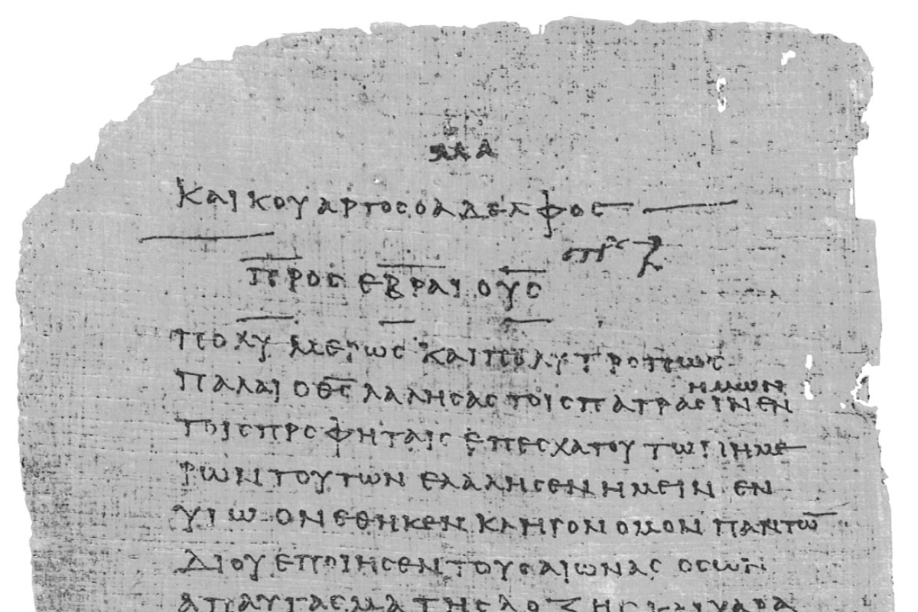
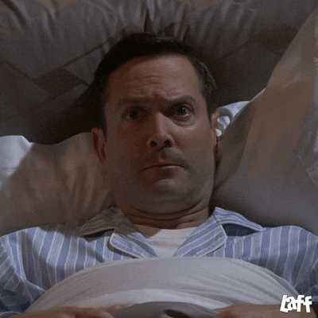
Pharisee Paul’s ἀπολογία to the Hebrews
Ἑβραῖος
Session-8
Hebrews 4:12-13
The WORD of God
and
the Bema βῆμα
Dr. Dave Newton
© 2025
Figure It Out
Calvary Chapel
Santa Barbara

Slide 2
SYNOPSIS of Paul’s ‘Foreshadow” Lesson
HEBREWS 1400BC ‘TODAY’
Saved-Justification
Blood of the Lamb covers, gives life Jesus the Lamb of God His blood covers sin
Saved from Goshen bondage of slavery Saved from former life in bondage of sin
Work-Thru, Growth, Sanctification
Encounter trials, testing of faith Encounter trials, testing of faith
No faith, No trust, doubts, anger Keep faith, trust God, no doubt, thankfulness
Stay the course, rune the race, finish well
Considered “Going Back” Why would you ever go back to sin?
Repent + God forgives Confess sin, He’s faithful and just to forgive
Reward-Inheritance
Time to inherit: Nothing received At Bema: Some receive, others do not
Caleb and Joshua enter In “Well done good and faithful servant”
“Rest” awaits at end of journey

Slide 3
Pharisee Paul’s ἀπολογία to the Hebrews Ἑβραῖος
Last Week Hebrews 4:11 be diligent to enter that rest, so that no one will fall
because of following the same example of disobedience
[see the connection in thought?]
4:12-13 because the word [λόγος = Logos] of God is living and active
sharper than any two-edged sword and
piercing as far as the division of soul and spirit
of both joints and marrow - and
able to judge the thoughts and intentions of the heart
and there is NO creature hidden from His sight but all things
are open and laid bare to the eyes of Him with whom we have to do
Interesting: No Bible in early 60s AD. Gods’ Word Logos is Paul referring to OT and
God’s verbal instruction to the Hebrews thru Moses then Joshua in context
of Passover-Exodus-Canaan “type” or “foreshadow”

Slide 4
Pharisee Paul’s ἀπολογία to the Hebrews Ἑβραῖος
God’s Logos] is living [ζάω Zao verb ‘to live’] and active [gives energy ἐνεργής = energes]
sharper than any [of man’s] 2-edged sword - piercing to the extent of
the partition of soul [ψυχή = psuche] and spirit [πνεῦμα = pneuma]
similar to being able to separate joints and marrow [seem indivisible]
able to judge the thoughts and intentions of the heart
psuche pneuma
1st Thess. 5:23 body σῶμα = soma soul and spirit Uniquely created 3 dimensions
Ephesians 6:17 the sword of the pneuma
2nd Tim. 3:16-17 all Scripture is θεόπνευστος theo-pneustos = God-breathed
ROI for teaching, reproof, correction, training in righteousness
Matt. 4:4 mankind lives on every Word that proceeds from the mouth of God
Psalm 19:7-9 Law of the Lord is perfect, restores the psuche, His testimony is sure,
His precepts are right, commandments are pure
Psalm 119:105 Your Word is a lamp to my feet and a light to my pathway

Slide 5
Pharisee Paul’s ἀπολογία to the Hebrews Ἑβραῖος
FOR 1st Century AD Hebrew Christians
God’s Word is all you need to hear and obey
Follow God’s clear instructions and be blessed
FOR 21ST Century AD Believers
God’s Word is all you need to hear and obey
Follow God’s clear instructions and be blessed
Hebrews 13:8 Jesus the LOGOS is the same yesterday, today, and forever
James 1:17 God has no variance and no shadow of turning
Psalm 138:2 God has magnified His WORD above His own name
CAN YOU IMAGINE IF ISRAEL/HEBREWS DID GOD’S WORD?
YOUR BIBLE IS THE GUIDEBOOK TO “finishing well”
YOUR BIBLE IS YOUR OWNER’S MANUAL ”unto good works”
YOUR BIBLE IS THE MAP “for running the race, enduring to the end”
YOUR BIBLE IS ALL YOU NEED!! [Power of Simplicity Chapter-1]

Slide 6
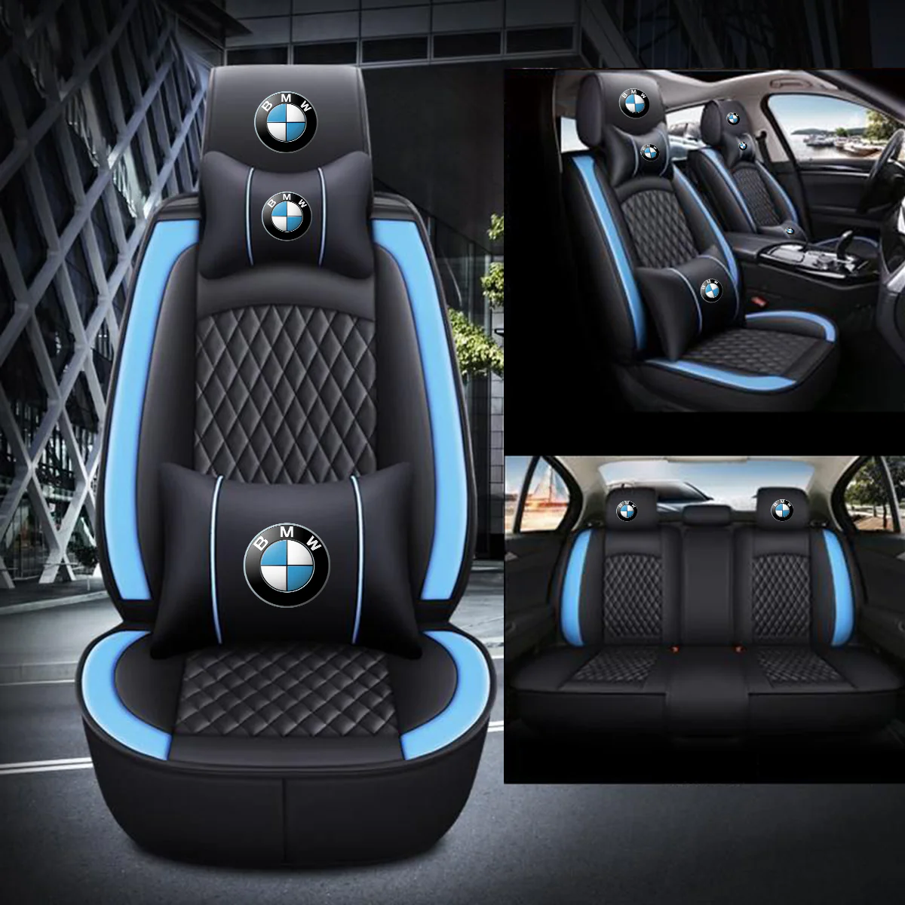
Pharisee Paul’s ἀπολογία to the Hebrews Ἑβραῖος
THE BEMA βῆμα or as they say in Jersey “da Beamer seat”

Slide 7
Pharisee Paul’s ἀπολογία to the Hebrews Ἑβραῖος
THE BEMA βῆμα Linked directly to Paul’s encouragement “finish the race well”
Philippians 3:13-14 I have not yet laid hold of the prize that lies ahead
1st Corinth. 9:24 run toward a final prize [after being saved]
2nd Tim. 4:7-8 finish the course to obtain Crown of Righteousness
God will award it to me On That Day! and not just to
me but to all who loved His appearing [harpazo]
Heb. 12:1 grandstand is packed, all are watching, run race with endurance
1st Corinth. 9:24-25 WE run on Earth to receive corruptible stephanos
but WE run to receive incorruptible stephanos
v26-27 I, Paul, run not with uncertainty but I discipline my body so that
AFTER I have preached to others I will not be disqualified [cast aside]
Paul is not worried about his salvation-justification, that’s sealed!!
What then is Paul worried/concerned about? HIS INHERITANCE

Slide 8
Pharisee Paul’s ἀπολογία to the Hebrews Ἑβραῖος
THE BEMA βῆμα great segue from end of Heb. 4:13
there is NO creature hidden from His sight - such that ALL THINGS
are open and laid bare to the eyes of Him with whom we have to do
we WILL stand before Jesus at the βῆμα
First Let’s Define βῆμα [bay-mah with ‘eta’ - not bee-mah with ‘iota’]
- athletes not punished/reprimanded at bema Always rewarded
- started in Athens, top-step from which you address all βαίνειν bainein
- raised platform/dais with steps [judge stands above recipient]
- center of the city platform-tribunal from which judgments passed/rendered

Slide 9
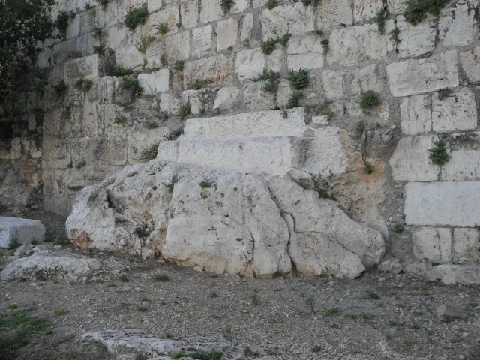
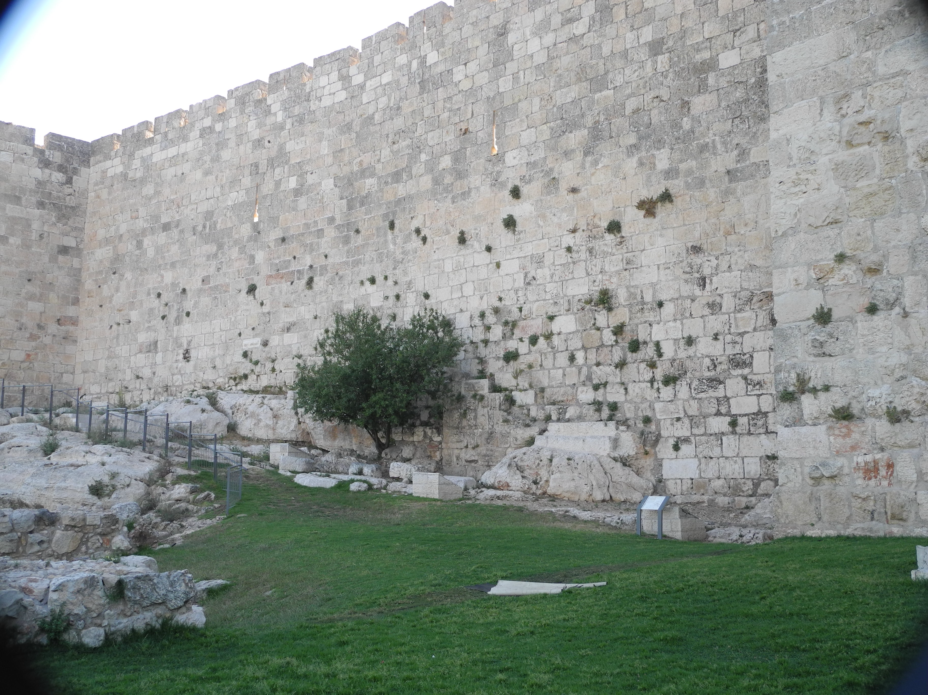
BEMA βῆμα in 1st Century AD
Pilate’s βῆμα at Praetorium
in Jerusalem [Matthew 27:19]

Slide 10
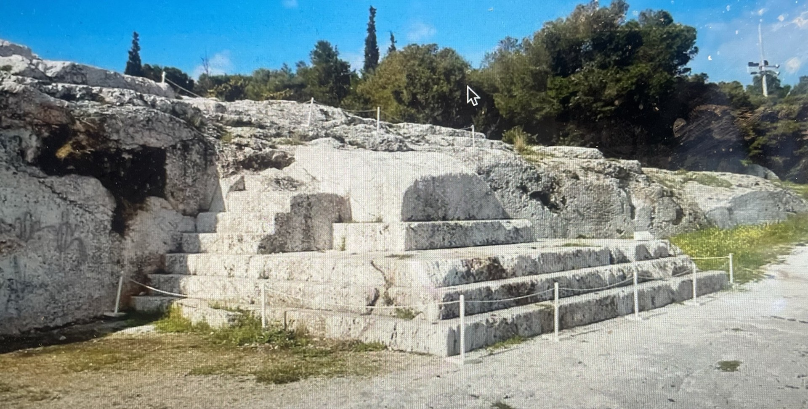
BEMA βῆμα in 1st Century AD
Herod’s βῆμα in Caesarea Maritime
He died on his Jerusalem βῆμα [Acts 12:21]

Slide 11
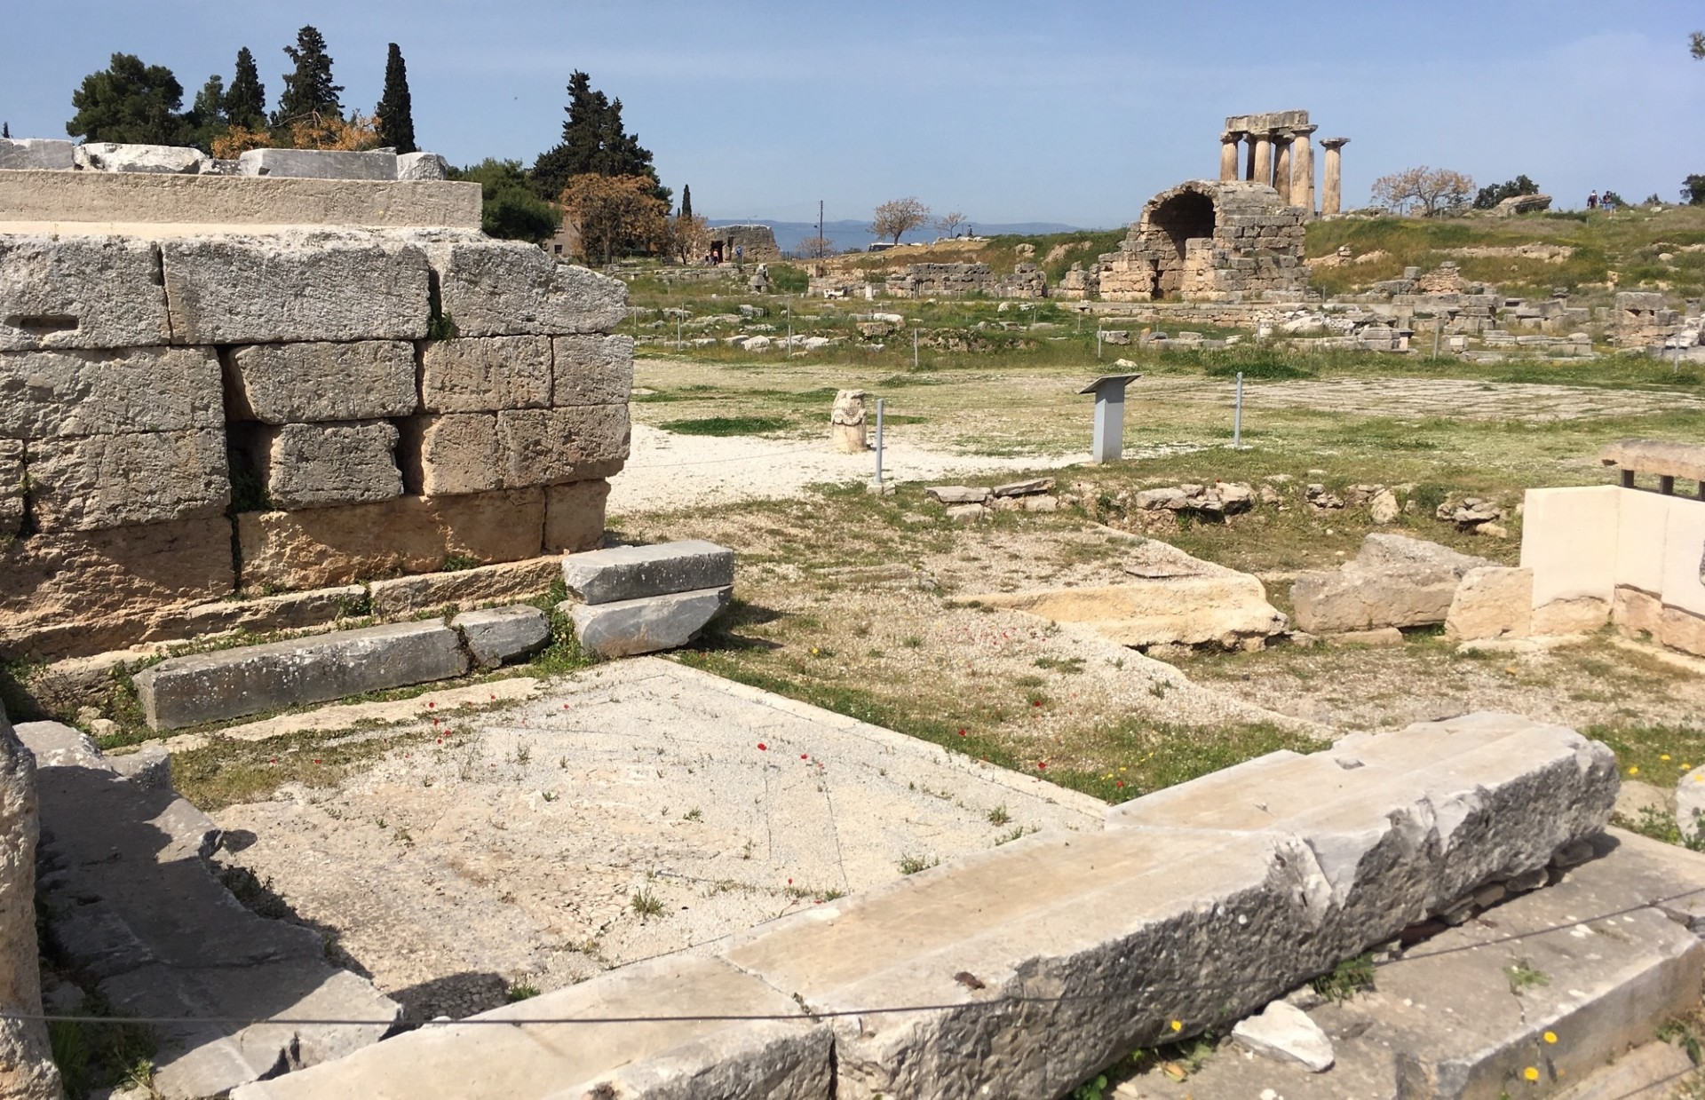
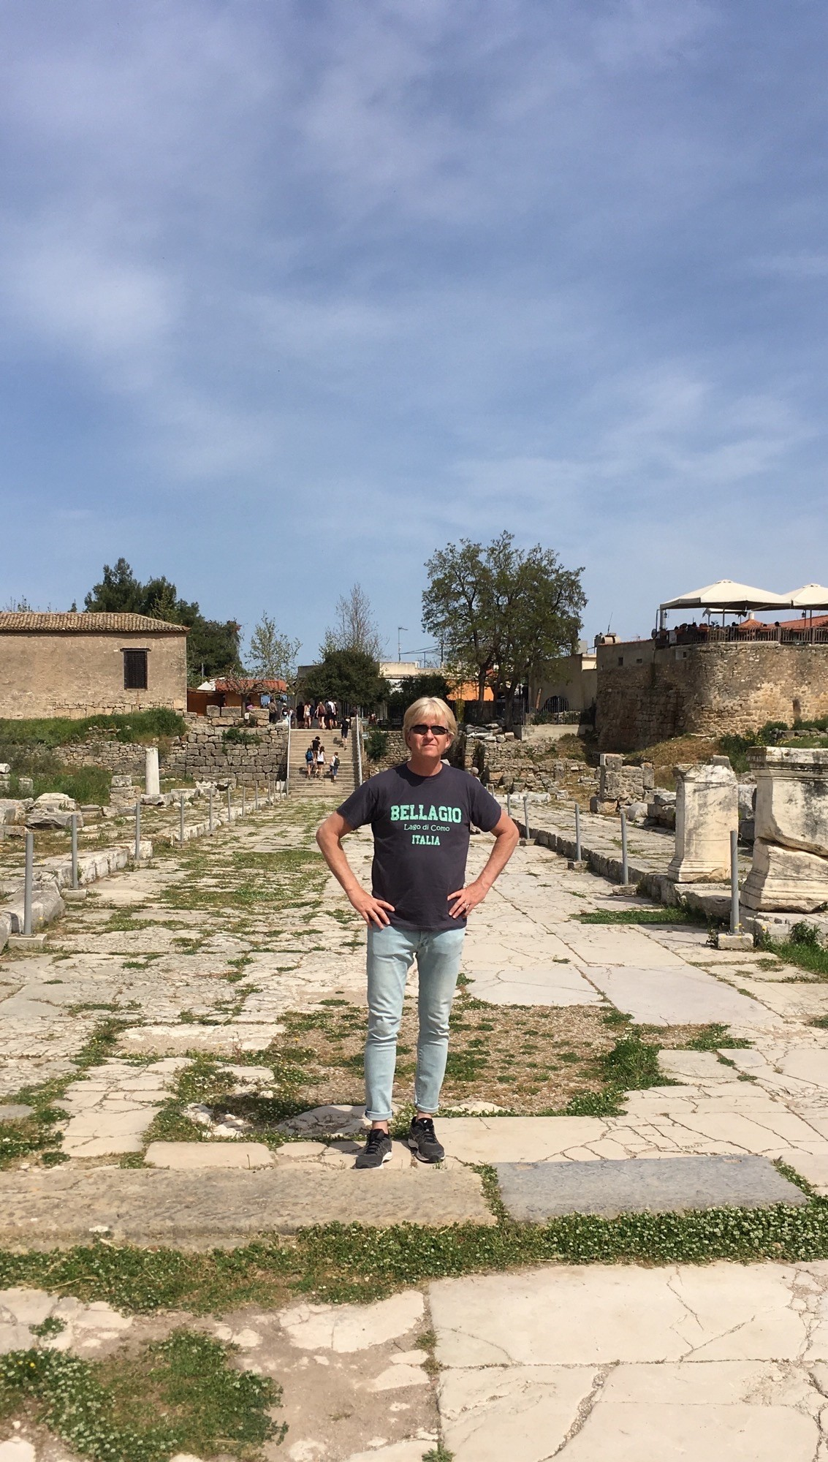
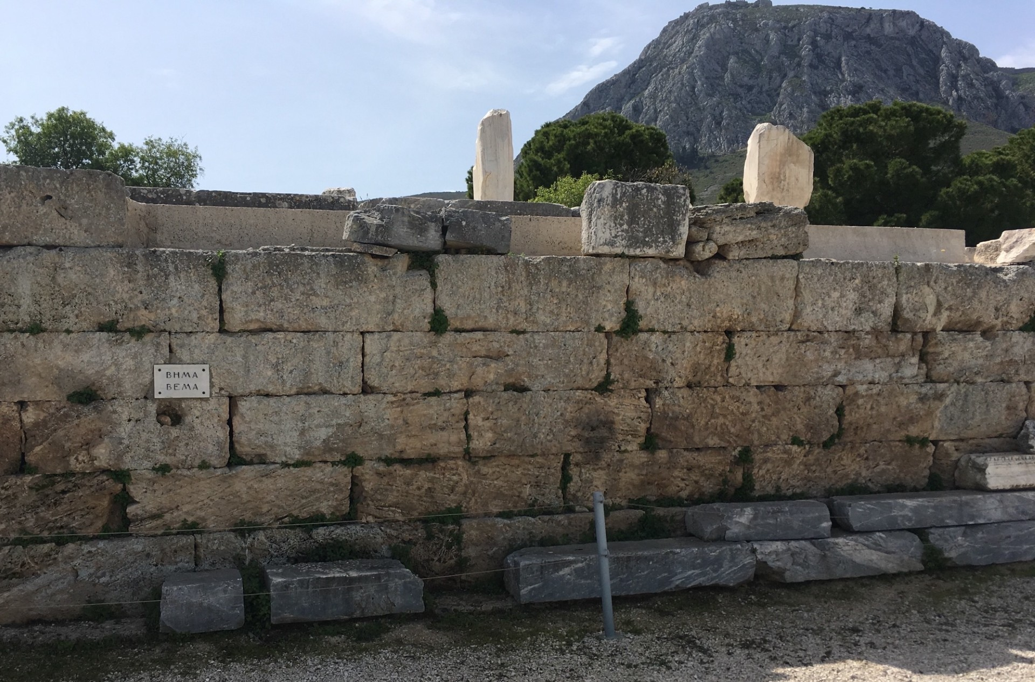
BEMA βῆμα in 1st Century AD
Gallio’s βῆμα in Corinth
[Acts 18:16-17]

Slide 12
Pharisee Paul’s ἀπολογία to the Hebrews Ἑβραῖος
THE BEMA βῆμα
2nd Corinth. 5:1-10 our earthly tent will be torn down, replaced with oikodome
‘building’
from God not made with human hands – we groan and long to be in that
we want to be clothed by God who gave His Holy Spirit as the “down payment”
on our inheritance, but for now we’re in our earthly body absent from the Lord
so we walk now by faith not by sight with good courage, and I’d prefer to be
absent from this body and at home with the Lord
for we [Paul too] must all appear before the βῆμα of Christ so that
each one may be Rewarded for his deeds in the body
according to what he has done whether GOOD or BAD [does it pass the test?]
IT’S NOT ABOUT YOUR SALVATION

Slide 13
THE BEMA βῆμα
Romans 14:10 why do you judge your brother or regard him with contempt?
because WE will all stand before the βῆμα [condition of the heart]
1st Corinth. 3:11-15 No man can lay a foundation other than the one which is laid
which is Jesus Christ - IF any man builds on that foundation [of Jesus] with Gold
Silver, Precious stones, wood, hay, straw then each man’s work will become evident
for That Day will show it because it is to be revealed with fire and the fire itself will
test the quality of each man’s work
1] IF any man’s work which he has built on Remains, he will receive a Reward
2] IF any man’s work is Burned Up he will suffer loss
BUT he himself will be saved yet so as through fire
1st Peter 1:7 the PROOF of your faith though tested by fire will result in
praise, glory, honor at the Revelation of Jesus
IT’S NOT ABOUT YOUR SALVATION

Slide 14
WHAT GETS JUDGED? Stuff you DO? or Condition-Motivation of HEART?
2nd Peter 1:5-8 applying all diligence in your
1] faith supply 2] moral excellence
3] knowledge 4] self-control
5] perseverance 6] godliness
7] brotherly kindness
φιλαδελφία = phila-delphia
8] love
ἀγάπη = agape
Very similar to: Romans 5:3-5 we exult in tribulations that bring
perseverance which brings proven character which brings hope
and hope does not disappoint
IT’S NOT ABOUT YOUR SALVATION

Slide 15
WHAT IS JUDGED? Stuff you DO? or Condition-Motivation of HEART?
IF these qualities are yours and are increasing in you [once again the heart]
THEN they render you neither: a] useless nor b] unfruitful in the true
knowledge of our Lord Jesus Christ
Galatians 5:22-23 fruit-evidence of His Holy Spirit is love, joy, peace, patience,
kindness, goodness, gentleness, faithfulness, self-control [again, the heart]
James 2:18 show me faith with no works? I’ll show my faith BY MY WORKS!

Slide 16
REWARDS? Dr. Newton’s 20+
2nd Peter 1:9-11 he who lacks these qualities is blind or short-sighted, having
forgotten his purification from his former sins - therefore, Hebrew brethren, be all
the more diligent to make certain about His calling and choosing you
IF you practice these things THEN you will never stumble
for in this way the entrance into the eternal kingdom of our
Lord and Savior Jesus Christ will be abundantly Rewarded to you
Colossians 3:23-24 do everything as unto the Lord and not for man, knowing that
you will receive the Inheritance as your Reward
2nd John 8 do not lose what you have already done so you’ll receive FULL Reward
2nd Tim. 4:8 Jesus the righteous judge will Reward my Crown on That Day!

Slide 17
REWARDS? Dr. Newton’s 20+
Matt. 5:12 rejoice and be glad when ridiculed-persecuted for My sake
for your Reward will be great!
Luke 6:22-23 you are blessed when men hate, ostracize, insult you, call you evil for
the Lord’s sake, be GLAD and leap for joy because
your Reward is great in heaven!
6:35 love your enemies, do good, lend expecting nothing in return,
and your Reward will be great!
Mark 9:41 give a cup of water to a follower of Christ will not lose his Reward

Slide 18
REWARDS? Dr. Newton’s 20+
Luke 14:14 invite guests - blind, lame, poor, crippled - you will be blessed because
they cannot repay - you will be Repaid at the resurrection of the just!
Hebrews 10:34-35 you showed sympathy to the prisoners and accepted joyfully
the persecution, so do not throw away this confidence
which has a great Reward
Matt. 6:4-6 regarding tithing, fasting, prayer, your Father in Heaven who sees what
is done in secret will Reward you [do it to be seen and that’s your reward]
Titus 3:8 trustworthy statement, engage in good deeds, they are PROFITABLE
Matt. 16:19-21 Store up Treasure in Heaven, no thieves, no moths, no rust
where your Treasure is there will your heart be also

Slide 19
REWARDS? Dr. Newton’s 20+
2nd John 8 watch yourselves that you do not lose what we have accomplished
but that you may receive the FULL Reward
1st Corinth. 4:1-2 we are servants of Christ and stewards of the mysteries of God
and it is required of Stewards to be found trustworthy
Rev. 3:11 behold I AM coming quickly, so hold fast to what you have
that no one may take Your Crown
Rev. 22:12 behold I AM coming quickly and My Reward is with Me
Isaiah 62:11 your salvation comes and His Reward is with Him
Rev. 3:4-5 those who have not soiled their garments will walk with Me
in white - he who overcomes will be clothed in white
2nd Tim. 2:12 IF we endure THEN we will Reign with Him
Rev. 3:21 he who overcomes I will Reward him to sit with Me on my throne

Slide 20
BEMA βῆμα - where Bride is called out from the “saved” believers [true ‘Church’]
to be presented to the Groom [Jesus]
Rev. 19:7-8 the marriage has come - bride [Church] has made herself ready
granted to her to be in fine linen clean and bright – this fine linen
is the righteous acts of the saints [Rev. 3:4-5 in “white”]
Rev. 16:15 blessed who stays awake - keeps spiritual clothes - is not naked
Gen. 2:21-23 bride Eve taken from Adam the Groom’s body “foreshadow’
Gen. 24:24 Eleazar [“type” of Holy Spirit] selects Isaac’s bride
from among his OWN people
24:65 Rebekah covers herself with her veil [she does this, HER veil]
1st John 2:28 abide in Jesus so when He returns - don’t hide in naked shame

Slide 21
THE BEMA βῆμα Bride called out from the “saved” believers [true ‘Church’]
to be presented to the Groom [Jesus]
Ruth 3:3 as the Bride [as “type” “foreshadowing”]
a] She washes Eph. 5:25-26 wife is washed by the WORD
b] She anoints with oil Matt. 25:1-13 need oil to enter wedding feast
c] She puts on her OWN very best clothing [She does all these – Her actions]
Rev. 3:18 Jesus advises buy gold from Him and white garments to be fully clothed
Matt. 22:1-14 only those selected attend the marriage feast

Slide 22
WHEN? and WHERE? The Timing Sequence . . .
1] Harpazo with “every tribe, tongue, nation, people” in Heaven
2] Marriage Jesus [Groom] and the Church [Bride] in Heaven
3] The Bema βῆμα. in Heaven Rewards include “Reign with Jesus”
[logical segue into Millennium Kingdom]
1st Corin. 4:5 don’t pass judgment before THE Time, wait ‘til Lord comes
He’ll bring to light what’s hidden and DISCLOSE MOTIVES of HEARTS
then each person’s commendation will come from God!
4] The 2nd Coming Jesus returns to Earth with His Church
5] Marriage Feast 10 virgins [on Earth] - Israel ready after Tribulation”
6] Millennium Kingdom 10 Centuries on restored Earth

Slide 23
The BEMA βῆμα seems to be for post-Calvary believers
During OT pre-Calvary only the “promise” of Mashiach to Abraham
Romans 4:3 Galatians 3:6 James 2:6 Abraham belief = righteousness
Luke 16 explains all who died pre-Calvary went to Sheol “abode of the dead”
many believed in same way Abraham believed
1st Peter 3:19 Jesus descended and preached to those in Sheol
Ephesians 4:9 Jesus descended to Sheol and delivered those waiting for Messiah
- OT believers in promise to Abraham did not have Holy Spirit down payment on their
redemption, could not exhibit Fruit of the Spirit [2nd Peter 1 and Galatians 5]
- Their earthly life did not have sins covered at Calvary and grace bestowed – could not
“walk in the Spirit” of faithful works - they simply believed God’s still-future “promise”
- At physical death, not absent from body present with the Lord [Sheol] so they cannot
stand at bema before Jesus to give account of their lifetime’s spiritual stewardship
BELIEVERS AFTER CALVARY ARE RESPONSIBLE FOR THIS

Slide 24
Pharisee Paul’s ἀπολογία to the Hebrews Ἑβραῖος
CAREFUL!!! The TREE and Fruit not bema
Matt. 7 full context: v15ff false teachers, wolves in sheep’s clothing are
coming who say all the terms and catch-phrases
Matt. 7:21-23 Not everyone who says to Me “Lord, Lord” will enter
the kingdom of heaven - but he who does the will of My Father who is in Heaven
will enter - many will say to Me on THAT DAY:
“Lord, Lord” did we not prophesy in Your name and
in Your name [Lord Lord] cast out demons, and
in Your name [Lord Lord] perform many miracles? [nothing about Word]
Then I will declare to them “I Never Knew You so now depart from Me
you who practice lawlessness”
This is about FALSE PROPHETS & TEACHERS!!

Slide 25
CAREFUL!!! the Marriage Feast not bema
Matt. 25:1-13 Ten virgins awaiting the Groom + Bride
[Jewish believers came thru Tribulation awaiting Jesus’ 2nd Coming]
This is about Israel prepared for Marriage Supper of Lamb
the Banquet Invitations not bema
Matt. 22:1-14 King gives feast and invitations to attend, but invitees have no regard
King’s prophets killed by invitees, so He judges them and
sends invites out to all evil and good to fill wedding hall
But King finds those without proper wedding clothes – they are bound
and thrown into outer darkness – MANY are called, few are chosen
NJ Presbyterian church: “Many are cold, but few are frozen”
True meaning: Many invited but far fewer choose to attend
Luke 24:16-24 similar invitees have excuses so 2nd invite goes out to all and none of
those originally invited will taste of that feast
These are about ISRAEL REJECTING God’s Word and Prophets

Slide 26
CAREFUL!!! The Talents [just after the 10 virgins] perhaps not bema
Matt. 25:14-30 Master entrusts stewardship of 10 talents, 5 talents, and 1 talent
different distribution as He wills
Context of Chaps. 24-25 = Israel thru Tribulation before the 2nd Coming of Jesus
- two faithful stewards are rewarded
- unfaithful steward is chastised and punished
Luke 19:11ff Master departs and entrusts minas to His bondslaves
until He returns – Those faithful in this, even more given to them
v27 Master kills these enemies “who do not want Me to reign over them”
BOTH parables end in death of irresponsible servant [NOT believers at Bema]
Instead same as Matt. 25:32-33 sheep and goats separated by God
to Sheep: “Inherit the kingdom prepared for you”
to Goats: “Depart from me to eternal fire prepared for Satan, angels”
In direct context of “good works” to: hungry thirsty stranger naked sick imprisoned
MORE DETAILS ON THESE PARABLES NEXT WEEK

Slide 27
Pharisee Paul’s ἀπολογία to the Ἑβραῖος
NEXT WEEK
Biblical Definitions
of ‘Our Inheritance’
5 CROWNS
RULING WITH JESUS
and other Judgments

