Slide 1
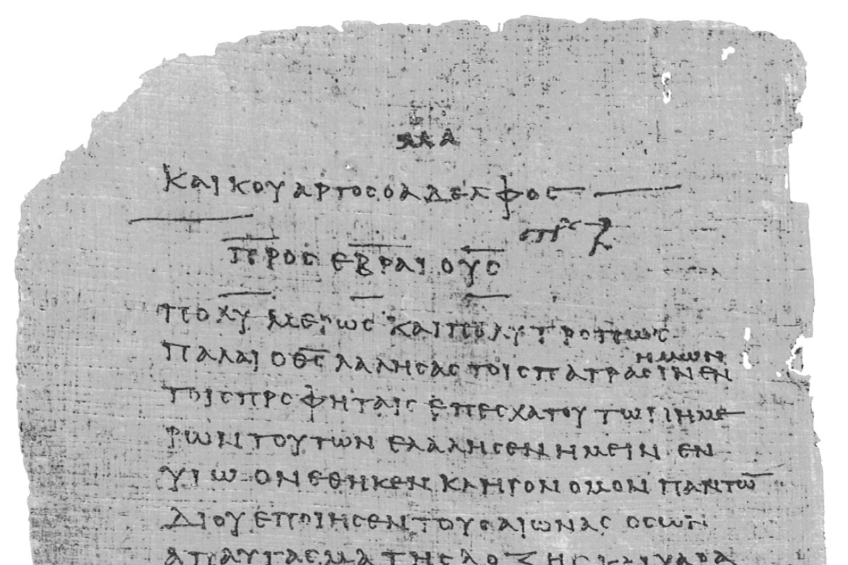
Pharisee Paul’s ἀπολογία to the Hebrews
Ἑβραῖος
Session-9
Biblical Definitions
of ‘Our Inheritance’
- 5 CROWNS
- RULING WITH JESUS
and other Judgments
Dr. Dave Newton
© 2025
Figure It Out
Calvary Chapel
Santa Barbara

Slide 2
Pharisee Paul’s ἀπολογία to the Hebrews Ἑβραῖος
Last Week Hebrews 4:12-13 God’s WORD and the BEMA βῆμα
Tonight - 2 things happen at the Bema: 1] Our works and motives “tested by fire”
2] Rewards given by the Lord for “tested”
“My Reward is with Me” Rev. 22:12
Scriptures about His Reward
2nd Peter 1:9-11 Colossians 3:23-24 2nd John 8
2nd Timothy 4:8 Matthew 5:12 Matthew 9:41
Luke 6:22-23 Luke 6:35 Luke 14:14
Hebrews 10:34-35 Matthew 6:4-6 Titus 3:8
Matthew 16:19-21 1st Corinth. 4:1-2 Rev. 3:11
Revelation 3:4-5 Revelation 22:12 2nd Tim. 2:12
Revelation 3:21 1st Corinth. 9:24-27 2nd Corinth. 5:1-10
1st Corinth. 3:11-15

Slide 3
Pharisee Paul’s ἀπολογία to the Hebrews Ἑβραῖος
Last Week Hebrews 4:12-13 God’s WORD
and the BEMA βῆμα This is NOT judgment of sin
Romans 8:1 there is NO condemnation for those who are in Christ
Psalm 103:12 our sin is REMOVED as far as the East is from the West
Tonight: What is the “Inheritance”? What are the “Rewards” ?
We’re saved from wrath when He judges sin Romans 5:9
We’re not destined for wrath but for inheritance 1st Thess. 5:9
Great JOY standing before the Lord in resurrection bodies, YET
there could be tears because of regret over lost opportunities in life
Rev. 21:4 Jesus will wipe away every tear from our eyes
1st John 2:28 at the harpazo we want to have confidence and
not shrink/cower away from Him in shame

Slide 4
Pharisee Paul’s ἀπολογία to the Hebrews Ἑβραῖος
The best part? Your inheritance comes without any cost to you:
- No legal fees - No intermediary transaction fees
- No finder’s fees - No management fees
And NO taxes of any kind. Everything for sin has already been paid
Romans 8:17 if children of God then fellow-heirs with Jesus
Ephesians 3:6 Gentiles are now fellow heirs, partakers of the Promise
Rev. 4:1 meta-tauta then a door opened in Heaven and [harpazo]
“Come up here and I will show you the things that WILL take place”
AFTER harpazo, Marriage at throne, then the Bema, I might ask,
“How did you do with the time you still had in 2025 and beyond?”

Slide 5
Pharisee Paul’s ἀπολογία to the Hebrews Ἑβραῖος
The ONLY Basis for our “works” . . .
Ephesians 2:10 we are His workmanship created for Good Works!
1. GOD’s Plans not our own
1st Corinth. 3:9-10 we are God’s building, and on that foundation
another builds on that, but take heed
in HOW you build
2. GOD’s Foundation not the world’s
1st Corinth. 3:11 you cannot lay any other foundation except that
which is laid which is Jesus Christ
3. GOD’s Motives not the world’s
1st Corinth. 3:12-13 build with gold, silver, precious stones vs.
wood, hay, chaff-stubble, when these are tested
by fire it will reveal eternal value or not

Slide 6
Pharisee Paul’s ἀπολογία to the Hebrews Ἑβραῖος
THE 3 TYPES OF REWARDS
Jesus’ statements to the 7 churches
A. νικάω nikao = overcomer 1st John 5:4-5 Romans 8:37
Ephesus Rev. 2:7 you will eat from Tree of Life in Rev. 22:2, 14, 19
Smyrna Rev. 2:11 will not be hurt by the second death
Pergamum Rev. 2:17 will receive hidden manna and a white stone
with a new name
Thyatira Rev. 2:26 I will give you authority over the nations
Sardis Rev. 3:5 will be clothed in white garments
Philadelphia Rev. 3:12 will be a pillar in God’s final Temple
Laodicea Rev. 3:21 I will grant him to sit with Me on My Father’s throne

Slide 7
to Pergamum Rev. 2:17 will receive hidden manna [what is this?]
John 6:48-58 I AM the bread of life, your fathers ate manna in the
wilderness and they died, this is the bread from heaven you eat
and don’t die, I AM that living bread from heaven, whoever eats
it will live forever [manna in the Exodus a “foreshadow” of Jesus]
Apocalyptic [Revelation] literature uses provocative imagery to illustrate truths
“hidden” is κρύπτω krypto = concealed [cryptography, encrypted = ”not for all”]
connotes it is exclusive for believers in Jesus, unbelievers do not partake of it
white stone λευκός leukos = brilliant light [numerous attempted explanations]
with a new name Greek-Roman victors at the games awarded a diamond-like stone
with their name inscribed [clearly another Reward ]
- Believers will be spiritually sustained by partaking in Jesus for all eternity
and the ‘new name’ refers to the adopted-standing as fellow heir/child of God

Slide 8
Pharisee Paul’s ἀπολογία to the Hebrews Ἑβραῖος
THE 3 TYPES OF REWARDS
B. Jesus has designated 5 unique “Crowns” to be granted at His discretion.
These are referred to with the Greek term stephanos that describes a circular
wrapped-wreath of leaves Awarded to the winner of an event
[not the diadem crown that is worn by a King as a Royal Ruler]
C. Bible also speaks whether a person will/will not Rule with Jesus in Millennium
Revelation 2:26-27 will rule with Jesus in His kingdom
Revelation 3:21 Jesus will reward overcomer to sit down with
Him on His throne, even as Jesus overcame

Slide 9
B. Stephanos No. 1
Crown of Righteousness στέφανος δικαιοσύνη stephanos dikai-ozone
purity from any form of sin
2nd Tim. 4:7-8 I have fought the good fight,
I have finished the course [race]
I have KEPT the faith so that in the future is stored for me
the Crown of Righteousness, which the Lord
“the righteous Judge” [at Bema] will Reward me ON THAT DAY!
and not just to me [Paul] but also to all
those who have loved His appearing Maranatha!
100% convinced in soon return of Jesus! Rewarded for that faith + finish.
1st Tim. 4:8 bodily discipline [exercise] has little [limited] profit
but godliness is profitable unto all things,
it holds “Promise” for this present life and also
for the Life still to Come

Slide 10
Pharisee Paul’s ἀπολογία to the Hebrews Ἑβραῖος
B. Stephanos No. 2
Crown of Life στέφανος ζωή stephanos zo-ay
James 1:12 blessed is the one who perseveres under trial for once approved
he will receive the Crown of Life “Promised” to those who love Him
Revelation 2:10 do not be fearful about what you are about to suffer
you will be imprisoned and tested
you will have tribulation, so be faithful unto death,
then I will give you the Crown of Life
These speak of being tried, tested, suffering BUT persevering without fear
Those who demonstrate holding fast OVERCOME earthly life and physical death
to eternal life Receiving that stephanos zoa – life that has no end!

Slide 11
Pharisee Paul’s ἀπολογία to the Hebrews Ἑβραῖος
B. Stephanos No. 3
Crown of Glory στέφανος δόξα stephanos doxa = glory/splendor
[doxology: “glory be to the Father . . . “]
1st Peter 5:1-4 shepherd the flock with love, have oversight not out of compulsion
but voluntarily as per the Will of God, and never for sordid gain
but serve with eagerness, and don’t lord your position of authority
over those allotted to your charge, but be an example to the flock
and then when the Chief Shepherd appears, you will receive
the unfading Crown of Glory
Those humble servant-leaders shepherding God’s people in His
absence, in the same loving manner as the Lord! [not just ‘pastors’]
Ephesians 6:7-8 serve others as unto the Lord, and whatever good
you do, this you will receive back from the Lord

Slide 12
Pharisee Paul’s ἀπολογία to the Hebrews Ἑβραῖος
B. Stephanos No. 4
Crown of Exultation στέφανος stephanos of pure rejoicing-joy-happiness
Rejoicing in fruit of evangelism
1st Thess. 2:19 who is our hope, our joy, our Crown of Exultation?
it is YOU [who believed] when we see you in the presence of
the Lord Jesus at the harpazo . . . YOU are our glory and joy
[those who believe because of your witness/testimony]
Philippians 4:1 therefore YOU are my beloved brothers in Christ,
whom I long to see, YOU are my joy and my Crown
Those who evangelize, spread the Gospel, rejoice in people coming to Jesus

Slide 13
Pharisee Paul’s ἀπολογία to the Hebrews Ἑβραῖος
B. Stephanos No. 5
Incorruptible Crown ἄφθαρτος στέφανος aphithartos stephanos immortal!
1st Corinth. 9:25 everyone who competes demonstrates self-control in
in all things – here on earth they do so for a
perishable stephanos [corruptible crown]
but we compete for an imperishable stephanos [incorruptible]
Everything in this world is temporal, corruptible, perishable
All that one does that has an ETERNAL ROI is incorruptible and imperishable
Store up for yourself “treasures in heaven”
You are a believer [saved] but all you do is for the wrong reasons!
OR your motives are pure, as unto Jesus Colossians 3:23-24
whatever you do, work at it with your whole heart, as unto
the Lord and not for the praise of men

Slide 14
Pharisee Paul’s ἀπολογία to the Hebrews Ἑβραῖος
C. Ruling with Jesus in the Millennium
Rev. 2:26 I will give authority over the nations
Rev. 5:9-10 You have made them to be a kingdom and priests to our God
and they will reign upon the Earth
Rev. 3:21 I will grant him to sit with Me on My Father’s throne
1st Cor. 6:1-3 the saints will judge the world, we will also judge angels
Rev. 20:6 these will be priests of God and Christ
and they will reign with Jesus for 1,000 years
Daniel 7:27 the kingdom and dominion given to the people the saints of the
Most High whose kingdom is everlasting

Slide 15
Pharisee Paul’s ἀπολογία to the Hebrews Ἑβραῖος
C. Ruling with Jesus in the Millennium
Luke 22:28-30 you will sit on thrones judging the 12 tribes of Israel
2nd Tim. 2:12 if we endure will will also reign with Him
Galatians 4:7 you are not a slave but a son and God has made you an heir
Matt. 5:21 you were faithful with a few things, I will put you in charge of many

Slide 16
Pharisee Paul’s ἀπολογία to the Hebrews Ἑβραῖος
- Your Inheritance is on reserve OUTSIDE this temporal realm
This is where you store up additional, compounded future value
100% risk-insured against fraud, forgery, theft, or transfers of any kind
[1st Peter 1:4 it is imperishable - undefiled - will not fade away]
- Consider earthly assets with their values, and then compare those to the
Rewards of your INHERITANCE and you’ll understand the perspective of
HOW shall we live? - from the Pharisee Saul from Tarsus:
“for me to live is Christ, and to die is gain” Philippians 1:21
- Hebrews 12:2 “Turn your eyes upon Jesus, look full in His wonderful face
and the things of Earth will grow strangely dim
in the light of His glory and grace” [Helen Lemmel, 1922]

Slide 17
Pharisee Paul’s ἀπολογία to the Hebrews Ἑβραῖος
JUDGMENTS in the Bible
1. Bema believers ‘good’ works OR works for wrong motives
2. Sheep and Goats Matt. 5:23-46 after the Tribulation, Jesus separates
those who come thru that horrific time on Earth based on those who had
faith and showed ‘good’ works toward Israel after the abomination
hungry, thirsty, stranger, naked, sick, imprisoned
“When you did it to the least of these my Hebrew brothers”
Goats repaid for their deeds/works that were bad”
Sheep rewarded for their deeds that were “good”
3. Great White Throne Rev. 20:11 books opened and Book of Life
sinners finally judged to eternal separation from
God - exactly what they always wanted

Slide 18
Pharisee Paul’s ἀπολογία to the Hebrews Ἑβραῖος
CAREFUL!!! The TREE and Fruit not bema
Matt. 7 full context: v15ff false teachers, wolves in sheep’s clothing are
coming who say all right terms and catch-phrases
Matt. 7:21-23 Not everyone who says to Me “Lord, Lord” will enter
the kingdom of heaven - but he who does the will of My Father who is in Heaven
will enter - many will say to Me on THAT DAY:
“Lord, Lord” did we not prophesy in Your name and
in Your name [Lord Lord] cast out demons, and
in Your name [Lord Lord] perform many miracles? [nothing about Word]
Then I will declare to them “I Never Knew You so now depart from Me
you who practice lawlessness”
This is about FALSE PROPHETS & TEACHERS!!

Slide 19
CAREFUL!!! the Marriage Feast not bema
Matt. 25:1-13 Ten virgins awaiting the Groom + Bride
[Jewish believers came thru Tribulation awaiting Jesus’ 2nd Coming]
This is about Israel prepared or not for Marriage Supper of Lamb
the Banquet Invitations not bema
Matt. 22:1-14 King gives feast and invitations to attend, but invitees have no regard
King’s prophets killed by invitees, so He judges them and
sends invites out to all evil and good to fill wedding hall
But King finds those without proper wedding clothes – they are bound
and thrown into outer darkness – MANY are called, few are chosen
NJ Presbyterian church: “Many are cold, but few are frozen”
True meaning: Many invited but far fewer choose to attend
Luke 24:16-24 similar invitees have excuses so 2nd invite goes out to all and none of
those originally invited will taste of that feast
These are about ISRAEL REJECTING God’s Word and Prophets

Slide 20
CAREFUL!!! The Talents [just after the 10 virgins] not bema
Matt. 25:14-30 Master entrusts stewardship of 10 talents, 5 talents, and 1 talent
different distribution as He wills
Context of Chaps. 24-25 = Israel thru Tribulation before the 2nd Coming of Jesus
- two faithful stewards are rewarded
- unfaithful steward is chastised and punished
Luke 19:11ff Master departs and entrusts minas to His bondslaves
until He returns – Those faithful in this, even more given to them
v27 Master kills these enemies “who do not want Me to reign over them”
BOTH parables end in death of irresponsible servant [NOT believers at Bema]
Instead same as Matt. 25:32-33 sheep and goats separated by God
to Sheep: “Inherit the kingdom prepared for you”
to Goats: “Depart from me to eternal fire prepared for Satan, angels”
In direct context of “good works” to: hungry thirsty stranger naked sick imprisoned

Slide 21
Pharisee Paul’s ἀπολογία to the Ἑβραῖος
NEXT WEEK
Hebrews 4:14 thru 5:6
Cites Psalms 2:7, 110:4
Infers Psalm 139:7-12

