Slide 1
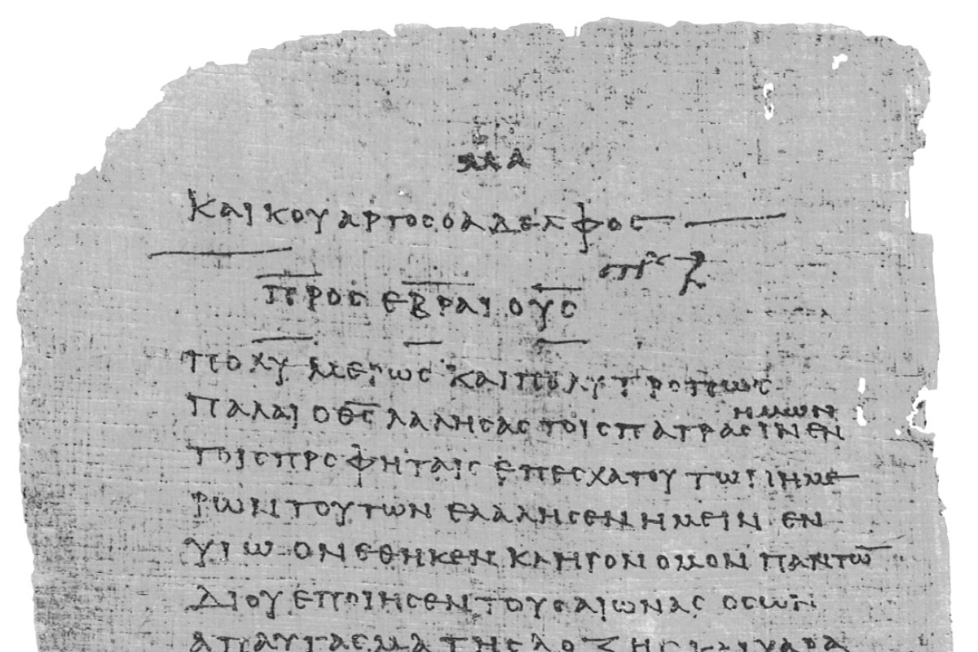
Pharisee Paul’s ἀπολογία to the Hebrews
Ἑβραῖος
Dr. Dave Newton
© 2025
Figure It Out
Calvary Chapel
Santa Barbara

Slide 2
Pharisee Paul’s ἀπολογία to the Hebrews
Ἑβραῖος “hay-brai-os”
Tonight’s Study:
A. Background on Saul/Paul of Tarsus who was also known as Paul [Acts 13:9]
The résumé of a very learned highly-educated Pharisee
B. Overwhelming evidence that Paul is the author of Hebrews
12 Reasons that only Paul could write this epistle

Slide 3
Pharisee Paul’s ἀπολογία to the Hebrews Ἑβραῖος
The Readers: Clearly written “Hebrews” Ἑβραῖος
”to the Hebrews” κατά Ἑβραῖος in the earliest existing copies
The Pivot [first 2 verses]
1st Peter 1:10-12 Fall 2024 "prophets who prophesied” Isaiah Jeremiah Ezekiel
Paul reminds his Jewish readers [already believers] a very clear segue:
God, AFTER He spoke long ago to the fathers in the Prophets
[who prophesied] in many portions and in many ways
has NOW in these Last Days spoken to us in His Son Jesus, whom He
appointed Heir of all things thru whom He also made the world
No Longer Any Need for Prophets
God has come to mankind in the Person of Jesus to fulfill EVERYTHING
from the Hebrew Scriptures

Slide 4
Pharisee Paul’s ἀπολογία to the Hebrews Ἑβραῖος
The Prophets KNEW This!
Peter clearly states that Isaiah Jeremiah Ezekiel Daniel Amos Joel Malachi
ALL were fully aware that what they spoke and wrote down was NOT for them
but for those AFTER Messiah had come!
Saul of Tarsus KNEW Hebrew Scriptures Torah [memorized] - Psalms - Prophets
so he is going to use 40 separate citations from these to craft his amazing
apologia that Jesus is in fact Israel’s Maschiach [“Anointed One”].

Slide 5
Paul’s Bibliography
2 Samuel 7:14 Heb 1:5a
Psalm 2:7 Heb 1:5b
Psalm 104:4 Heb 1:7
Psalm 45:6-7 Heb 1:8-9
Psalm 102:25-27 Heb 1:10-12
Psalm 110:1 Heb 1:13
Psalm 8:4-6 Heb 2:5-10
Psalm 22:22 Heb 2:12
Isaiah 8:17 Heb 2:13
Isaiah 8:18 Heb 2:13
Psalm 95:7-11 Heb 3:7-11
Psalm 95:11 Heb. 4:3
Genesis 2:2 Heb 4:4
Psalm 2:7 Heb 5:6
Psalm 110:4 Heb 5:6
Deut. 32:43 Heb 6:1
Gen 22:16-17 Heb 6:14
Psalm 110:4 Heb 7:17
Psalm 110:4 Heb 7:21
Exodus 25:40 Heb 8:5
Jeremiah 31:31-34 Heb 8:7-13, 10:15-18
Exodus 24:8 Heb 9:20
Psalm 40:6-8 Heb 10:5-10
Deut. 32:35 Heb 10:30
Deut. 32:36 Heb 10:30
Habakkuk 2:3-4 Heb 10:37-38
Gen 21:12 Heb 11:18
Prov. 3:11-12 Heb 12:5-6
Deut. 9:19 Heb 12:21
Haggai 2:6 Heb 12:26
Deut. 31:6 Heb 13:5
Psalm 118:6 Heb 13:6

Slide 6
Pharisee Paul’s ἀπολογία to the Hebrews Ἑβραῖος
1. Paul’s Résumé
Describes himself with contranym “a Hebrew among Hebrews” [Philippians 3:5-6]
as to the Law, a Pharisee - as to zeal, I persecuted the early church
Acts 26:5 I lived as a Pharisee according to STRICTEST sect of our religion
Acts 22:3 I’m a Jew born in Tarsus brought up in Jerusalem under Gamaliel
taught according to the STRICTNESS of our fathers’ Law
Jewish parents. Father is a Rabbi. from tribe of Benjamin.
Circumcised on 8th day. Studied in Jerusalem under Gamaliel to become a Pharisee.
Member of the revered Sanhedrin [present and in agreement at Stephen being stoned]
How STRICT was Saul? Jesus described these “religious elite”
Galatians 6:12-14 Paul says the circumcised may not even keep the Law themselves but want to keep
up a good appearance in the flesh by compelling others to be circumcised so they
can boast about having persuaded them to do so keeping outward requirements
that have nothing to do with the condition of the heart

Slide 7
Pharisee Paul’s ἀπολογία to the Hebrews Ἑβραῖος
Let’s insert “Paul” as Jesus exposes these STRICT religious Pharisees [Mark 7:1-8]
“Paul worshipped God in vain, teaching as doctrine what are nothing more than his own precepts and ideas”
Pharisees were disturbed that Jesus’ disciples did not ceremonially wash their hands before eating
Pharisees own ideas HOW to wash a cup or pitcher or copper pot, that nothing impure enters the body
[Matthew 15:11] “It’s not what enters a man’s mouth that defiles Paul, but what comes out”
Jewish Halakah included not only the Law of Moses in the Torah, but oral traditions and other
precepts rabbis had interpreted and passed along to each generation.
Jesus’ parable about a Pharisee [Luke 18:9-14] and publican tax-collector, Jewish sell-out collaborator with Rome
Both went into the Temple to pray. Paul boastfully thanked God he was not like “other people”
swindlers, unjust, adulterers, and like this publican praying next to him.
Self-assured Pharisee-Paul thought to himself he fasted twice a week and tithed from all he received.
Publican simply asked God to be merciful to him for he was a sinner.
Jesus said the publican went home justified that day - but not Paul the Pharisee
“For everyone who exalts himself will be humbled, but he who humbles himself will be exalted”

Slide 8
Pharisee Paul’s ἀπολογία to the Hebrews Ἑβραῖος
Jesus exposed the fasting of Pharisees [Matthew 6:16] calling them hypocrites, because they intentionally
neglected their outward hygiene so their disheveled appearance while fasting would get them attention from the
people, who then admired how devout these Pharisees were. Jesus said they got noticed by men so THAT alone
was their reward for fasting. It counted for nothing with God because the heart was not humble.
Jesus exposed their tithing [Luke 21:1-4] as the wealthy made a public show of bringing their tithe to the Temple,
again, to be noticed by men – AND they were giving out of their surplus, not their first fruits.
Jesus uncovered their true intentions [Matthew 6:5] about prayer - how Pharisees are hypocrites who love to pray
standing up in the synagogues for all to see, or out on the street corners in their robes to be seen by men.
Jesus exposed further hypocrisy that Pharisees will tithe their cooking spices of mint, dill, and cumin - literally
separating out ten percent of these used for a meal - but they do not show justice, mercy, or faithfulness, the things
they should be very willing to parse out [Matthew 23:23].
Pharisees even go so far as to strain a gnat that accidentally flies into their mouth on a windy day, just to be sure
they did not violate the Law of Moses and eat meat on a day when it was not allowed [Matthew 23:24].
Pharisees said their offering on Temple altar as more important than the altar itself [Matthew 23:18-19]

Slide 9
Pharisee Paul’s ἀπολογία to the Hebrews Ἑβραῖος
Jesus warned that Pharisees are concerned about getting dirty dishes ceremonially clean for the next meal,
because the outward appearance is not what is important, when they themselves inside remain full of robbery
and self-indulgence [Matthew 23:25-26].
Jesus made it clear [Matthew 23:27] that hypocritical zeal of Pharisees makes them just like whitewashed tombs
which on the outside appear beautiful, but inside are full of dead men’s bones and all uncleanness – even as they
loved being out in public among “ordinary people” wearing elaborate long robes, to be greeted with reverence.
Pharisees got the choice seats of honor up in front when they arrived at the synagogue [Luke 20:46].
Pharisees were also known [verse 46] for devouring the homes of widows [also Matthew 23:14 and Mark 12:40]
using their standing and supposed lofty reputation to take advantage of widows whom they “helped”, and then
feigned that they expected any financial compensation for their efforts – but ended up using the widow’s situation
as an opportunity to manipulate her finances or home ownership to benefit themselves.

Slide 10
Pharisee Paul’s ἀπολογία to the Hebrews Ἑβραῖος
Consider the widow who gave that mite as her offering to the Temple treasury [Matthew 12:42-44] - perhaps she
was overly burdened with expectations from Pharisees that she HAD to give an offering, even though she
literally had nothing to give, as she tried to exist on charity from others. If Pharisees truly had a humble heart and
loved God, they were supposed to provide protection and care for the widows and orphans [Deuteronomy 26:12].
Jesus’ brother James wrote that care for these at the lowest end of societal standing – widows and orphans - was
the true definition of pure and undefiled religion [James 1:27].
It is interesting that the Pharisees did not have respect for direct warning from God [Isaiah 10:1-2] regarding
those who would take advantage of, or rob from, widows.
Jesus noted [John 5:39] that although Pharisees knew the Hebrew Scriptures [memorized the entire Torah], they
believed that in that alone they had life. However, they actually had no life, because those very same passages
they committed to memory from the Torah, Psalms, and prophets were entirely about Jesus the Messiah, who
would literally fulfill all Scripture - “If you REALLY knew the Scriptures you would know they testify of Me”
THIS will frame Paul’s apologia to the Hebrews – that the Scriptures clearly testify of Jesus!

Slide 11
Pharisee Paul During Jesus’ Ministry
Paul’s personal testimony is reliable - he was “one born out of due season” [1st Corinthians 15:8]
He was not a direct contemporary in time [and age] with the other Apostles chosen personally by Jesus.
He was probably born 10-12 years after Jesus. If Jesus was born on Yom Teruah - September 29, 2 BC - Saul
could have been born in 9-11 AD. When Jesus started His ministry at age 30 [Luke 3:23, Numbers 4:3] in the
Fall of 29 AD, Saul would have only been 18-20 years old and probably still a student of Gamaliel in Jerusalem.
Saul would have very likely heard about the new teacher, Jehoshua from Nazareth, doing many amazing things
in and around Jerusalem. He may have even been present at one of the times Jesus taught in the Temple.
Very plausible that as a young up-and-coming Pharisee, Saul was present during Passover week in 32 AD – when
Jesus came into Jerusalem on a donkey’s foal, and ended up before the Sanhedrin for an illegal overnight trial.
Saul had his sights set on one day becoming a member of that same religious ruling body.
But being only 18-20 +/- years of age at that time, he was probably not present when Jesus was questioned
and ridiculed prior to being sent over to Pontius Pilate who sentenced Him to death by crucifixion.
No direct indication Saul was present on Golgotha as Jesus hung on the cross. But it is very likely he
heard about the empty tomb and various claims that Jesus had been seen by hundreds of people during those
six weeks after the Feast of First Fruits. That is the precursor to how he began his persecution of believers . . .

Slide 12
Pharisee Paul During Jesus’ Ministry
Saul was clearly on track toward a prominent position among the Jews, studying in Jerusalem under the renowned
Rabbi Gamaliel probably between 23 to 36 AD – and overlapped with Jesus’ nearly three years of public ministry
in and around Jerusalem - from September 29 AD up through May of 32 AD
It is intriguing to see Saul alive and living-studying in Jerusalem during the same years that Jesus ministered in
that city. He no doubt heard about this teacher from Nazareth, as he was active in the circles of the Jewish
religious leaders. While none of the four Gospels or Luke’s Acts record Saul being present when Jesus spoke,
did miracles, hung on the cross, or was seen by hundreds after the resurrection, he was specifically named as
he stood and watched Stephen stoned to death by those religious elite Pharisees he aspired to be part of.
Saul was, in his own words, a very STRICT Pharisee with zeal for the Law of Moses - the same as the Pharisees
Jesus exposed as hypocrites. That zeal drove him to openly attack the followers of Jesus exactly as
Luke records [Acts 22:3-4] he was “zealous for God and persecuted The Way to the death, putting both
men and women into prison”
But God had another plan for this learned Pharisee

Slide 13
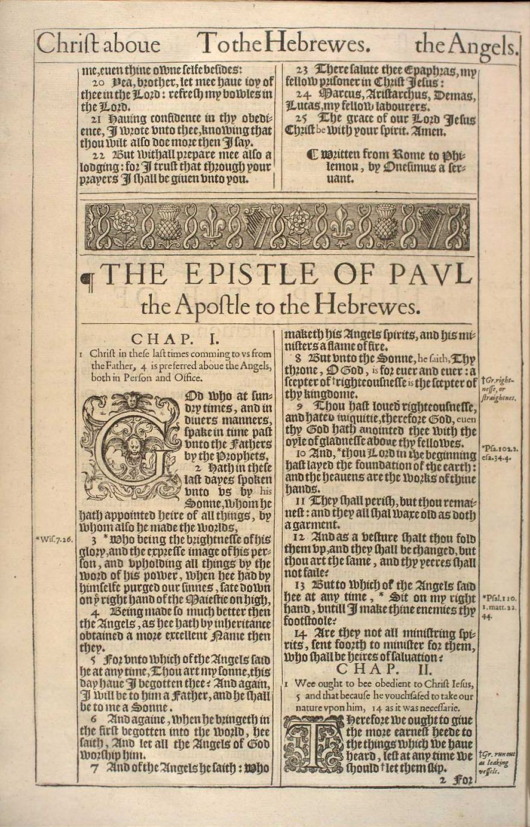
Strong Evidence Paul Wrote this Hebrews Epistle
B. Paul’s Authorship 12 Evidences
#1 For almost 2 millennia virtually everyone
agreed Paul wrote Hebrews [1st Cent. AD thru 1700s]
The 1611 King James Bible:
THE EPISTLE OF PAUL
the Apostle to the Hebrewes
Saul/Paul is THE most logical experienced/learned
scholar with background-education to write this!

Slide 14
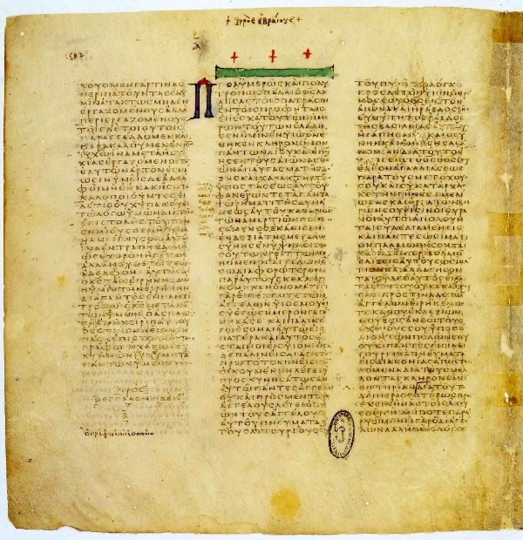
Codex Vaticanus
4th Century AD
“Epistle to the Hebrews”
on display in Rome’s library

Slide 15
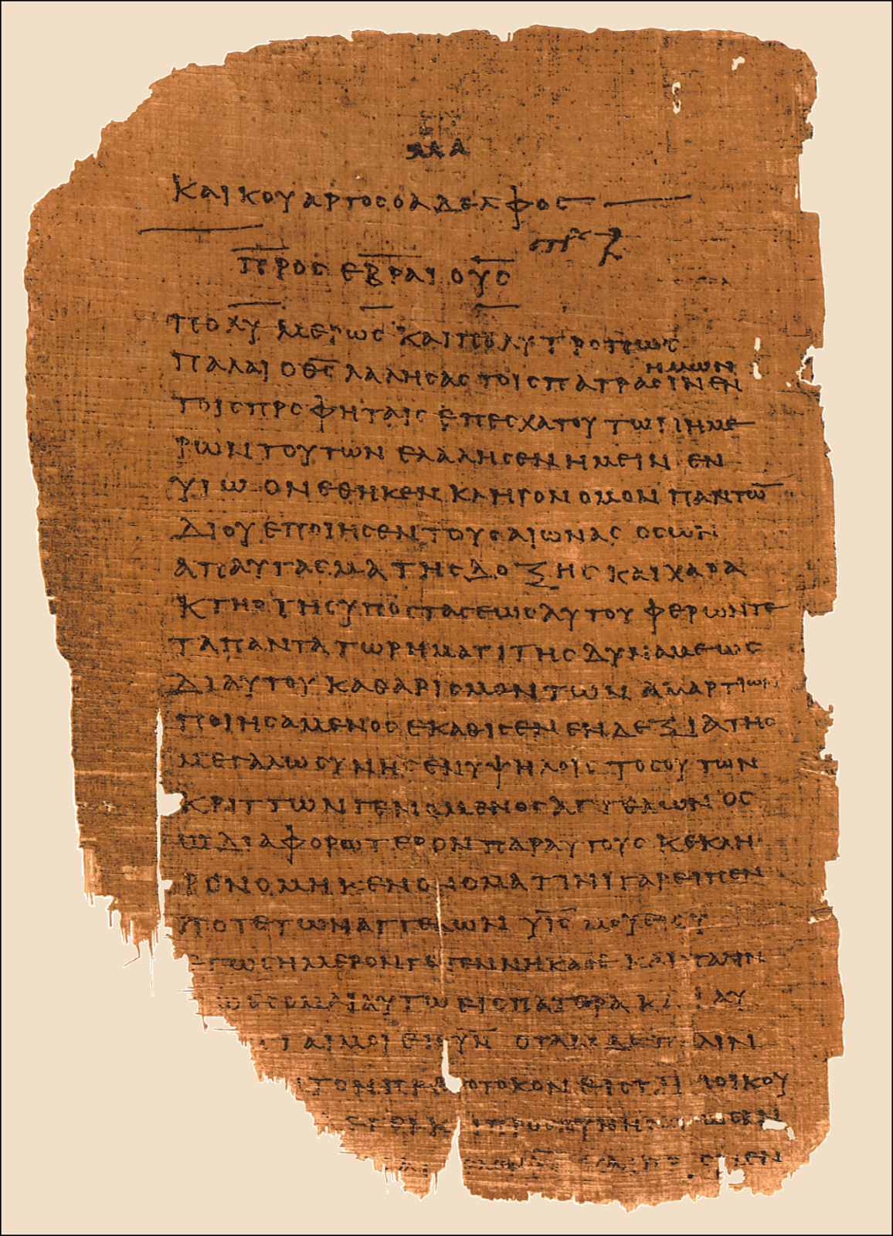
Papyrus 46 [175-205 AD]
Romans, 1st and 2nd Corinthians
Galatians, Ephesians, Colossians
Philippians, 1st Thessalonians
and Hebrews . . . . ALL by Paul!
Hebrews 1:1-7 in koine Greek
κατά Ἑβραῖος
“to the Hebrews”
on display in Chester Beatty Library, Dublin
and Univ. of Michigan Papyrus Collection

Slide 16
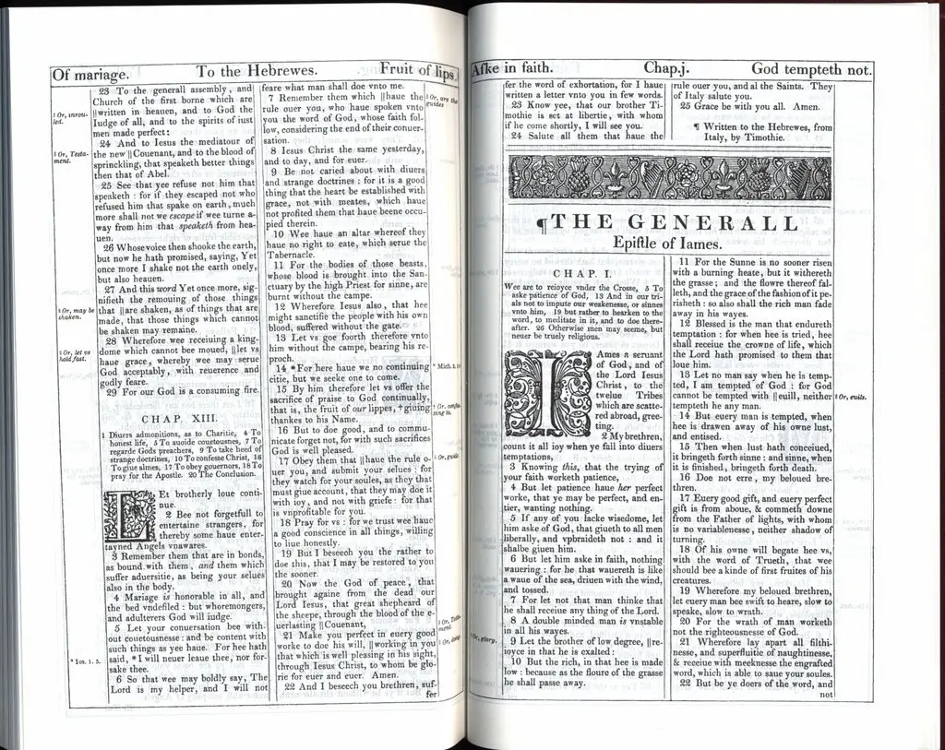
Later Edition
King James Bible
Written to the Hebrews
from Italy
by Timothie [what?]
This was added in by
translators but it’s
not in manuscripts
Hebrews 13:23 says,
“take notice that our brother
Timothy has been released
with whom, if he comes soon
I will then see you also”
Cannot arrive with Yourself!

Slide 17
Strong Evidence Paul Wrote this Hebrews Epistle
Only in the last 3 centuries [1800s, 1900s, 2000s] supposedly “learned”
“enlightened” seminarians, theologians, pastors, authors, professors needed
new controversial topics to research, write-about, debate, call into question
They suggest: Bar-Nabas? Aquila and Priscilla? Apollos? Timotheus?
but have ZERO substantive evidence to support ANY of these
They are ALL essentially speculation only!
?? Hebrews 2:3 after it was at first spoken thru the Lord, it was confirmed
to us by those who heard
Liberal Interpret: “it was taught to me by Jesus’ Apostles”
Logical-Literal: ”after Lord spoke it to me, Peter and James confirmed it to me”
Galatians 2:9 Peter and John extend Apostolic
hand of fellowship to Paul their equal

Slide 18
Strong Evidence Paul Wrote this Hebrews Epistle
2. Paul’s Authorship
#2 Hebrews is circulated with Paul's other epistles in ancient manuscripts
Papyrus 𝔓46 [175-205 AD] Chester Beatty II
86 leaves found in Egypt
Numerous early church writers-theologians recognize Saul/Paul
Clement Polycarp Pantaenus Ambrose Rufinus Eusebius
#3 Tertullian first to claim Bar-Nabas
But Councils of Hippo and at Carthage rejected his position and declared,
”the Epistle to the Hebrews is from Paul and it is canon”
#4 Hebrews 13:23 our brother Timothues has been released, with whom, if he
comes soon, I will see you
Paul & Timothy longstanding history together
Timothy would not be writing about accompanying himself!!

Slide 19
Strong Evidence Paul Wrote this Hebrews Epistle
2. Paul’s Authorship #5 UNIQUE signature/sign-off to his Epistles
Romans 16:24 Grace of our Lord Jesus be with you all, Amen
1st Corinth. 16:23 Grace of the Lord Jesus be with you
2nd Corinth. 13:14 Grace of Lord Jesus be with you all
Galatians 6:18 Grace of Lord Jesus with with your spirit
Ephesians 6:24 Grace be with you all
Philippians 4:23 Grace of Lord Jesus be with your spirit
1st Thess. 5:28 Grace of Lord Jesus be with you
2nd Thess. 3:18 Grace of our Lord be with you all
1st Timothy 6:21 Grace be with you
2nd Timothy 4:22 Grace be with you
Titus 3:15 Grace be with you all
Philemon 1:25 Grace of Lord Jesus be with your spirit
Hebrews 13:25 Grace be with you all

Slide 20
Strong Evidence Paul Wrote this Hebrews Epistle
2. Paul’s Authorship #6 UNIQUE request also only in 2 other Paul epistles
1st Thess. 5:25 PRAY FOR US
2nd Thess. 3:1 PRAY FOR US
Hebrews 13:18 PRAY FOR US
#7 Romans-Galatians-Hebrews
Similar “lists” of 17
Romans 8:35-39 17 things cannot separate from Christ’s love [7 then 10 more]
Galatians 5:19-21 17 things that do keep us from being in Christ’s Spirit
Hebrews 12:18-24 17 things whereby Zion is better than Sinai [7 then 10 more]

Slide 21
Strong Evidence Paul Wrote this Hebrews Epistle
2. Paul’s Authorship SAME Romans-Galatians-Hebrews same O.T. Quote
Habakkuk 2:4 For the Just [the righteous] will live by Faith
Paul is the ONLY writer in the entire New Testament who cites Habakkuk 2:4
#8 Romans 1:17 Paul cites Habakkuk 2:4 as righteousness of God is revealed in Faith
#9 Galatians 3:11 Paul cites Habakkuk 2:4 because no one is justified by the Law
Hebrews 10:38 Paul cites Habakkuk 2:4 because Jesus is coming for those who live by Faith

Slide 22
Strong Evidence Paul Wrote this Hebrews Epistle
2. Paul’s Authorship #10 Timotheus
Hebrews 13:23 take notice that our brother Timotheus has been released
with whom, if he comes soon, I will then see you also
2nd Corin. 1:1 from Paul an Apostle and Timotheus our brother
Colossians 1:1 from Paul an Apostle of Jesus and our brother Timotheus
1st Thess. 1:1 from Paul and Sylvanus and Timotheus
Acts 16:1 17:14-15 18:5 19:22 20:4 Timotheus with Paul
Romans 16:21 Timotheus is my fellow worker
1st Corin. 4:17, 16:10 2nd Corin. 1:19 Philemon 1:1 etc…..
NO such relationship noted with Bar-Nabas or Apollos or Aquila & Priscilla

Slide 23
Strong Evidence Paul Wrote this Hebrews Epistle
2. Paul’s Authorship #11 Peter also mentions Paul writing to Hebrews
2nd Peter 3:14-15 my beloved Jews be diligent to be found in Him and regard the patience
of the Lord as salvation, just as our beloved brother Paul according to
the wisdom given to Him also wrote to you “you” = Jews/Hebrews
2nd Peter 3:16 just like in all his other letters he spoke of these same things, in which are
some topics that are hard to understand which the untaught and unstable
distort as they do also the rest of our [Hebrew] Scriptures
“other letters Paul spoke of these” is Peter referring to Paul’s epistles to GENTILES
but Peter contrasts those with “he also wrote to YOU” [Peter’s readers are all Jews]
Dave Hunt & Chuck Missler both note: if Paul didn’t write Hebrews, there’s another letter
out there just to Jewish believers that’s missing!
Peter [Galilean fisherman] notes “some topics hard to understand”
[from this highly-educated Pharisee Paul]

Slide 24
Strong Evidence Paul Wrote this Hebrews Epistle
2. Paul’s Authorship #12 VERY similar OT-citations by Paul
Acts 13:32-39 [in Pisidian Antioch]
And we declare to you glad tidings, Promise made to the fathers
God has fulfilled this for us their children, He has raised up Jesus.
As written in second Psalm [v-7], “You are My Son, today I have begotten You.”
He raised Him from the dead, no more to return to corruption, He has spoken this:
“I will give you the sure mercies of David” [Isaiah 55:3, 35]
Therefore He also says in another Psalm [16:10]
“You will not allow Your Holy One to see corruption” for David after he served his
own generation by the will of God, died and was buried and saw corruption,
but He whom God raised [JESUS] saw no corruption.
Therefore let it be known to you, brethren, that through this Man is preached to
you the forgiveness of sins - and by Him everyone who believes is justified from
all things from which you could not be justified by the law of Moses.

Slide 25
Strong Evidence Paul Wrote this Hebrews Epistle
2. Paul’s Authorship WHY would Paul intentionally keep this epistle anonymous?
Acts 9:15 God told Ananias of Damascus “Saul is my chosen instrument to the GENTILES”
Acts 13:46 because Jews reject Gospel, “we are turning our attention to the GENTILES”
Acts 18:6 because the Jews blasphemed Paul he replied, “I will go to the GENTILES”
Galatians 2:2 Paul states “I preach the Gospel to the GENTILES”
Ephesians 3:1 Paul states “I Paul, am captive by Jesus for the sake of the GENTILES”
Acts 22:21 as Paul watched Stephen stoned “I will send you far away to the GENTILES”
But notice that every time Paul preached-taught-spoke to a Jewish audience
it resulted in chaos-riot-anger-backlash! He is always accused of blaspheming
Acts 21 Roman soldiers intervene to avoid Paul being killed by angry Jews
Acts 23 40 Jews took a vow to kill Paul
Acts 18 in Corinth Acts 13 Pisidian Antioch etc…..

Slide 26
Strong Evidence Paul Wrote this Hebrews Epistle
2. Paul’s Authorship Anonymous?
- Jews hated the former Pharisee now preaching Gospel of Jesus
- Jews hated Paul’s teaching that “the Law could not save a person”
- Jews refuted his teachings about circumcision “of the heart”
- Jews challenged Paul being an Apostle like Peter and John
An “open anonymous letter” to ALL of Hebrew lineage would not be refuted
outright because it’s from Pharisee Paul [they had intense bias/prejudice], but
they would give it a read-thru or listen to it and judge it based on its merits,
drawing from Hebrew Scriptures [not hostile outright because it’s from Paul]
Probably written after Rome house arrest, but prior to 2nd arrest and prison
in Mamertine [circa 65-66] before execution in 67 and DEFINITELY before
Romans destroy Jerusalem and Temple in 70 AD

Slide 27
Strong Evidence Paul Wrote this Hebrews Epistle
2. Paul’s Authorship Transcribed Oral Sermon?
Could it be that Paul preached a detailed sermon to a Jewish audience
and Luke took notes to later transcribe that address into written epistle form?
This could explain what perhaps appears to be different style of Greek writing
by Luke that is not similar to when Paul pens his own epistles
Dr. Newton’s position: Pharisee Saul used his most educated-academic writing
style in this ONE epistle to his beloved Hebrew nation of
Israel because it’s an apologia drawing on 40 Scriptures
[unique from more “everyday” Greek style to Gentiles]
HOWEVER: Clement of Alexandria [150–215 AD] writes
Paul wrote Hebrews in Hebrew, Luke then translated his words into Greek

Slide 28
Strong Evidence Paul Wrote this Hebrews Epistle
Paul’s Authorship
dozens of Greek grammatical similarities
Dr. Dave Black, Prof. of NT and Greek
Southeastern Baptist Theological Seminary
Hebrews 2:10 7:5 11:21-22 12:5, 7, 8
ALL have υἱός [hu-ee-os] for “sons”
But other N.T. writers tend to use
τέκνον [tek-non] ”child/children”
[4 Gospels and Acts]
Paul’s Romans 8:16
Spirit Himself testifies with our spirit
Paul’s Hebrews 10:15
Spirit testifies within us

Slide 29
Pharisee Paul’s ἀπολογία to the Hebrews
Ἑβραῖος “hay-brai-os”
Summary
Saul/Paul of Tarsus is the ONLY one with background-education-incentive to
pen such a detailed apologetic to Hebrews based on Hebrew Scriptures
Overwhelming evidence that Paul is the author of Hebrews
12 Reasons
Plus dozens of Greek-grammatical examples from Dave Black

Slide 30
Pharisee Paul’s ἀπολογία to the Ἑβραῖος
NEXT WEEK
Hebrews 1:1-9
Paul cites:
2nd Samuel 7
Psalm 45

