Slide 1
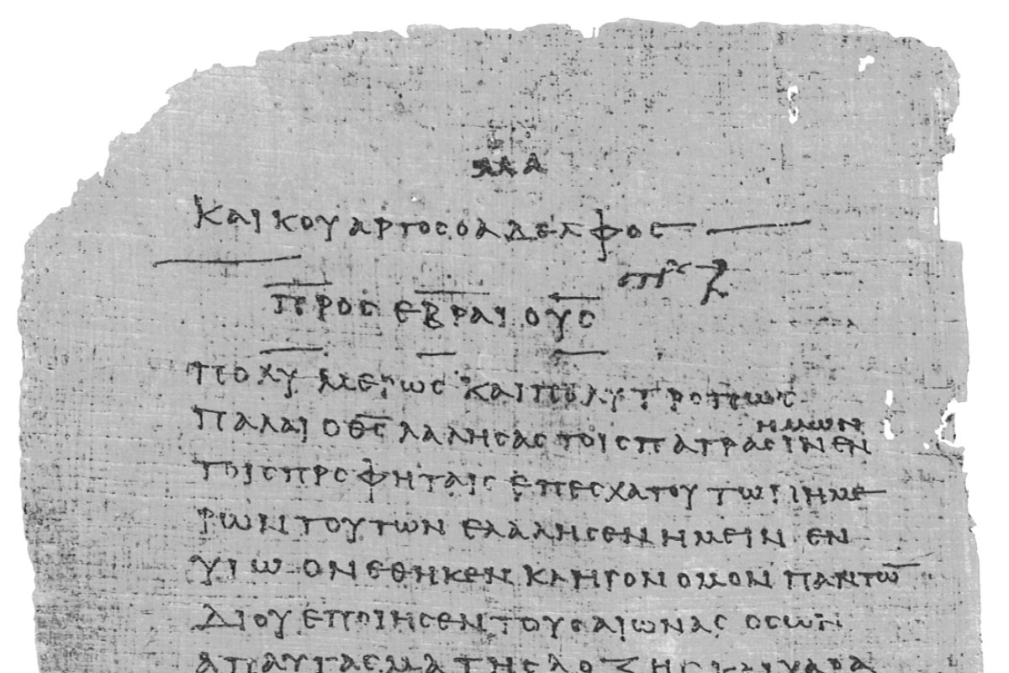
Pharisee Paul’s ἀπολογία to the Hebrews
Ἑβραῖος
Session-2
Hebrews 1:1-9
Paul cites:
2nd Samuel 7
Psalms 2, 45, 104
Dr. Dave Newton
© 2025
Figure It Out
Calvary Chapel
Santa Barbara

Slide 2
Pharisee Paul’s ἀπολογία to the Hebrews
Ἑβραῖος “hay-brai-os”
Last Week / Session-1
Background on Saul/Paul résumé of highly-educated Pharisee
Overwhelming 12 Reasons Paul is the author of Hebrews
Notes and Video at NewtonFIO.com
Babylon Bee humor: Innovative new Bible
concordance provides
out-of-context verses
to justify any behavior.

Slide 3
Paul’s Bibliography PhD Philosopiae Doctor Pharisiae Doctor
2 Samuel 7:12-14 Heb 1:5a
Psalm 2:7 Heb 1:5b
Psalm 104:4 Heb 1:7
Psalm 45:6-7 Heb 1:8-9
Psalm 102:25-27 Heb 1:10-12
Psalm 110:1 Heb 1:13
Psalm 8:4-6 Heb 2:5-10
Psalm 22:22 Heb 2:12
Isaiah 8:17 Heb 2:13
Isaiah 8:18 Heb 2:13
Psalm 95:7-11 Heb 3:7-11
Psalm 95:11 Heb. 4:3
Genesis 2:2 Heb 4:4
Psalm 2:7 Heb 5:6
Psalm 110:4 Heb 5:6
Deut. 32:43 Heb 6:1
Gen 22:16-17 Heb 6:14
Psalm 110:4 Heb 7:17
Psalm 110:4 Heb 7:21
Exodus 25:40 Heb 8:5
Jeremiah 31:31-34 Heb 8:7-13, 10:15-18
Exodus 24:8 Heb 9:20
Psalm 40:6-8 Heb 10:5-10
Deut. 32:35 Heb 10:30
Deut. 32:36 Heb 10:30
Habakkuk 2:3-4 Heb 10:37-38
Gen 21:12 Heb 11:18
Prov. 3:11-12 Heb 12:5-6
Deut. 9:19 Heb 12:21
Haggai 2:6 Heb 12:26
Deut. 31:6 Heb 13:5
Psalm 118:6 Heb 13:6

Slide 4
Amazing Presentation of Jesus in Hebrew Scriptures
Acts includes 15 teachings by 4 different men on this very same topic
AND these always result in significant responses from listeners
Chap-2 Peter in Jerusalem at Pentecost to Jews
Chap-3 Peter after he healed the lame man to Jews
Chap-4 Peter to the Sanhedrin to Jews
Chap-7 Stephen to the Sanhedrin to Jews
Chap-10 Peter to Cornelius [explains Jewish salvation for Gentiles too]
Chap-11 Peter to Jerusalem church to Jews
Chap-13 Paul at synagogue in Pisidian Antioch to Jews
Chap-15 Peter at Council of Jerusalem to Jews
James at Council of Jerusalem to Jews
Chap-17 Paul on Areopagus in Athens to Greeks re: Jewish God and Jesus
Chap-20 Paul at Miletus to Ephesus elders to Jews and Greeks
Chap-22 Paul gives his testimony in Jerusalem to Jews
Chap-23 Paul to Sanhedrin to Jews
Chap-24 Paul to Felix and his wife Drusilla she’s a Jew
Chap-26 Paul to King Agrippa + wife Bernice Jews Porcius Festus

Slide 5
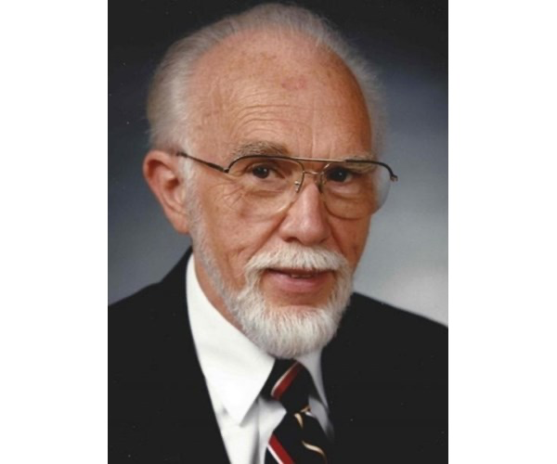
Pharisee Paul’s ἀπολογία to the Hebrews
Written to Jews who already BELIEVE in Jesus
Salvation is not only the act of accepting Christ
JUSTIFICATION The decision to believe
SANCTIFICATION Subsequent process becoming more like Jesus
GLORIFICATION Ultimate redemption in our new bodies
Dr. Earl Rachmacher, former president of Western Seminary [1965-1990]
General Editor of Thomas Nelson NKJV Bible
“I was saved, I'm being saved, and I will be saved”
PAST PRESENT FUTURE

Slide 6
Pharisee Paul’s ἀπολογία to the Hebrews
The “Kingdom” of God Matthew 6 - the Lord’s Prayer
Millennium - the fulfillment of God’s Covenant with David
Luke 1:32-33 Lord God will give Him throne of His father David, He will
reign over the house of Jacob forever - His kingdom will have NO end!
Amos 9:11 Lord will literally raise up Jerusalem to its former glory
Did that occur at Jesus’ first coming?
2 Views: Jesus is now ruling/reigning allegorically thru the church
former literal Israel is now the church [Replacement Theology]
Jesus will literally reign over the Earth from Jerusalem
specific promise/Covenant to Israel will be fulfilled

Slide 7
Pharisee Paul’s ἀπολογία to the Hebrews
“Kingdom of God” [Millennium]
1st Corinthians 15:20-28 But now Christ has been raised from the dead, the first fruits
of those who have died for since by a man came death, by a man also came resurrection
of the dead, for as in Adam all die, so also in Christ all will be made alive, but each in his
own order: 1] Christ the first fruits, 2] after that those who are Christ’s at His 2nd Coming
then comes the end, when He hands over The Kingdom to the God and Father, when
He has abolished all rule and all authority and power [in His Millennial Kingdom] for
He must reign until He puts all His enemies under His feet, the last enemy abolished
is death. He has put all things in subjection under His feet. When He says, “All things
are put in subjection,” it is evident He is excepted who put all things in subjection to
Him – so when all things are subjected to Him, then the Son Himself also will be
subjected to the One who subjected all things to Him, so that God may be all in all
Jeremiah 31:31 the days are coming when I will make a NEW covenant with the
house of Israel and the house of Judah

Slide 8
Pharisee Paul’s ἀπολογία to the Hebrews
5 Warning to Believers
2:1-5 Warning-1: Don't Drift Away
3:7 thru 4:13 Warning-2: Open Disobedience/Unbelief
6:4-8 Warning-3: Time to Grow Up/Be Mature
10:26-39 Warning-4: Volitional/Deliberate/Willful Sin 12:25-29 Warning-5: Indifference/Casual Ambivalence
and over 20 times, Paul includes himself [“we”] in these warnings!

Slide 9
Pharisee Paul’s ἀπολογία to the Hebrews Ἑβραῖος
Hebrews 1:1-9
verses 1-2 God, AFTER He spoke long ago to the fathers in the prophets
in many portions and in many ways, in THESE LAST DAYS has spoken
to us in His Son,
Jesus sums up ALL that was spoken by the prophets. Jesus fulfills ALL the Law!
Matthew 5:17 Jesus came to fulfill the Law and the Prophets
The EXACT SAME opening Paul uses in his epistle to Rome
Romans 1:1-3 God, which He promised beforehand thru His
prophets in the holy Scriptures [Torah, Psalms, prophets]
concerning His Son [Jesus] who was born of a
descendant of David coming in the flesh . . .

Slide 10
Pharisee Paul’s ἀπολογία to the Hebrews
. . . Has spoken to us in His Son
verses 2-3 whom He appointed heir of all things, thru whom also He made the
world - Jesus is the radiance of His glory and EXACT representation
of His nature and upholds all things by the word of His power.
When He had made purification of sins, He sat down at the
right hand of the Majesty on high
John 14:9 Jesus said if you’ve seen ME then you’ve seen the Father
Matthew 17:1-8 Jesus shows His eternal radiance-glory to Peter, James, John He IS God!
John 19:30 Jesus on the cross said Tetelestai “it is finished” Jesus made restitution for sin!
verses 1-3 Jesus as Prophet King Priest
God now speaks thru Jesus who rules over all things purification for sin

Slide 11
Pharisee Paul’s ἀπολογία to the Hebrews Ἑβραῖος
Heir of all things Who are fellow heirs with Jesus? Everyone?
Romans 8:14-17 IF indeed we suffer with Him
1st Peter 1:11-20 Father impartially judges according to each man’s work
conduct yourselves in fear knowing HOW you were redeemed
not with gold-silver, but with Precious Blood of the Lamb
those who Overcome Rev. 2:26-27 Matt. 19:28 2nd Tim. 2:11-12
those who are Partakers Romans 8:17 Colossians 1:12 1st Peter 4:13
in Christ’s suffering
Paul will explain throughout: Not all who are saved will have full inheritance
[1M ‘saved’ from Egypt, only 2 ‘inherited’ land]

Slide 12
Pharisee Paul’s ἀπολογία to the Hebrews
1:4 having become as much better than the aggelos [God’s messengers]
as He has inherited a more excellent name than they
Jesus is Superior to Top-3 Core Tenets of Judaism: aggelos, Moses, Levitical Priests
First: the aggelos Jews huge reverence for angels
aggelos are most exalted of God’s created beings
aggelos gave Law to Moses Deut. 33:2 Psalm 68:17 Acts 7:53 Galatians 3:19
aggelos were present when God created the world Job 38:4-7 morning stars
aggelos abide in God’s Heaven Matthew 24:36 around God’s throne Rev. 5:11
aggelos are holy Matt. 25:31 God’s dispatched “messengers” Psalm 104:4
[but one-third chose to follow Lucifer in his disobedience]

Slide 13
Pharisee Paul’s ἀπολογία to the Hebrews Ἑβραῖος
Jesus is Superior to aggelos Proof from 4 Hebrew Scriptures
1:5 for to which of the aggelos did He ever say,
“You are my Son today I have begotten You”? [Psalm 2:7] and again,
“I will be a Father to Him and He will be a Son to Me”? [2nd Sam. 7:14-15]
Never said this of aggelos
1:6 and when He again brings the firstborn [Jesus] into the world, He says,
“Let all the aggelos of God worship Him” [Deut. 32:43 in LXX]
1:7 and of the aggelos He says, “Who makes [creates] His aggelos
as winds and His ministers a flame of fire?” [Psalm 104:4]

Slide 14
Pharisee Paul’s ἀπολογία to the Hebrews
The Proof?
1:5 for to which of the aggelos did He ever say,
“You are my Son today I have begotten You”? [Psalm 2:7]
He said to Me, “You are My Son, today I have begotten You”
Paul cites this exactly same in his sermon of Acts 13:33 Pisidian Antioch
Begotten is NOT the start of life, but rather the start of the incarnation.
This is the installation/appointment of Mashiach.
The pre-incarnate Mashiach referred to as “the Son”
but Jesus was always God within the distinct ‘Persons’ of Father-Son-Spirit
John 17:5 the glory I had with the Father BEFORE the world was
Colossians 1:17 Jesus is BEFORE all things and holds all things together
at Jordan Matthew 3:17 this is My beloved Son with whom I AM well-pleased
on mount Matthew 17:5 this is My beloved Son with whom I AM well-pleased

Slide 15
Pharisee Paul’s ἀπολογία to the Hebrews Ἑβραῖος
The Proof?
1:5 “I will be a Father to Him and He will be a Son to Me”? [2nd Sam. 7:14-15]
Paul cites the prophecy of Samuel re: God’s Eternal Covenant with David
2nd Samuel 7:12-14 When your days [David] are complete and you lie down
with your fathers, I will raise up your descendant after you who will come from
you - I will establish His kingdom - He will build a house for my Name
[Solomon], and I will establish the throne of His kingdom forever
I will be a Father to Him and He will be a Son to Me Messiah is Son of David
Solomon is David’s immediate son, but it’s thru Jesus born of Mary and from
David’s lineage that “I will establish the throne of His kingdom FOREVER
I will be a Father to Him and he will be a Son to Me”
Samuel prophesies of David’s Covenant fulfilled thru Jesus in the Millennium

Slide 16
Pharisee Paul’s ἀπολογία to the Hebrews
The Proof?
1:6 and when He again brings the firstborn [Jesus] into the world, He says,
“Let ALL the aggelos of God worship Him” [Deut. 32:43 in LXX]
NASB, other translations seem to make no mention of “aggelos worship Him”
But the LXX reads, “Rejoice, O heavens, with Him, and let all the sons of God
worship him. Rejoice, O nations, with His people, let all the angels of God prevail
for Him, For He will avenge the blood of His sons and will render vengeance on
His adversaries and will atone for His land and His people
Job 1:6, 2:1, 28:7 “sons of God” = aggelos

Slide 17
Pharisee Paul’s ἀπολογία to the Hebrews Ἑβραῖος
The Proof?
1:7 and of the aggelos He says, “Who makes [creates] His aggelos ‘malak’
winds and His ministers ‘sarat’ = servants a flame of fire?” [Psalm 104:4]
They are created/made by God . . . Jesus is not! Jesus is the Creator
Examples: Genesis 19:13 brought down FIRE on Sodom and Gomorrah
Exodus 3:2-6 appear to Moses in FIRE of bush
Judges 6:21 FIRE from staff consumed Gideon’s meat + bread
Judges 13:20 FLAME went up from altar and angel in the flame
and still to come . . . Rev. 14 FIRE from altar to cleanse the Earth

Slide 18
Pharisee Paul’s ἀπολογία to the Hebrews
verses 8-9 But ONLY of the Son [not angels] He says,
“Your throne O God is forever and ever, the righteous scepter is the scepter of
His kingdom Psalm 45:6 the righteous scepter is the scepter of His kingdom
You have loved righteousness and hated lawlessness, therefore your God has
anointed You with the oil of gladness above your companions”
[from Isaiah 61:3]
Psalm 45:7 CLEARLY states the Deity of Jesus because He has His throne
His throne [rule/reign] is Forever and Ever Isaiah 9:6-7 Daniel 7:13-14
Did NOT occur at the 1st Coming of Jesus Luke 1:33
Will begin at the 2nd Coming of Jesus in His Millennial Kingdom
Will continue Forever and Ever in New Earth + New Jerusalem
Acts 15:16 Jesus said, meta-tauta “after these things” I will return and
rebuild a New Temple [in the Millennium]
Amos 9:11 in THAT DAY I will raise up the fallen covering of David
I will raise up its ruins and rebuild it

Slide 19
Pharisee Paul’s ἀπολογία to the Hebrews Ἑβραῖος
SUMMARY
Paul uses 4 citations from Hebrew Scriptures to show
Jesus is Superior to angels
1. Jesus is God
2. Jesus Rules on His throne
3. Jesus is King with His own scepter of righteousness
4. Jesus Rules in excellence and shows no partiality
5. Jesus has perfect sinless character on Earth
6. Jesus has specific subjection
7. Jesus is the Anointed One in His positions
8. Jesus is Eternal from before the creation of the world
[angels were created]

Slide 20
Pharisee Paul’s ἀπολογία to the Ἑβραῖος
NEXT WEEK
Hebrews 1:10-14
2:1-3a
Paul cites:
Psalm 102
Psalm 110

