Slide 1
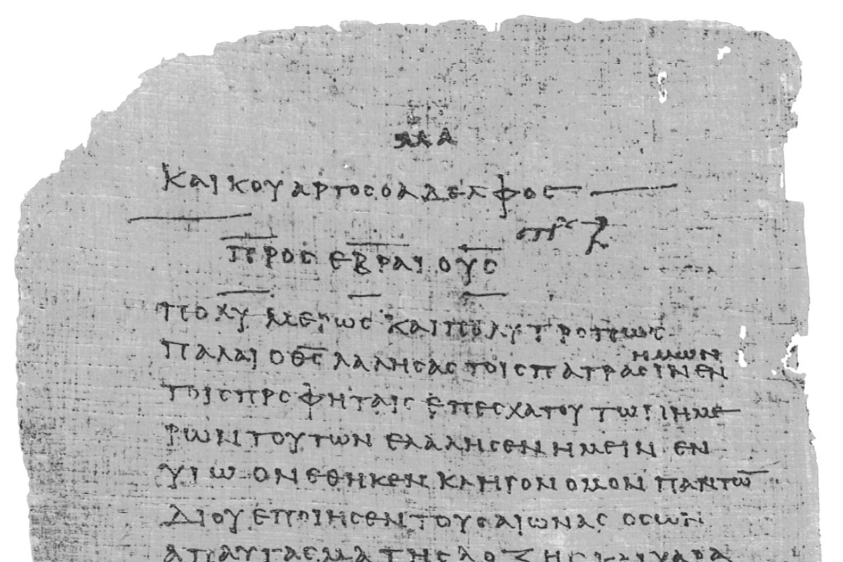
Pharisee Paul’s ἀπολογία to the Hebrews
Ἑβραῖος
Session-6
Hebrews 3:4 thru 4:3
Paul cites:
Psalm 95:8-11
Dr. Dave Newton
© 2025
Figure It Out
Calvary Chapel
Santa Barbara

Slide 2
Pharisee Paul’s ἀπολογία to the Hebrews
Ἑβραῖος “hay-brai-os”
Last Week / Session-5
Paul drives home the key point that Jesus HAD to be a man like you and me
because He dies on Calvary because our sin was put on Him. And He was
literally resurrected from being physically dead. He did not die for angels.
Jesus then has holy brothers, who are “partakers” with Him, and He is then
THE One true Apostle to the Hebrews.
Notes and Video at NewtonFIO.com

Slide 3
Pharisee Paul’s ἀπολογία to the Hebrews Ἑβραῖος
Cessation vs. Continuation 1st Corinthians 12:1-31 Paul clearly states
concerning spiritual gifts
I don’t want you to be unaware!!
FREE books this evening for everyone!
Chapter 3 - details on Fruit of the Holy Spirit
EVERYONE exhibits God’s character
Chapter 4 - details on Gifts of the Holy Spirit
As HE wills for HIS purposes

Slide 4
Paul’s Bibliography reminder: Romans 15:4 Hebrew Scriptures for OUR benefit!!
2 Samuel 7:12-14 Heb 1:5a
Psalm 2:7 Heb 1:5b
Psalm 104:4 Heb 1:7
Psalm 45:6-7 Heb 1:8-9
Psalm 102:25-27 Heb 1:10-12
Isaiah 34:4-12 Heb 1:12
Psalm 110:1 Heb 1:13
Psalm 8:4-6 Heb 2:5-10
Psalm 22:22 Heb 2:12
Isaiah 8:17 Heb 2:13
Isaiah 8:18 Heb 2:13
Psalm 95:8-11 Heb 3:7-11
Psalm 95:11 Heb. 4:3
Genesis 2:2 Heb 4:4
Psalm 2:7 Heb 5:6
Psalm 110:4 Heb 5:6
Deut. 32:43 Heb 6:1
Gen 22:16-17 Heb 6:14
Psalm 110:4 Heb 7:17
Psalm 110:4 Heb 7:21
Exodus 25:40 Heb 8:5
Jeremiah 31:31-34 Heb 8:7-13, 10:15-18
Exodus 24:8 Heb 9:20
Psalm 40:6-8 Heb 10:5-10
Deut. 32:35 Heb 10:30
Deut. 32:36 Heb 10:30
Habakkuk 2:3-4 Heb 10:37-38
Gen 21:12 Heb 11:18
Prov. 3:11-12 Heb 12:5-6
Deut. 9:19 Heb 12:21
Haggai 2:6 Heb 12:26
Deut. 31:6 Heb 13:5
Psalm 118:6 Heb 13:6

Slide 5
Last week Q+A? Could Jesus have sinned when tempted by Satan?
James 1:13-15 Let no one say he is tempted by God – God does not tempt
anyone and He himself cannot be tempted to sin – each of us is tempted when
carried away by our OWN inherent lust, that conceives & gives birth [ACTION]
to sin, and when sin is accomplished it brings forth death! [Jesus would be
guilty of His own sin just like we are. That could not happen for Calvary plan]
1st John 2:16 lust of flesh, lust of eyes, boastful pride of life NOT from GOD!
3:5 Jesus came to take away SIN and in Him there is NO SIN!
1st Peter 1:19 Jesus the precious Lamb was without any belish
1st Peter 2:22 Jesus committed NO SIN - NO Deceitfulness in Him [NO motive to ACT]
2nd Corinth. 5:21 it was for our sake that Jesus was MADE SIN who knew NO SIN!
Coming up in Hebrews 4:15 our true High Priest CAN sympathize with our weakness
He was in every way tempted like we are, but WITHOUT SIN!

Slide 6
Pharisee Paul’s ἀπολογία to the Hebrews Ἑβραῖος
FINAL REMINDER Threshold for ACTING on sinful intention . . .
Matthew 5:20-28 Jesus explains that “murder” is not simply the
actual taking of a life, but if someone is angry
and says to a brother ῥακά raka = you reproach
you worthless person, has committed murder
and do not commit adultery, but if you simply look
at a woman with lust has already committed adultery
It is the capacity to ACT to move forward with the temptation that
defines mankind’s sin-nature . . . That capability to CHOOSE to disobey
Jesus did not have that capability to action
BIBLE is clear: Jesus was “tempted” like all mankind is tempted
Jesus did not “sin” like all mankind sins

Slide 7
Pharisee Paul’s ἀπολογία to the Hebrews Ἑβραῖος
Reminder from Last Session
Jesus is Far Above/Superior to MOSES
Moses Jesus
- led Israel from bondage - leads from bondage of sin
- led Israel to Canaan - leads to eternal glory
- builds temporary tabernacle - is “the” Tabernacle among men
- sin nature from Adam + Abraham - is entirely without sin
- man of God - is God
- king in Jeshurun [Deut. 33:5] - is King of all kings
- THE prophet spoke God’s Word - is the fulfillment of that Word
- a priest to God [Ex. 24:6] - is our Great High Priest

Slide 8
Pharisee Paul’s ἀπολογία to the Hebrews Ἑβραῖος
Last week finished with: Hebrews 3:2-3
Jesus was faithful to God the Father who appointed Him, in the same way
Moses was faithful in all His house - for Jesus has been counted worthy of more
glory than Moses - by just so much as Jesus the Builder of the house has more
honor than the house - Paul no doubt means the “house of Israel”
NOW: Hebrews 3:4-6 For every house is built by someone, but the builder of all
things is God - now Moses was faithful in all His house as a servant, for a
testimony of those things which were to be spoken later - but Christ was
faithful as a Son over His house . . . . whose house we are, if we hold fast
our confidence and the boast of our hope firm until the end
Role of Prophet: Represent God to the people - Speak God’s Word
Role of Priest: Represent the people to God - Speak to God on their behalf

Slide 9
Pharisee Paul’s ἀπολογία to the Hebrews Ἑβραῖος
Hebrews 3:7-11 Therefore, just as the Holy Spirit says [citing Psalm 95:8-11]
[Paul notes it’s the Holy Spirit speaking thru David]
TODAY if you hear His voice then do not harden your hearts as when they provoked Me
[only 3 times in NT – all here]
as in the day of trial in the wilderness, where your fathers tried Me by testing Me
[Numbers 14 at Kadesh-Barnea 10 times!!]
and saw my works for 40 years, therefore I was angry with this generation, and said,
“They always go astray in their heart and they did not know My ways, as I
swore in My wrath, “They shall NOT enter My rest”.
Psalm 95:6-7 begins: Come let us worship and bow down, let us kneel before the
Lord our God our Maker, for He is our God and we are the
people of His pasture and the sheep of His hand.

Slide 10
Pharisee Paul’s ἀπολογία to the Hebrews Ἑβραῖος
they provoked Me [only 3 times in NT – all right here]
Numbers 13-14 at Kadesh-Barnea 10 times Hebrews provoke the Almighty
Numbers 14:22 tested me 10 times, even after
seeing my glory and signs
1. No faith to cross Red Sea
2. Angry about bitter waters at Marah
3. Angry about Wilderness/Desert of Sin
4. Gather more manna than for the day
5. Gather manna on shabbat
6. Angry about no water at Rephidim
7. Worshipped Aaron’s golden calf
8. Angry/complaining at Taberah
9. Angry about only manna “we want meat”
10. Kadesh-Barnea “we cannot enter the land”

Slide 11
Pharisee Paul’s ἀπολογία to the Hebrews Ἑβραῖος
FINAL complaining/provoking:
12 spies return with a 10-2 vote of ”we can’t take this land”
[Interesting: spied for 40 days, God requires 40 years]
Numbers 13:25 Numbers 14:34
There are descendants of Anak = Ahiman, Sheshai, Talmai
They report: “The people are very large” “They are too strong for us”
“We saw the Nephilim and were like tiny grasshoppers by comparison”
[Genesis 6]
Anak of Anakim – later comes Goliath “6 cubits + span” = 9ft 9in tall 1st Sam. 17:4
Genesis 15:13-21 GOD tells Abraham your descendants enslaved for 400 years
then I will judge the oppressors - then the 4th generation will return HERE!
Satan has 40 decades/4 centuries to set up genetic obstacles to inherit Canaan
This is why Joshua is instructed Joshua 6, 11 killed all the inhabitants of the land
killed all Anakim, just a few left in Gaza, Gath, Ashdod

Slide 12
Hebrews 3:12-19 Take care, brethren, that there not be in any one of you an evil
unbelieving heart that falls away from the living God but encourage one another day
after day [Paul uses verb form of Holy Spirit advocate-noun παρακαλέω para-kaleo]
like noun for Holy Spirit as Our Advocate παράκλητος para-kletos
as long as it is still called TODAY so that none of you will be hardened by
the deceitfulness of sin - for we have become partakers of Christ, IF we hold fast the
beginning of our assurance firm until the end while it is said,
TODAY “IF” you hear His voice do not harden your hearts as when they provoked me
partakers is μέτοχος = metachos has the condition ‘IF’ we hold fast/persevere
In the wilderness Hebrews complained/grumbled ”rather die in the desert”
God’s judgment gives them that! “your carcasses will die in the wilderness”
Only Caleb + Joshua enter from that unbelieving generation [under 20 in later]
Reminds me of 1992 ‘spying out’ this building. Our Board was unified in seeing God’s plan,
however, many complained/grumbled this building was a mistake,
“We should have stayed at Arlington or Pebble Hill”

Slide 13
Pharisee Paul’s ἀπολογία to the Hebrews Ἑβραῖος
become partakers of Christ, IF we hold fast the beginning of our assurance firm until the end
TODAY “IF” you hear His voice do not harden your hearts as when they provoked me
partakers metachos has Condition ‘IF’ we hold fast/persevere
It is NOT possible to lose one’s JUSTIFICATION That’s sealed by Jesus
It IS possible to miss out on one’s INHERITANCE That is a reward/prize/crown
The Hebrews were redeemed by the blood of the Lamb leaving bondage
so their salvation-justification is NOT at issue
However, they did not persevere, stay the course, finish well, and as a result
they did not come into their full inheritance

Slide 14
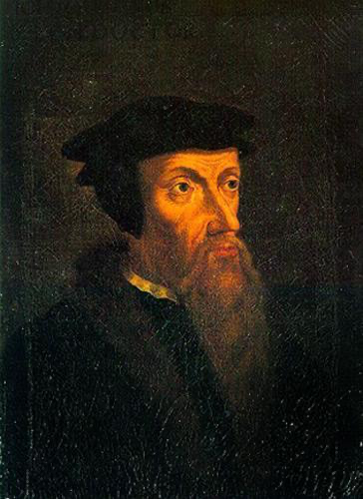
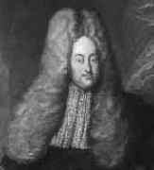
Pharisee Paul’s ἀπολογία to the Hebrews Ἑβραῖος
Opens up centuries-old DEBATE: Can you lose your salvation?
French Jean Calvin 1550 “Limited Atonement” “Perseverance” but NO free will
-
Dutch Jakob Hermann [‘Arminius] 1715 “Jesus died for ALL”
but might not Persevere IN free will
“Hey Pastor Chuck, does the Bible teach Calvinism or Arminianism?” Answer: “YES”
1] God’s extratemporal foreknowledge means He already knows who chooses
2] the ‘Overcomers’ = νικάω nikao
- James 1:12 steadfast, stand the test, crown of life
- 1st John 4:4 5:5 who overcomes? The one who BELIEVES
- Rev. 3:21 the one who overcomes will sit on my throne
- Rev. 3:5 the one who overcomes clothed in white garments
- John 16:33 Jesus has overcome the world
- Romans 8:31-39 we are more than overcomers

Slide 15
Pharisee Paul’s ἀπολογία to the Hebrews Ἑβραῖος
Paul uses the term “REST” for receiving that inheritance
κατάπαυσις kata-pausis = final inheritance due to someone
This is not shabbat rest from work, taking a break. This is arriving at a permanent comfort.
1st Century AD Hebrews who believed the Gospel then turned from Judaism and
once baptized to identify with Jesus’ resurrection, there is NO need for keeping the Law
however, many became disillusioned and “slipped away” out of ‘unbelief’ to return back
to the trying to keep the Law thru religious rituals and works.
The ”REST” promised them is not a temporary break from work, but
RESTING in God’s promise of salvation thru Jesus at Calvary, no works required!
Not sacrifices, diet, circumcision, prayers, washings, feasts, tithes . . . .
But that ”REST” is conditional on IF we hold fast our assurance firm until the end

Slide 16
Pharisee Paul’s ἀπολογία to the Hebrews Ἑβραῖος
Hebrews 3:16-19 has 3 Questions + 3 Answers:
Q1: who provoked God when they had heard? A1: indeed, did not all those who
came out of Egypt led by Moses - and Q2: with whom was He angry for 40 years?
A2: those who sinned, whose bodies fell in the wilderness - Q3: and to whom
did He swear that they would not enter His rest? - A3: but to those who were
disobedient, so we see that they were not able to enter because of unbelief
Paul uses the Exodus as “type” “foreshadow” of justified/saved from bondage of sin
then comes “falling away” “unbelief” and consequence of NOT entering in
they repent and are forgiven - but still lose their inheritance!
Paul uses the term “REST” for receiving that inheritance
MOSES also did not enter into that rest . . . but he was most certainly saved/justified
because he is present with Jesus and Elijah on the mount [Matthew 17 Mark 9]

Slide 17
Pharisee Paul’s ἀπολογία to the Hebrews Ἑβραῖος
Deut. 2:14 it took 38 years for that unbelieving generation to die off
Numbers 14:34 40 years for God’s judgment [1 year per day spying the land]
- 11days from Passover in Goshen and start Exodus until Mt. Sinai.
- 22 unique stops over 2 years from Mt. Sinai until Kadesh Barnea.
- 38 years from God’s judgment then equals 40 years total in the wilderness.
Similar 38 years from Jesus’ resurrection to complete Gospel message
in 32 AD until the end of the Temple era destroyed in 70 AD
Analogous to Promised Messiah given but that generation died off to 70AD?
Paul cites Psalm 95:10 the Lord said He loathed “that” generation of the Exodus
Paul skillfully changes pronoun to “this” generation TO INCLUDE 1ST CENTURY AD

Slide 18
Pharisee Paul’s ἀπολογία to the Hebrews Ἑβραῖος
Hebrews 4:1-3 therefore, let us fear - IF while a promise remains of entering His rest
any one of you may seem to have come short of it - for indeed we
have had good news [Gospel] preached to us, just as they did also
but the word they heard did not profit them
because it [justified-salvation] not united by faith in those who heard
for we who have believed enter that rest, just as He has said . . . .
[continue next week]
The Promise of inheritance is there, so don’t come up short
Back to Paul’s running the race, staying the course, finishing well
Paul is once again reminding his fellow-believer brothers in the Hebrew nation
SUMMARY: You came to faith in Jesus and were Justified [saved from sin]
Now it is time to press in during sanctification process
Best Reminder of Bema: Matt. 25:14-30 what did you do with what was entrusted?
Romans 14:10 1st Corin. 3:10-4:5 2nd Corin. 5:10 we will ALL stand before ‘bema’

Slide 19
Pharisee Paul’s ἀπολογία to the Ἑβραῖος
NEXT WEEK
Hebrews 4:4-11

