Slide 1
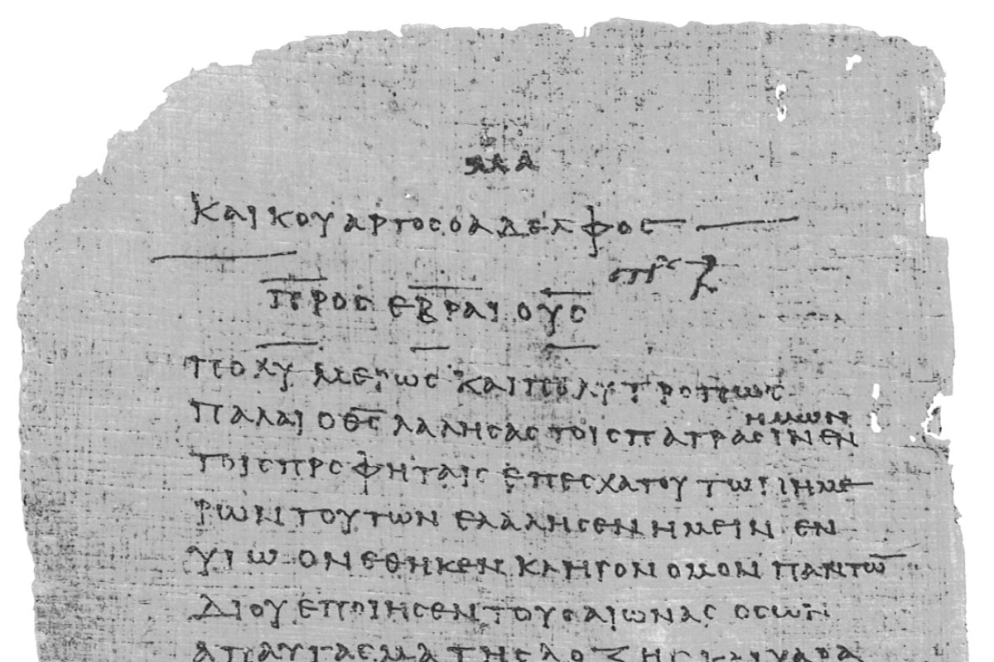
Pharisee Paul’s ἀπολογία to the Hebrews
Ἑβραῖος
Session-11
Hebrews 5:7 thru 6:8
Cites Deut. 32:43
Dr. Dave Newton
© 2025
Figure It Out
Calvary Chapel
Santa Barbara

Slide 2
Pharisee Paul’s ἀπολογία to the Hebrews Ἑβραῖος
Two BIG Topics Tonight
1. Warning #3 from Pharisee Paul re: Growing Up Maturing
Admonition: Get off the milk and press on to solid food!
2. Continues this line of thinking aligned with his on-going parallels
Passover-Exodus-Canaan for fellow Hebrew brethren-believers
Admonition: Don’t stand still, stagnant, stop moving forward
3. CANNOT lose justification-salvation Paul’s apologia already confirmed
John 6:39-40 10:28-29 Hebrews left Egypt slavery and
Romans 8:38-39 11:29 never went back!
Philippians 1:6
1st John 2:19 3:9-10 5:11-13

Slide 3
Pharisee Paul’s ἀπολογία to the Hebrews Ἑβραῖος
Hebrews 5:7-14 In the days of His flesh [Sept. 29 to May 32 AD] He offered up prayers
and supplications with loud crying and tears to the One able to save Him from death, and
He was heard because of His piety - although He was a Son, He learned obedience from the
things which He suffered and having been made perfect, He became to all those who obey
Him the source of eternal salvation [Jesus] being designated by God as a High Priest
according to the order of Melchi Sedek [time to learn of Jesus your High Priest]
Now concerning him we have much to say - it is hard to explain
since you have become dull of hearing for though by this time you ought to be teachers
you have need again for someone to teach you the elementary principles of the oracles of
God - you have come to need milk and not solid food - for everyone who partakes only
of milk is not accustomed to the word of righteousness, he is an infant - but solid food is for
The mature, who because of practice have their senses trained to discern good and evil.
This sets up Paul’s seemingly DIFFICULT passage in next 8 verses . . .

Slide 4
Pharisee Paul’s ἀπολογία to the Hebrews Ἑβραῖος
Hebrews 6:1-8 Therefore leaving the elementary teaching about the Anointed One
let us press on to maturity, not laying again a foundation of repentance from dead
works and of faith toward God, of instruction about washings and laying on of hands
and the resurrection of the dead and eternal judgment [all very Jewish matters]
. . . and this we will do if God permits for in the case of those who have once
been enlightened and have tasted of the heavenly gift and have been made
partakers of the Holy Spirit and have tasted the good word of God and the
powers of the age to come and then have fallen away, it is impossible to
renew them again to repentance since they again crucify to themselves
the Son of God and put Him to open shame WHY? for ground that drinks
the rain which often falls on it and brings forth vegetation useful to those for
whose sake it is also tilled, receives a blessing from God - but if it yields thorns
and thistles, it is worthless and close to being cursed, it ends up being burned

Slide 5
Hebrews 6:1-2 Move beyond elementary teachings about the Christ [basics]
new-believers’ class
let us press on to maturity, not laying again a FOUNDATION of: [don’t stand still]
1] repentance from dead works
2] faith toward God
3] of instruction about washings
4] laying on of hands
5] the resurrection of the dead
6] eternal judgment
These 6 considered “elementary” first-round ‘basics’
If these are milk, what is the solid food? Jesus High Priest + King in Millennium
v3 and this we will do, if God permits means "as God allows us to so move"
We are to move past basics into full spiritual maturity – THIS is once again
running the race, stay on course, finish well, work thru your salvation Phil. 2:12-13
Remember these are all very Jewish-Hebrew rites
as Paul admonishes
very Jewish
Hebrew believers

Slide 6
Pharisee Paul’s ἀπολογία to the Hebrews Ἑβραῖος
Hebrews 6:1-8 for in the case of those who have once:
1] been enlightened
2] and have tasted of the heavenly gift
3] and have been made partakers of the Holy Spirit
4] and have tasted the good Word of God
5] and the powers of the “age” to come
and then have fallen away
it is impossible to renew them again to repentance since they again crucify to
themselves the Son of God and put Him to open shame WHY?
because ground that drinks rain which often falls on it and brings vegetation useful to
those for whose sake it is also tilled, receives a blessing from God - but if it yields
thorns & thistles, it is worthless, close to being cursed and it ends up being burned

Slide 7
Pharisee Paul’s ἀπολογία to the Hebrews Ἑβραῖος
TOP-8 ATTEMPTS to INTERPRET THIS [with 2 or 3 versions of each]
1. Paul is simply making a figurative-hypothetical example [not literal]
2. Greek word “impossible” ἀδύνατος adunatos must mean just ‘difficult’
[not the definition]
3. Actually refers only to the OT Levitical sacrifices [not salvation?]
4. Profession of faith but not REALLY saved/born-again [but audience is saved]
5. REALLY saved/born-again but they absolutely lost salvation [NOT possible]
6. People get saved, lost, saved, lost, saved, lost THEN hit their max limit
[cycles over time?]

Slide 8
Pharisee Paul’s ἀπολογία to the Hebrews Ἑβραῖος
TOP-8 ATTEMPTS to INTERPRET THIS [with 2 or 3 versions of each]
7. Paul refers to unbelievers agreeing in mind with basic truths about Jesus
but no spiritual conversion – they got a little enlightened - had a little taste
these are soils #2 and #3 Matt. 13:3-23 [but Paul’s audience saved Hebrews]
8. Paul refers to Hebrew Believers then infers “IF” they fall away as hypothetical
instance to make point that Believers cannot/do not fall away, otherwise
Jesus would have to be crucified over and over This grammatical tool is called
‘reductio ad absurdum’ = logic leading to absurdity proves it can’t happen!
BIG problem: Greek text has no “IF” of any kind - obvious or inferred

Slide 9
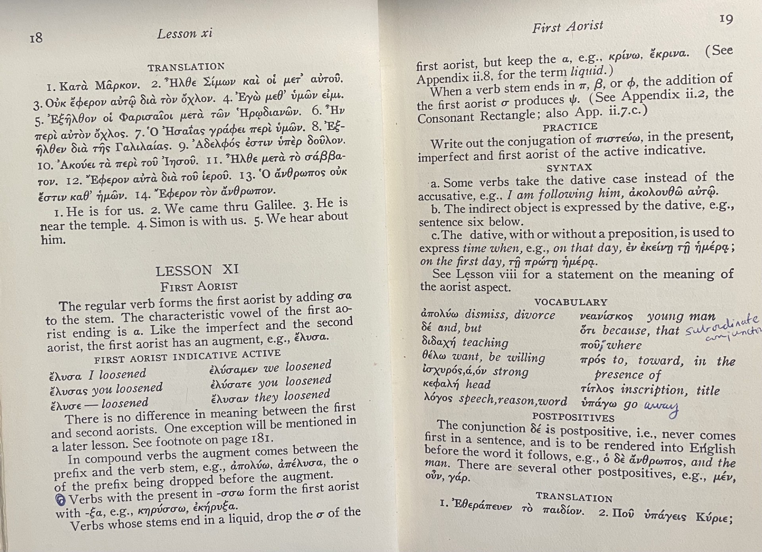
Newton’s 9TH Position: use Scripture Greek-context to understand Scripture
Aorist tense is
completed action

Slide 10
Newton’s 9TH Position: use Scripture Greek-context to understand Scripture
verses 4-5-6 are just ONE sentence with 5 descriptors
once enlightened φωτίζω photizo = regenerated, brought to light
[aorist tense: completed] same as Heb. 10:32 remember the former days after
being enlightened, you endured great conflict sufferings
These are CLEARLY saved
tasted heavenly gift same as Heb. 2:9 Jesus “tasted” death for everyone
aorist not a sample or halfway, Fully saved!
partakers of Holy Spirit Heb. 2:14 μέτοχος metochos = all-in Full participation
aorist Heb. 3:1 holy brothers full-participation heavenly call
Heb. 3:14 we are full-participation with Christ if we
hold fast with assurance until the end
tasted good word of God ῥῆμα rayma = spoken word
powers of world to come Heb. 2:4 saw miracles, signs [power]
aorist αἰών aion = singular time/age [plural is ‘worlds’]
when Mashiach has come points to Millennium kingdom

Slide 11
Stay with Paul’s on-going parallel Passover-Exodus-Canaan inheritance:
[these Hebrews are believers-justified-saved]
v5 - μέτοχος metochos = all-in Full participation in exit from slavery [sin]
Fully understood Millennium kingdom to come
but refuse to go forward [sanctification] they stop/stagnate!
THESE match up exactly with Paul’s Hebrew history parallel . . . . Guess?
They are same as those at Kadesh-Barnea [Genesis 14]
Heb. 6:6 ἀδύνατος adunatos = impossible [dunatos = happening, a-dunatos = not]
These Hebrews are all saved Full-Participation in the 5 descriptors aorist completed
IF a person in 5 completed-descriptors it is a-dunatos [impossible]
to renew them again to repentance
because they: 1] stop moving forward aorist completed
2] crucify Jesus present-active continuing activity
3] openly ridicule Jesus present-active continuing actions

Slide 12
Saved Hebrews are Full-Participation in 5 descriptors aorist completed
IF a person in 5 completed-descriptors it is a-dunatos [impossible]
to renew them again to repentance
because they: 1] stop moving forward aorist completed
2] crucify Jesus present-active continuing activity
3] openly ridicule Jesus present-active continuing actions
Based on this grammatical Greek language, the a-dunatos [impossibility]
remains only IF #2 and #3 are continuing/on-going/stay active
IF they become aorist completed, THEN impossibility ceases
3 Actions above [one aorist two present-active] define a-dunatos
IF persons stop doing two present-active it is no longer impossible so they are then
able to be renewed, but IF they continue in these, they cannot be renewed!!
What person does in present-active actions enables that impossibility
Impossible is dependent upon person’s two present-active CONTINUING actions

Slide 13
HERE’S THE KEY!!!
IF the a-dunatos [impossibility] was explained by Paul as a permanent state,
THEN 2] crucifying Jesus and 3] openly-publicly ridiculing Jesus
your sin trivializes it your ‘witness’ has NO testimony
those two present-active actions would have been in the aorist completed tense
Paul’s deliberate structure of Greek grammar is by definition “Temporary”
and is NOT permanent!
BECAUSE Paul uses present-active tense in these two actions, it is not a
permanent state without any hope for forgiveness-restoration, rather
there IS hope for any who slip-away, have unbelief, or become stagnant
IF ”crucifying” and “ridiculing” had been aorist completed THEN any person
who slips away, has unbelief, or stops moving forward would have
NO hope to be renewed again to repentance
this is not ”renewed again to salvation” but “renewed to repentance”
WHAT IS THIS?

Slide 14
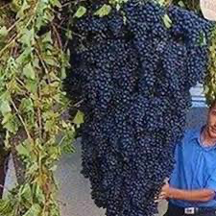
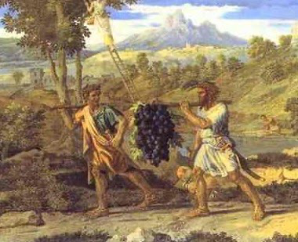
Pharisee Paul did not say: ”renewed again to salvation”
Paul clearly said: “renewed again to repentance”
μετάνοια metanoia = change your mind
Numbers 13 + 14 God swore by His own Name: “Hebrews will not enter the land”
That oath means God cannot change His mind [proclamation]
this gets to the immutability of God’s character
12 spies, 1 from each tribe, only 2 got their inheritance
Numbers 13:19-20 scout a] inhabitants and b] land
23-24 grapes of Eschol were massive
GIANT inhabitants
were massive

Slide 15
Pharisee Paul’s ἀπολογία to the Hebrews Ἑβραῖος
Numbers 13:19-20 scout inhabitants and land
23-24 grapes of Eschol were massive
YES! the land is robust, but people are too big!
Caleb says, “Let’s go in right now”
10 spies, “Anakim-Nephilim we’re grasshoppers”
14:1-2 Congregation murmurs, cries, complains “We came to die in wilderness?”
“Let’s appoint captain to go back to Egypt”
Caleb + Joshua “Lord surely will give it to us” Congregation STONED them
Lord says, “How long will I be provoked, consider ALL the signs I showed”
“I will start over a new nation – I will disinherit them”
God DID that in Genesis 6 with worldwide flood – left only 8 people
Moses intercedes-negotiates, “The nations will say God was not able”

Slide 16
Moses intercedes-negotiates, “The nations will say God was not able”
Numbers 14:17-18 “I beg of you Lord - You are longsuffering, merciful, forgiving
iniquity and transgression, BY NO MEANS CLEARING THE GUILTY,
continuing the sin of the fathers to their children, 3rd and 4th generations”
v 19-21 “pardon these people Lord as per Your great mercy, as you have
forgiven them since Egypt until now” - and the Lord pardoned them
Part-1: God does forgive them of their sin [they remain justified-saved]
However
Part-2: as I Already Swore, they shall not see the land [inheritance]
God references His oath that HE cannot “change His mind”
μετάνοια metanoia
Remember Heb 3:17-19 God cannot change His oath
So the people ‘change their mind’ - are forgiven - but God cannot change His mind!
In fact, Hebrews try to take land on their own and suffer massive defeat!!

Slide 17
However . . . as I the Lord swore they shall not see the land [inheritance]
God references His oath that cannot be changed
Heb 3:17-19 God cannot change His oath
People repent [Hebrews changed their minds] but too late for God to change His mind!
Paul’s statement: “it is impossible to renew them again to repentance”
actually reads: “impossible to renew again due to a changed mind”
WHO cannot reverse-change mind? The people?
NO it is God who cannot relent-reverse-change His decision due to His oath!
Paul illustrates same point later in Heb. 12:16-17 immoral-godless Esau disobeyed
sold his birthright to Jacob for food. Then at time to inherit the blessing he
was rejected, there was no room for Isaac to relent-reverse-CHANGE His Mind
even though Esau pleaded with tears [Isaac could not change his oath]

Slide 18
Pharisee Paul’s ἀπολογία to the Hebrews Ἑβραῖος
Details in Genesis 27 Isaac asks Esau to hunt and make him one last amazing
meal before he dies. While Esau is out hunting, Rebekah makes similar meal
and gets Jacob to go into Isaac to receive the blessing before Isaac dies, by
deceiving Isaac to believe Jacob is Esau
v19 Jacob blatantly lies to Isaac “I am Esau” and gets Isaac’s blessing.
Isaac evens asks, “How did you hunt and prepare this so fast?”
and Jacob lies “The Lord let me do this”
v22 Isaac says voice sounds like Jacob, but hands feel like Esau
v24 Are you really my son Esau? “Yes I am” [blatant lie]
v30 Esau returns and the deception comes to light
Esau pleads with tears that Isaac would relent-reverse-change his mind
but Isaac says, “I cannot give you that blessing”
[he cannot relent/change his mind]

Slide 19
Pharisee Paul’s ἀπολογία to the Hebrews Ἑβραῖος
again Hebrews 6:6 it is impossible [a-dunatos] to renew them due to a
Change of God’s Mind [His oath by His name cannot change]
because they again put Jesus on the cross [continued sin trivializes His sacrifice]
and their witness in the world puts Jesus to shame [they have NO testimony]
HOW does this work? an analogy/metaphor . . .
v 7-8 because ground that drinks rain which often falls on it brings forth vegetation
useful to those for whose sake it is tilled and receives a blessing from God
BUT if the ground yields thorns and thistles, it is [3 things] 1- worthless and
2- close to being cursed, and 3- ends up being burned Matt. 13 ‘soils’

Slide 20
v 7-8 ground drinks rain brings useful vegetation receives a blessing from God
ground drinks rain brings thorns and thistles, it is:
1- worthless 2- close to being cursed 3- ends up being burned
Field full of weeds, FIELD is not destroyed or discarded, but bad growth
is 1- worthless 2- cursed 3- burned off so field can again produce vegetation.
This expands verses 4-5-6 Hebrew believers who align with lusts of this world
[slip away, unbelieving heart, remain stagnant/no forward progress]
their works are worthless, cursed, and burned up when tested by fire at Bema
1st Corinth. 3:12 gold silver gems come thru test by fire
wood hay stubble/chaff consumed by test of fire
Remember: Hebrew nation stagnated at Kadesh-Barnea, stopped moving forward,
resulted in God’s oath that could not change His mind: NO Inheritance!
They were 1- worthless, 2- close to being terminally cursed, and
3- ended up dying in wilderness . . . BUT after that field was burned off
it had WORTH was not permanently CURSED and next generation
did enter that inheritance [useful vegetation received God’s blessing]

Slide 21
SUMMARY
Pharisee Paul: “Hey my Hebrew brothers in Christ [saved-justified believers]
don’t slip away, don’t fall into unbelief, and DON’T remain stagnant but keep
moving forward in your sanctification. Move past the elementary teachings of
Judaism ‘basics’ [get off milk] and press into maturity [solid food] regarding
Jesus your High Priest and His ministry now in heaven AND when He comes in
His Millennial kingdom” WHY? . . .
Paul: . . . “BECAUSE you cannot slip, doubt, stagnate in active-present tense
that mocks-scorns what Jesus did on the cross for you and you ruin any chance
of having a solid witness-testimony as a true believer . . . so NO inheritance!”
You won’t lose your justification-salvation - but NO Rewards
Paul: “Convert current actions to aorist completed [done, finished] and you
CAN be renewed to repentance and like 2nd generation, get your inheritance!

Slide 22
Pharisee Paul’s ἀπολογία to the Ἑβραῖος
NEXT WEEK
Session-12
Hebrews 6:9-20
Much Better Priesthood
in Jesus

